Slide 1
link.springer.com
TUTORIAL
Welcome to SpringerLink
Notes:
*NB for Sales:
SpringerLink: https://link.springer.com/
Springer for R&D: https://rd.springer.com/
Springer for health and hospitals: https://health.springer.com/

Slide 2
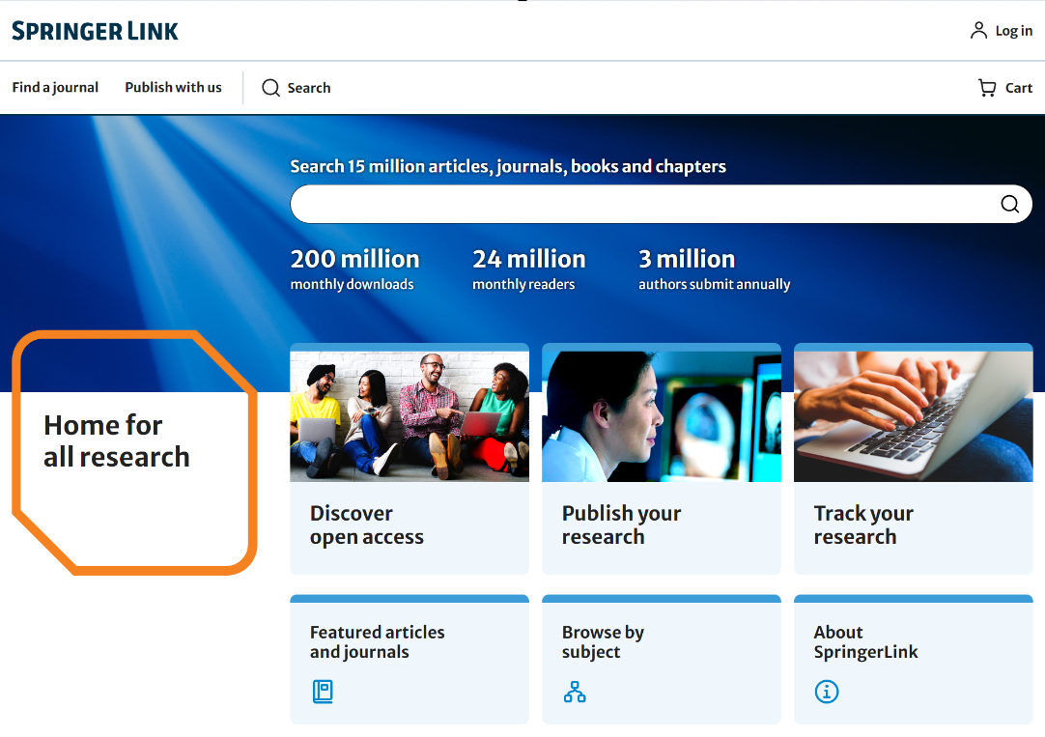
link.springer.com
15 million+ scientific resources to explore, such as journals, eBooks, conference papers, and videos from Springer, BMC, Nature Portfolio, Palgrave Macmillan.
Sign-in
Responsive search function

Slide 3
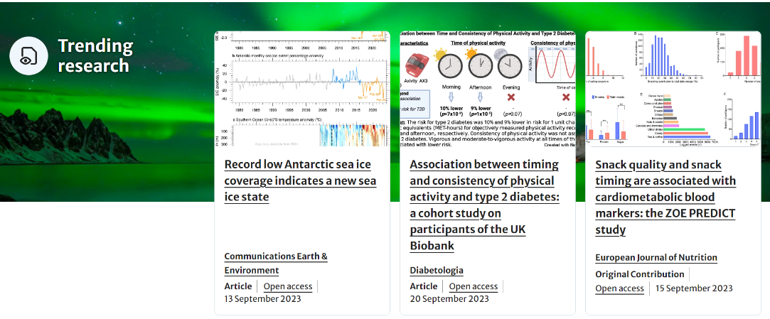
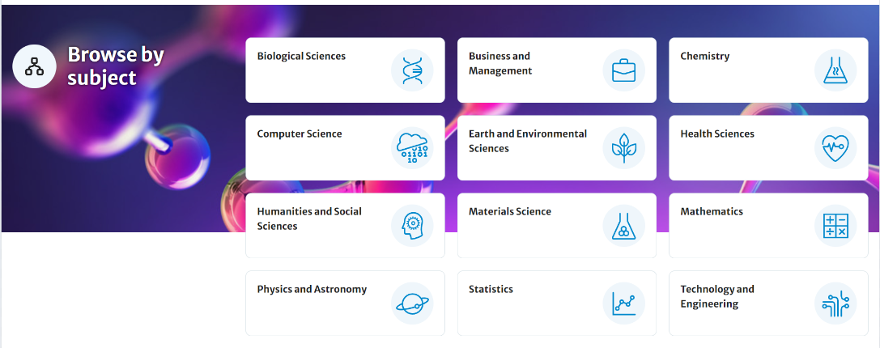
link.springer.com New Homepage
Trending research: high-quality content from Springer, BMC, Nature Portfolio, Palgrave Macmillan
New Homepage, Better Experience
Publish And Search On A Single Website

Slide 4
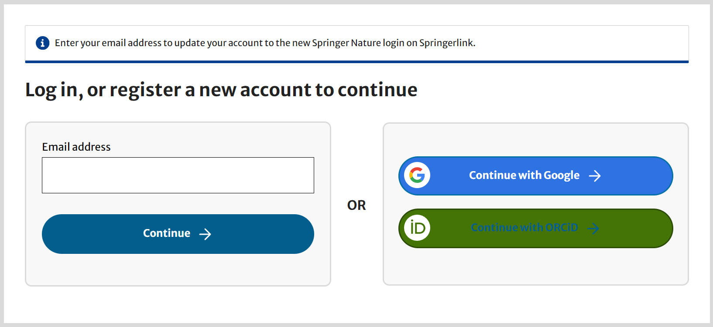
Institutional / Athens log-in
Register a new account
Registered users can log-in directly
Users not yet registered with SpringerLink can easily do so. The account will also be valid across other platforms of Springer Nature
Notes:
https://hive.springernature.com/home/ls/community/darwin/post/6752899806330880

Slide 5
获得平台授权的机构用户登录方法
Not sure if it’s also applied in this case
根据用户所在的不同空间位置，SpringerLink平台的登录方法可以划分成以下两大类：
1）在校或者到馆登录
学校和图书馆的IP范围已得到平台授权，用户通过台式电脑、笔记本电脑或者IPAD、手机等各种移动终端连接到学校或者图书馆的网络，即可自动获得平台访问权限。
直接输入网址即可登录https://link.springer.com‍。
2）远程登录
远程登录方法一：VPN代理登录
用户在台式电脑、笔记本电脑或者IPAD、手机等各种移动终端上，通过VPN连接到学校或者图书馆的内部网络环境，即可自动获得平台访问权限。
直接输入网址即可登录https://link.springer‍.com。
远程登录方法二：CARSI（教育网）远程认证登录（教工号、学号认证登录）
访问图书馆SpringerLink数据库主页，点击CARSI远程登录链接，页面将自动跳转至大学统一身份认证系统页面，输入本人账号和密码登录，即可使用SpringerLink平台资源。

Slide 6
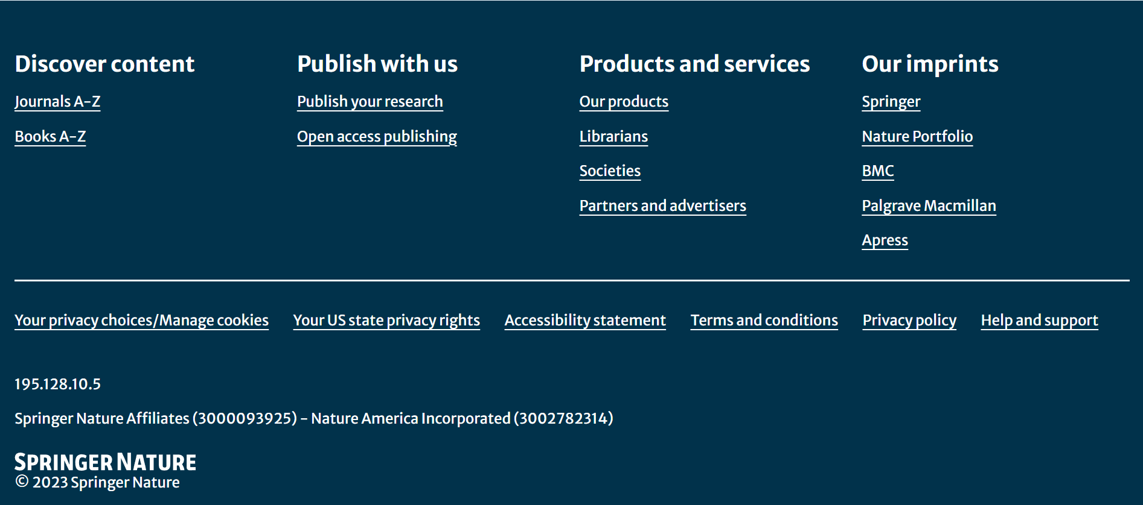
Want to know if your organization has authorized access to the SpringerLink platform after logged in?
You can find it out by checking the bottom of the homepage.

Slide 7
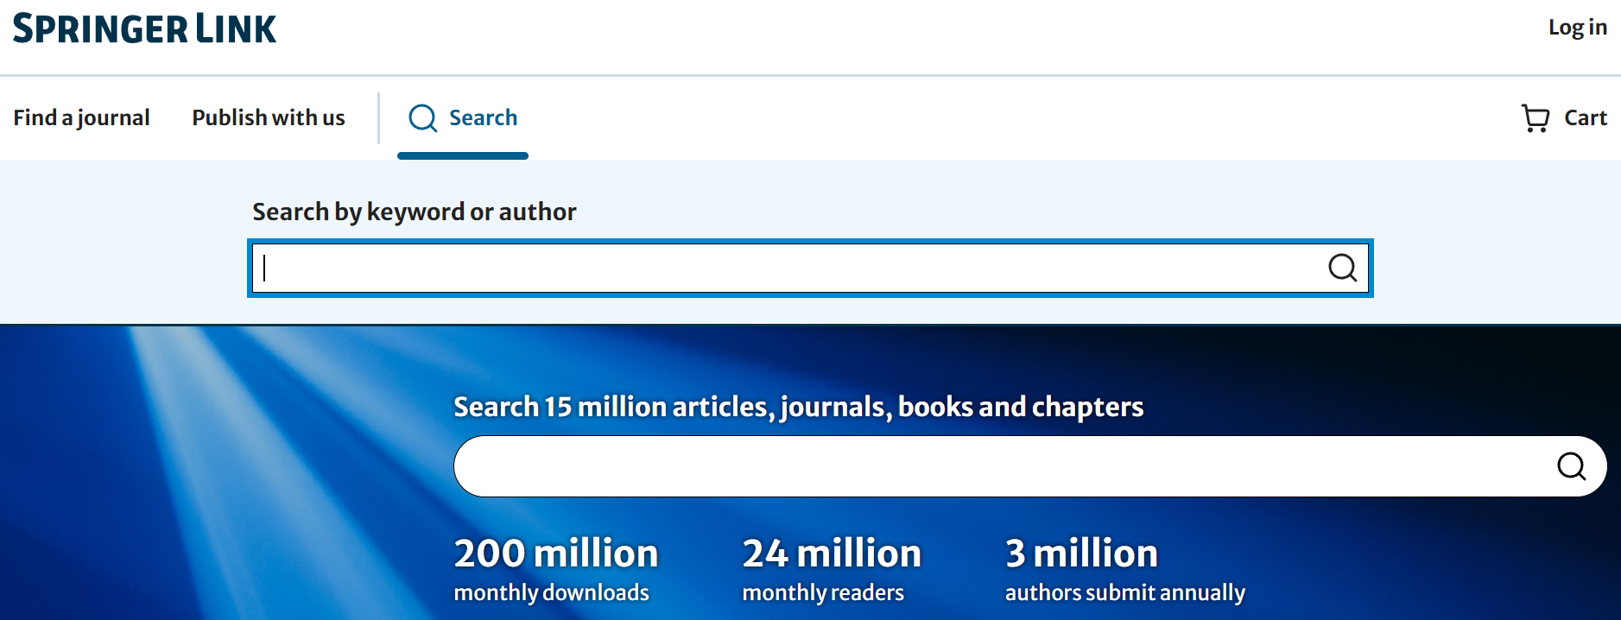
Search functions
Most users access our content through the search functionality.
Advance search options & search help are available on search results page.
You can also search for all Springer Nature journals or books alphabetically.

Slide 8
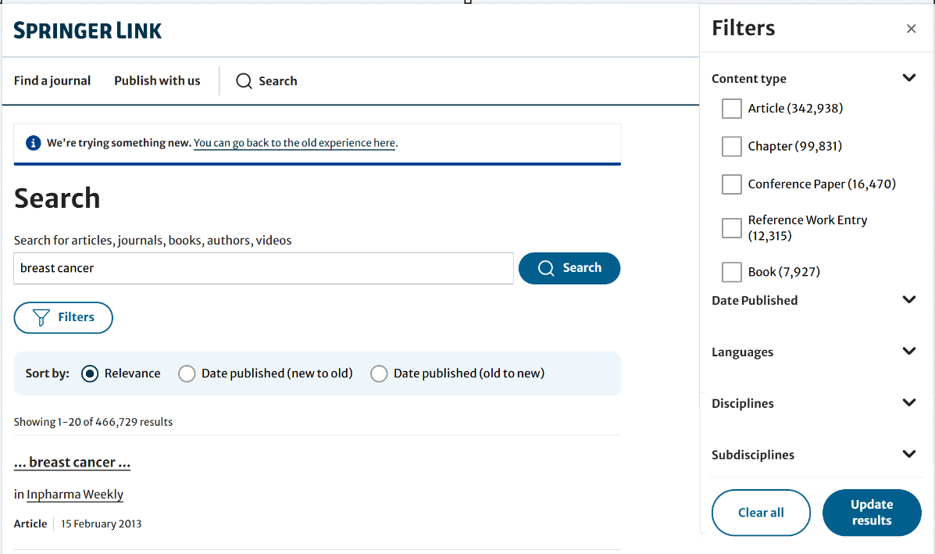
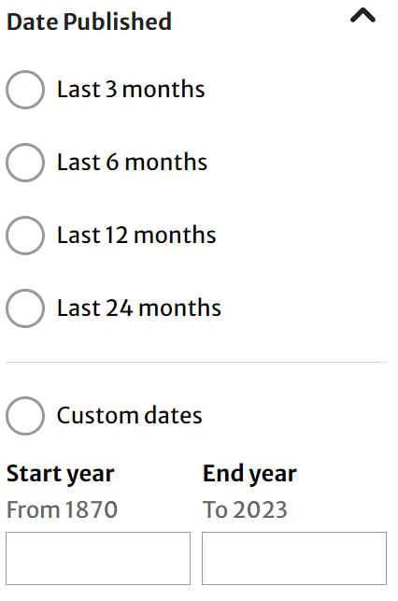
Search Results Page
Search results page list all relevant content on the SpringerLink platform by default, including all content from Springer, BMC, Nature Portfolio, Palgrave Macmillan.
Click “Filter” icon to use the Advanced Search option to further refine searches .
Available filter options:
Languages
Date Published
Content type
Disciplines
Subdisciplines
Click here to jump back to the old experience
*temporary link
Structure of list items within a search result page
Title of list item
Published in which product
Author of list item
Type of content and publish year
(1)
(2)
(4)
(3)

Slide 9
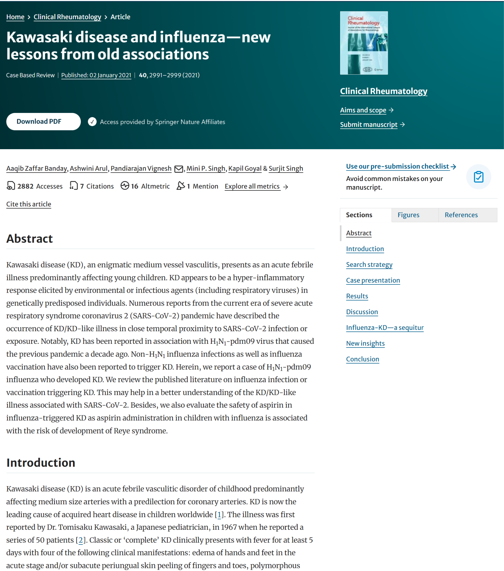
Journal Article - Functionality Overview
(1)
Journal
Title
Type, online publication date, volume, page number (issue)
Download full-text PDFs, check whether access is authorized by your institution
Visit journal's homepage; learn about the journal's mission and scope, submit a manuscript online
Author information
Accesses/downloads, Altmetric and more metrics
Cite this article
Article abstracts
Section
Figures
References
Read the article online
(2)
(3)
(5)
(4)
(6)
(7)
(8)
(10)
(11)
(12)
(9)
(13)
Notes:
https://rd.springer.com/article/10.1007/s10067-020-05534-1

Slide 10
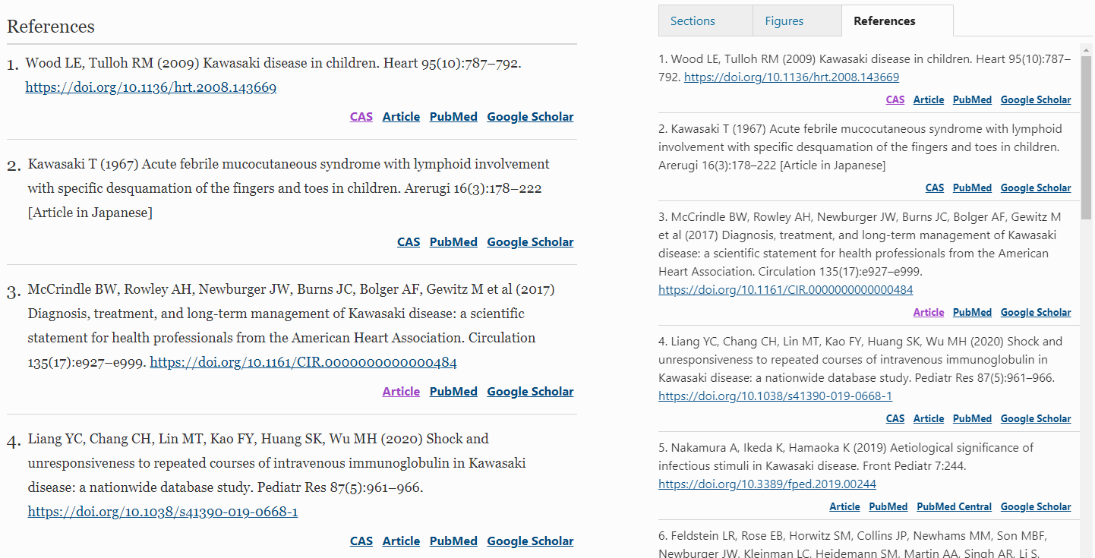
Journal Article - References
References cited in an article can be viewed either after the article text or in the menu on the right sidebar.
Most references provide external links (e.g., PubMed/Google Scholar, etc.) to the abstract or the original article.

Slide 11
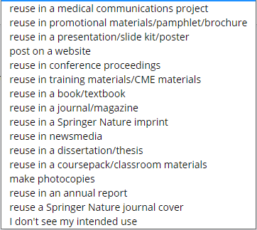
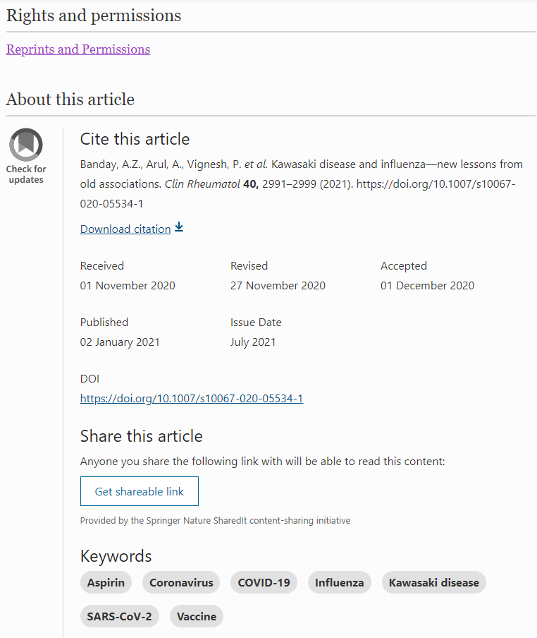
Journal Article - Rights and permissions & About this article
Cite the article:
Export the citation in ris format,
Copy the citation directly from the page.
Publishing Timeline
Historical versions of the article
Get shareable link

Slide 12
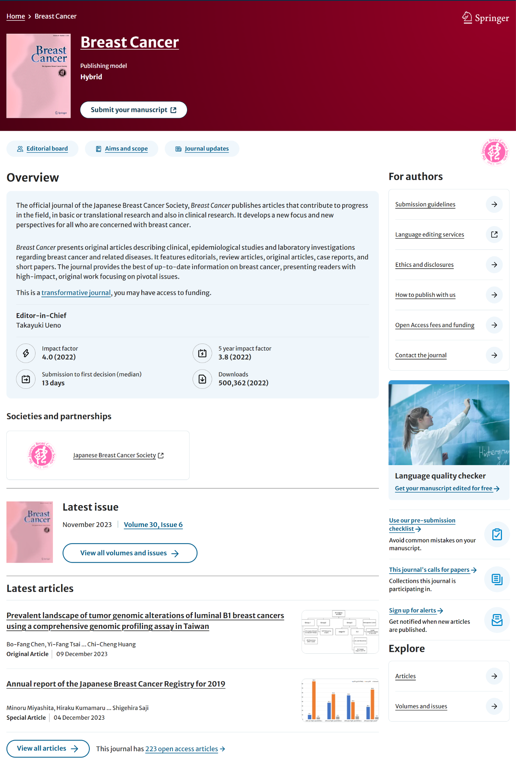
Journal Homepage - Functionality Overview
Journal name
Publishing model (open access, hybrid, subscription)
Submit your manuscript
Editorial Board
Aims and Scope
Journal updates
Journal Introduction
Editors-in-Chief and Editors
Impact Factor and other metrics
Co-Publishers/Organizations logo
Latest Issue
View all content from the latest issue
View all volumes and issues
Latest articles
View all articles
Information for authors
Pre-submission checklist
View the collection of feature articles under call for submissions
Sign-up for e-alerts
View all volumes, issues, and collections (where available)
(1)
(2)
(3)
(4)
(5)
(6)
(16)
(7)
(8)
(9)
(10)
(11)
(12)
(13)
(17)
(14)
(18)
(19)
(20)
(15)
Notes:
https://link.springer.com/journal/12282

Slide 13
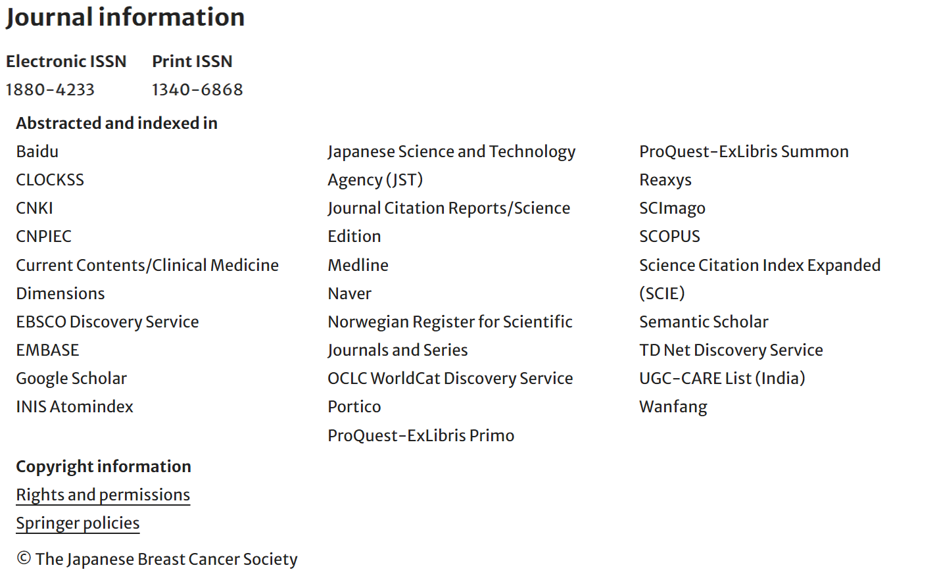
Journal information & updates
Journal updates
Notes:
https://www.springer.com/journal/10067

Slide 14
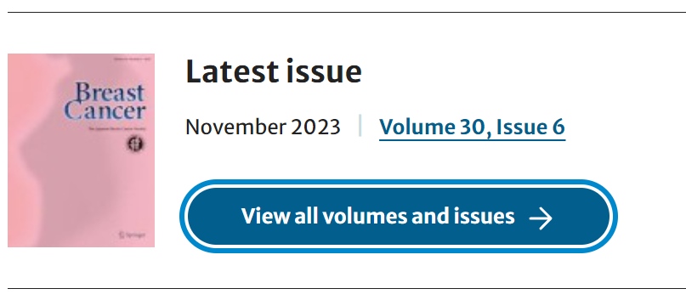
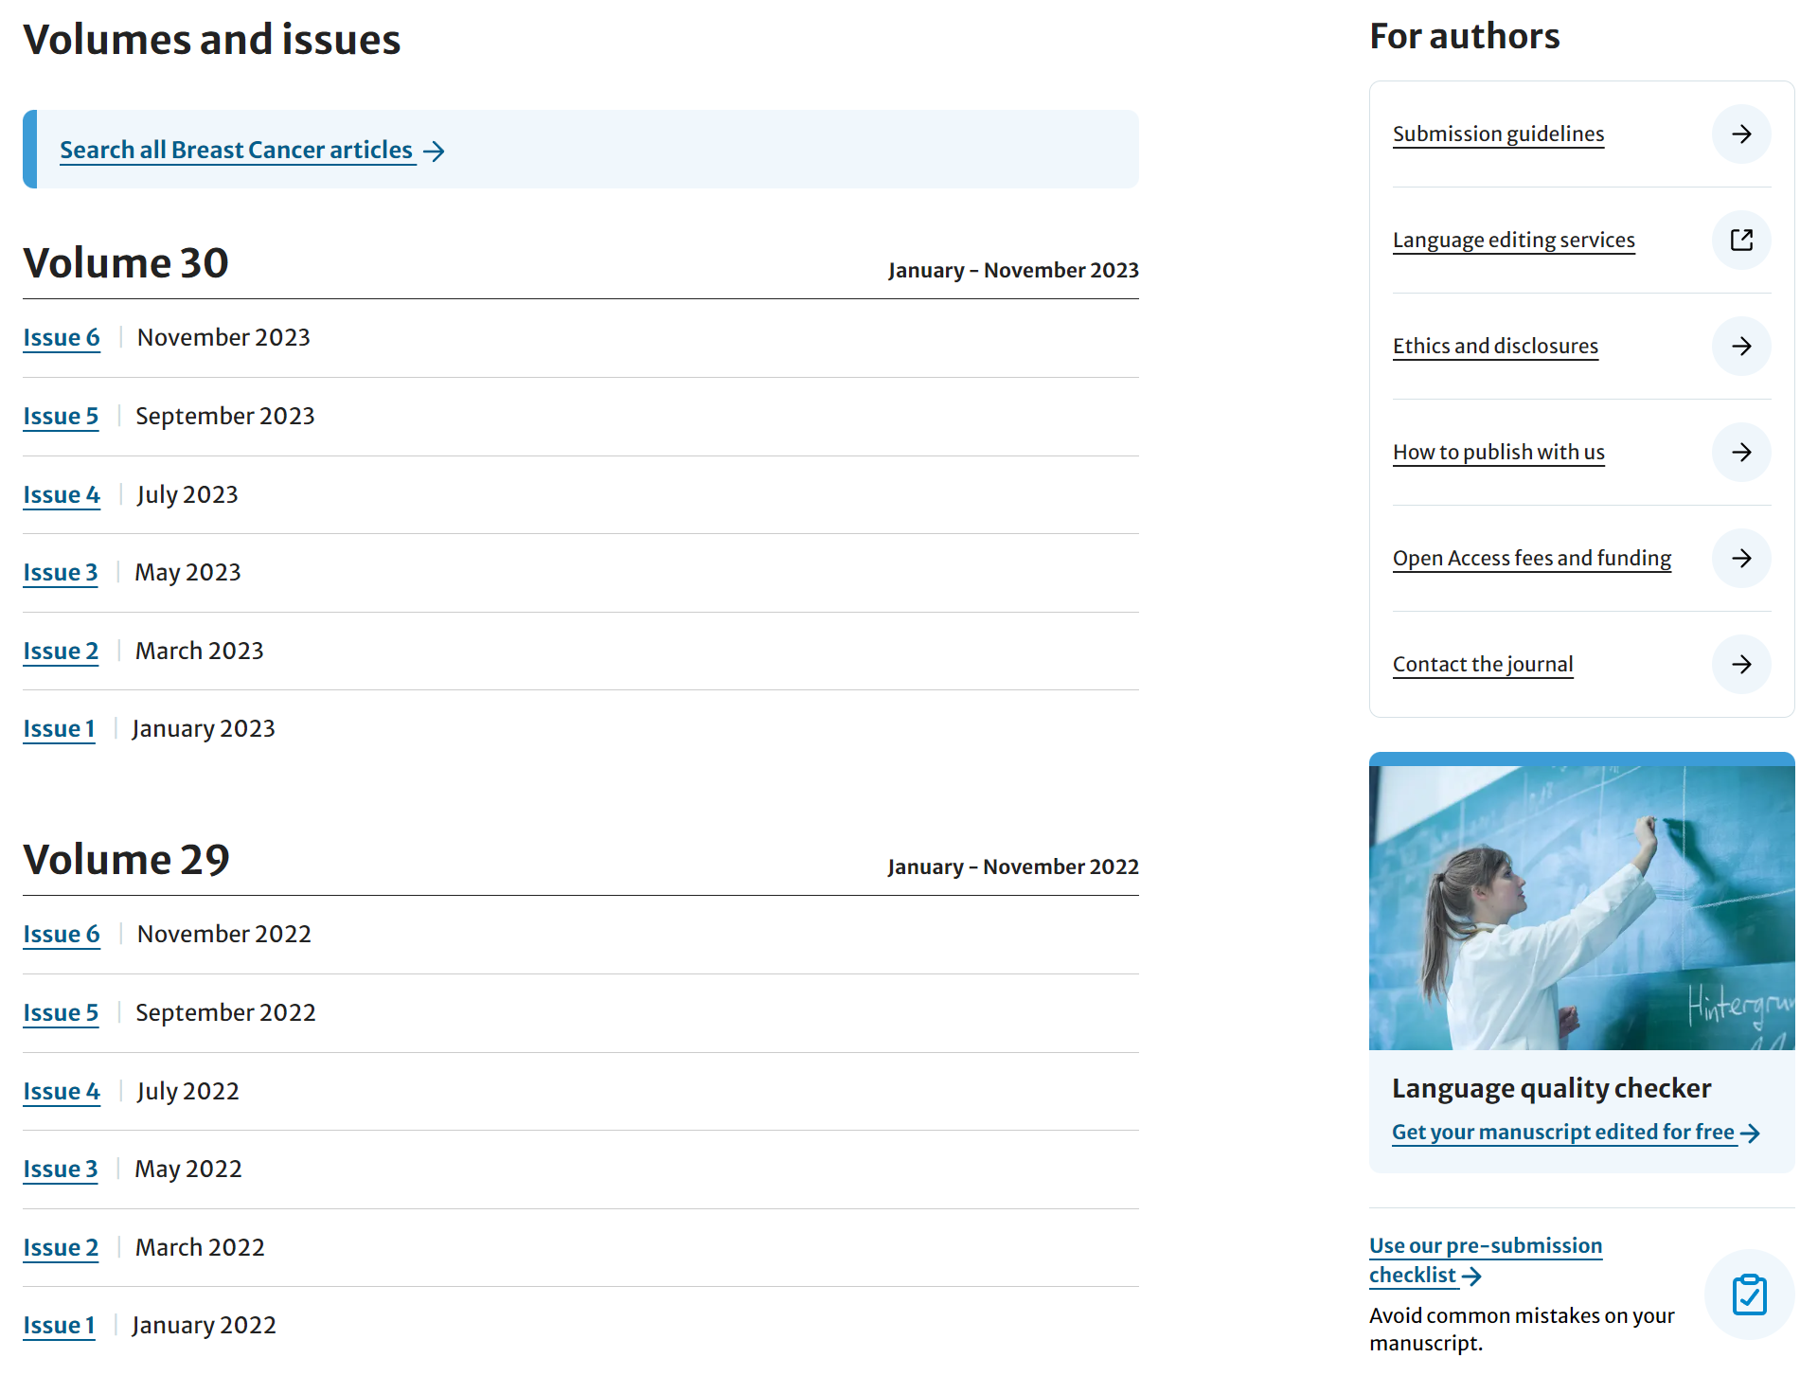
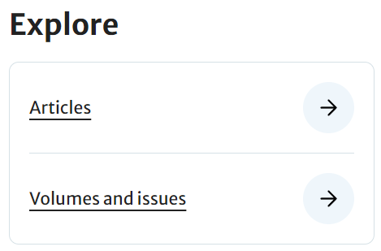
Journal - All volumes & issues
Search in this journal
Notes:
https://link.springer.com/journal/12282

Slide 15
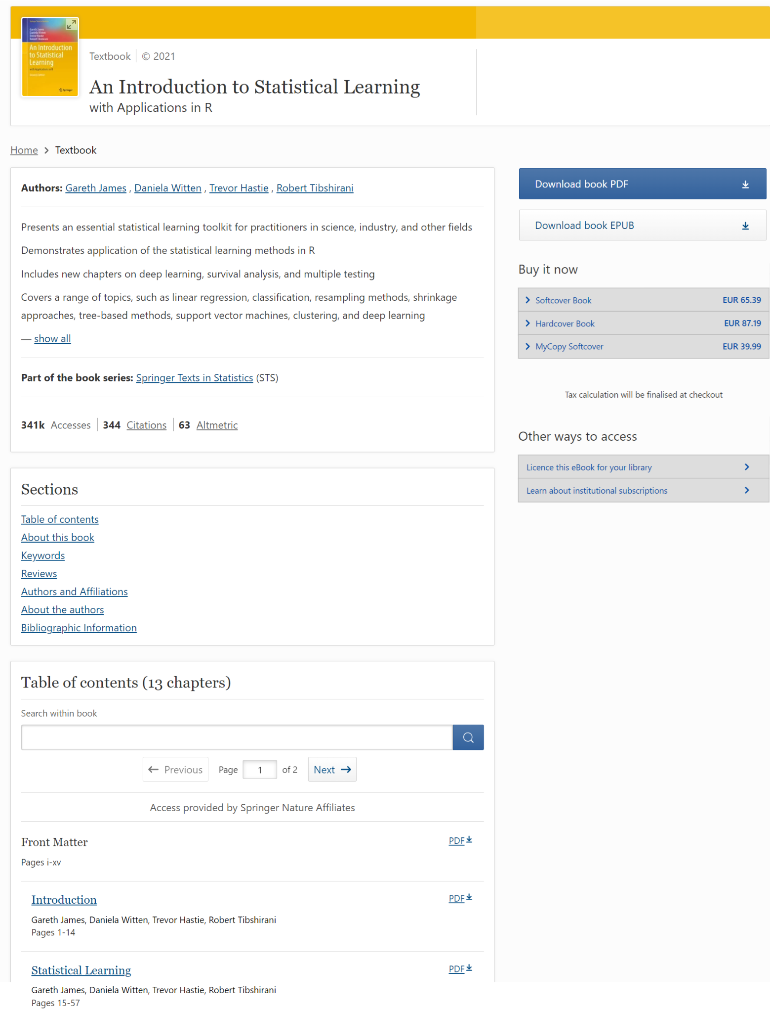
Book - Functionality Overview
(1)
(3)
(2)
Type and copyright year
Title
Subtitle
Author/editor and affiliation
Introduction
Accesses/downloads, citations and Altmetric
Download in PDF format
Download in EPUB format
Quick Navigation (Table of contents, About this Book, keywords etc.)
Table of contents
Search within book
Chapter navigation
Download chapters PDF
Read chapters online
(4)
(7)
(5)
(8)
(6)
(9)
(10)
(11)
(12)
(13)
(14)
Notes:
https://link.springer.com/book/10.1007/978-1-0716-1418-1

Slide 16
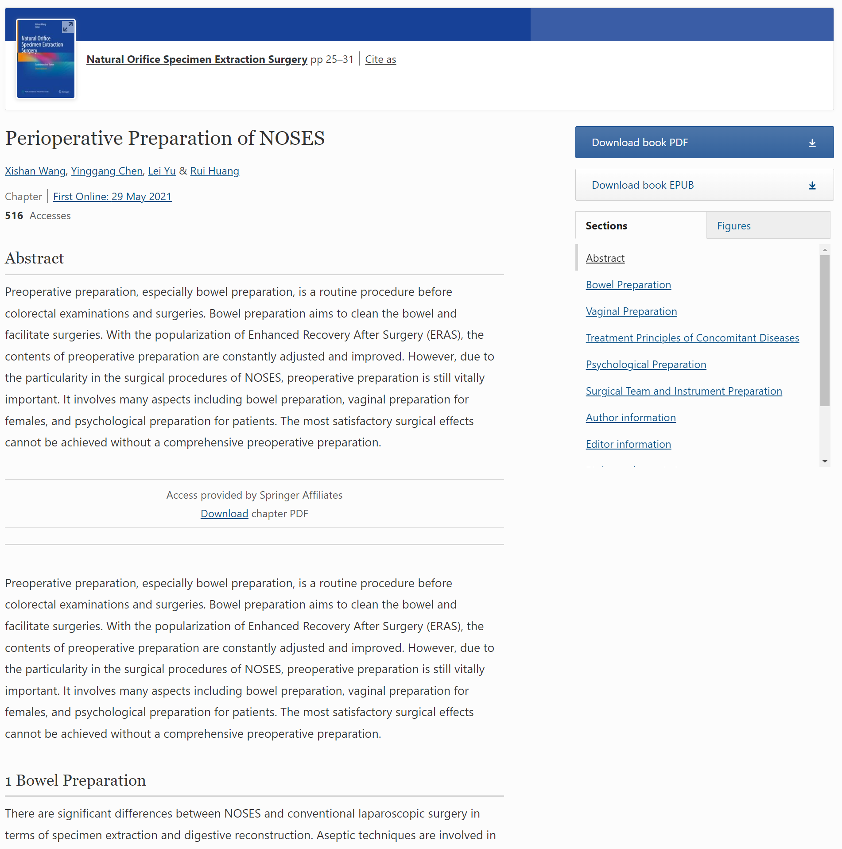
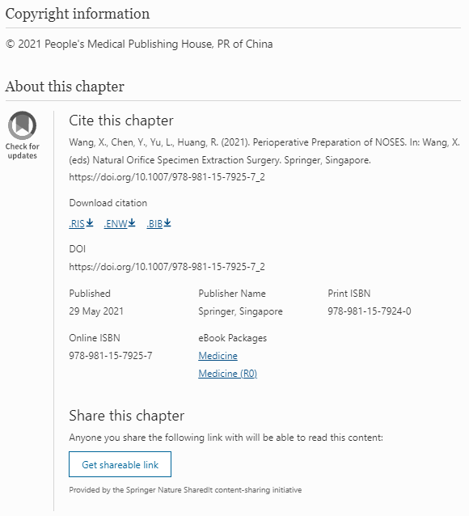
Book chapter - Functionality Overview
Book Title
Cite this chapter
Chapter title
Author and affiliations
Chapter online publication date
Accesses/downloads
Chapter abstract
Check if you can download chapter PDF
Chapter content
Download book PDF & EPUB
Chapter section & figures and quick navigation
Copyright information
About this Chapter
(1)
(2)
(1)
(2)
(3)
(11)
(4)
(3)
(5)
(2)
(4)
(10)
(12)
(5)
(6)
(7)
(6)
(11)
(7)
(8)
(13)
(14)
(9)
(8)
(12)
(13)
(10)
(2)
(9)
Notes:
https://link.springer.com/chapter/10.1007/978-981-13-0466-8_2

Slide 17
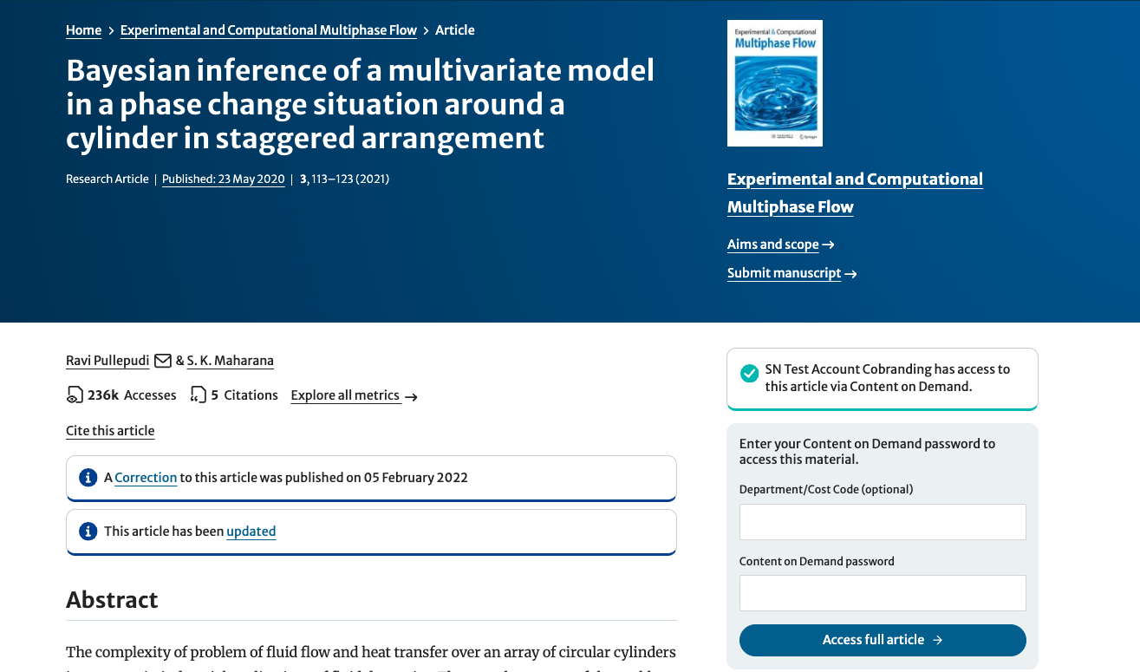
Springer Nature Content on Demand Model
Institutional users who have CoD enabled can access materials by entering password.
Notes:
Can remove this slide for non-CoD subscriber.
https://link.springer.com/article/10.1007/s42757-020-0060-8

Slide 18
谢谢！
Thanks

