Slide 1
Introduction of Library Resources and Services
For Academic Staff
Du Juan, University Librarian
2025.8.25

Slide 2
01
Introduction
Agenda
02
Resources
03
Services

Slide 3
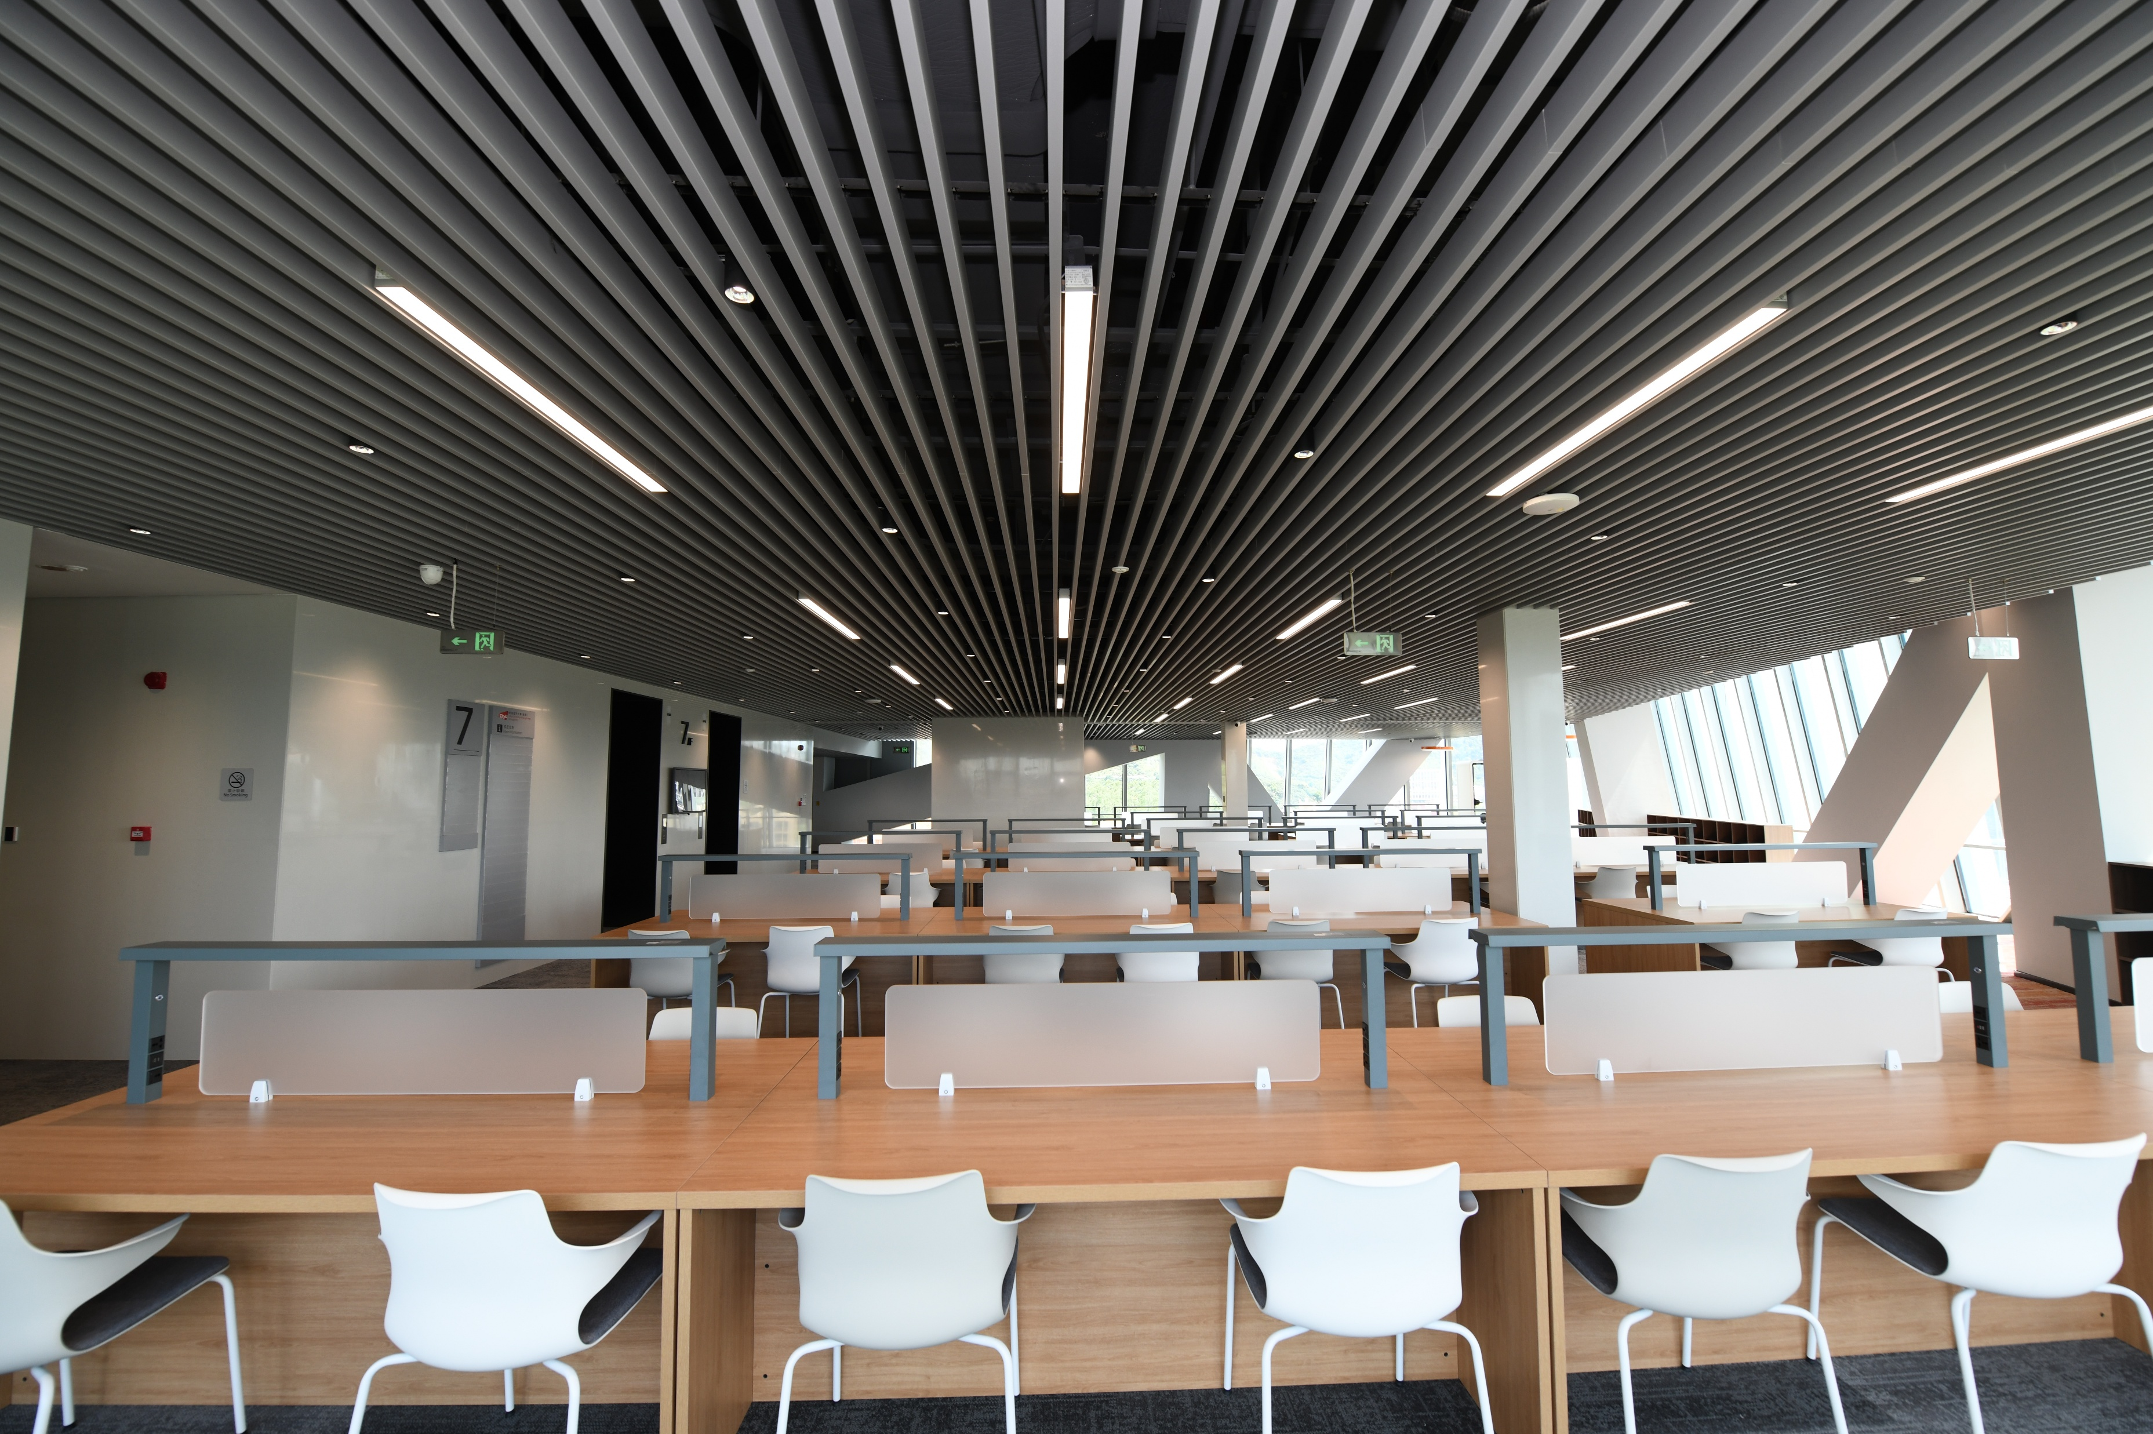
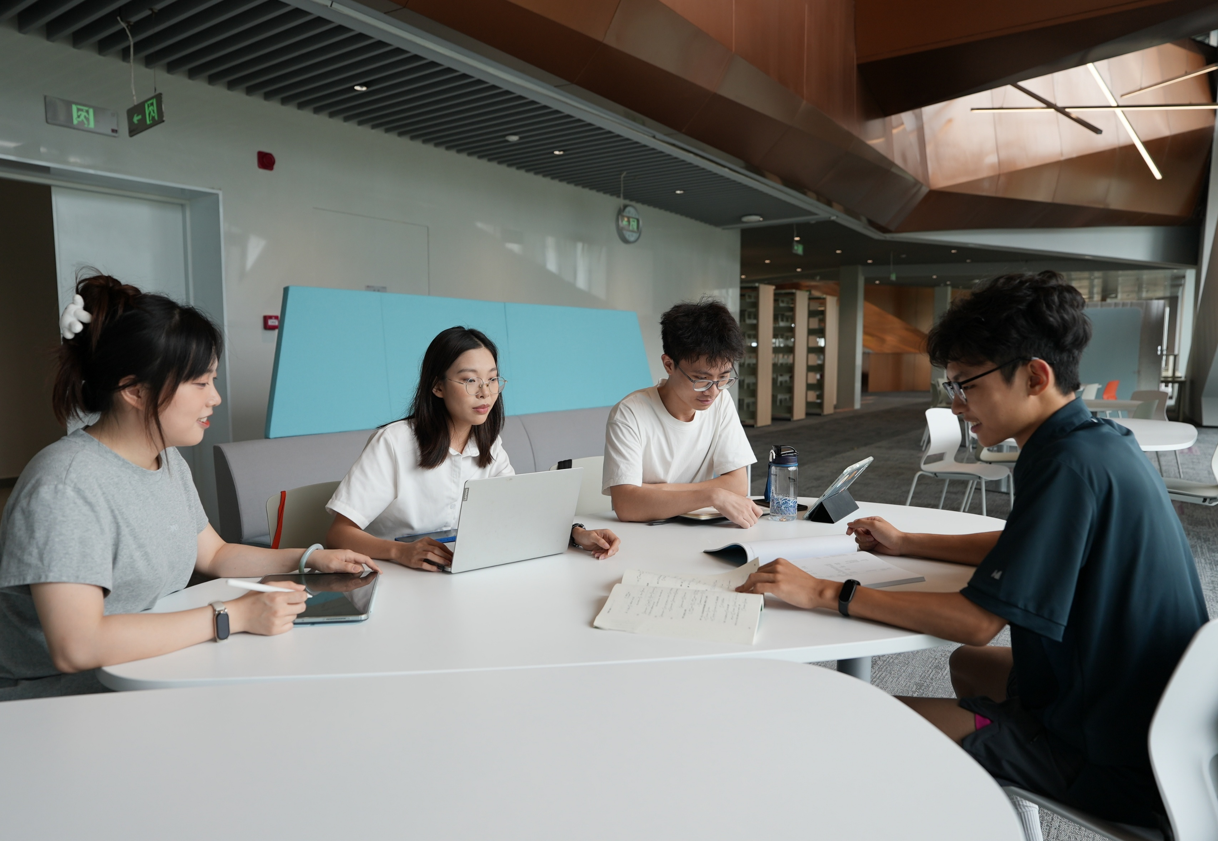
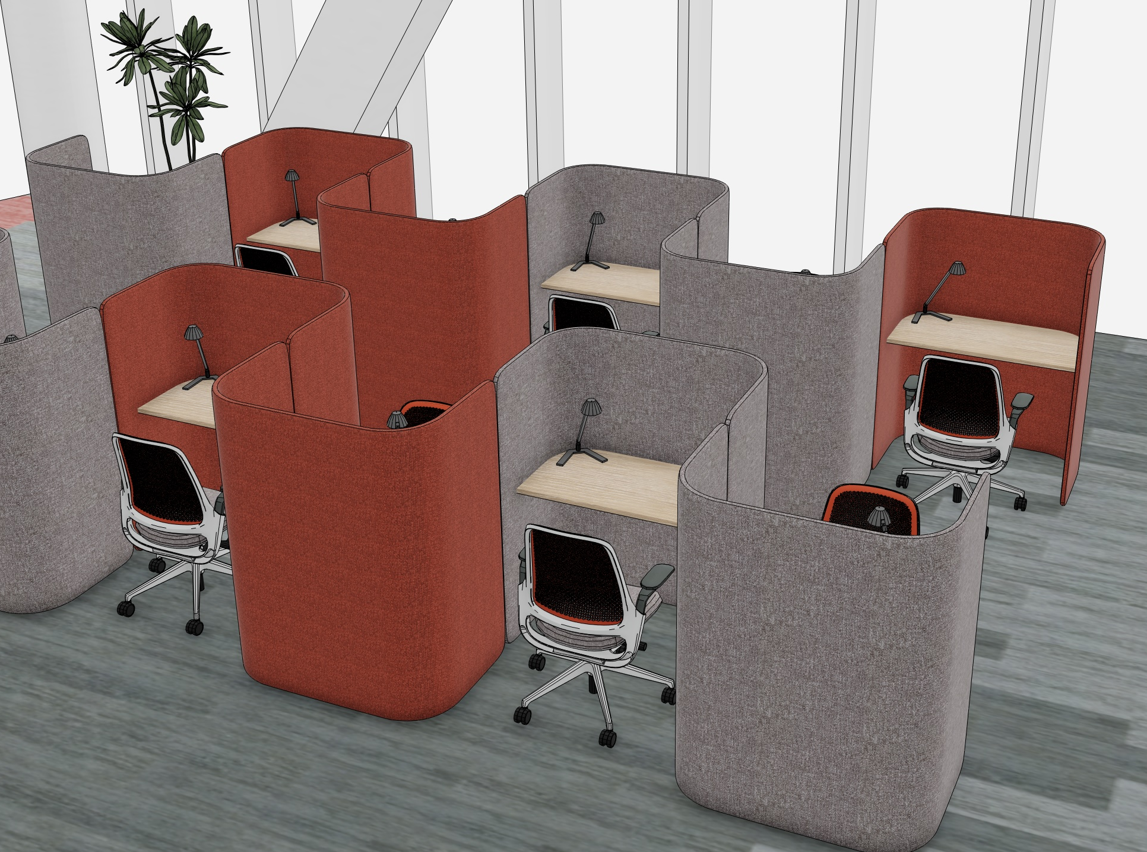

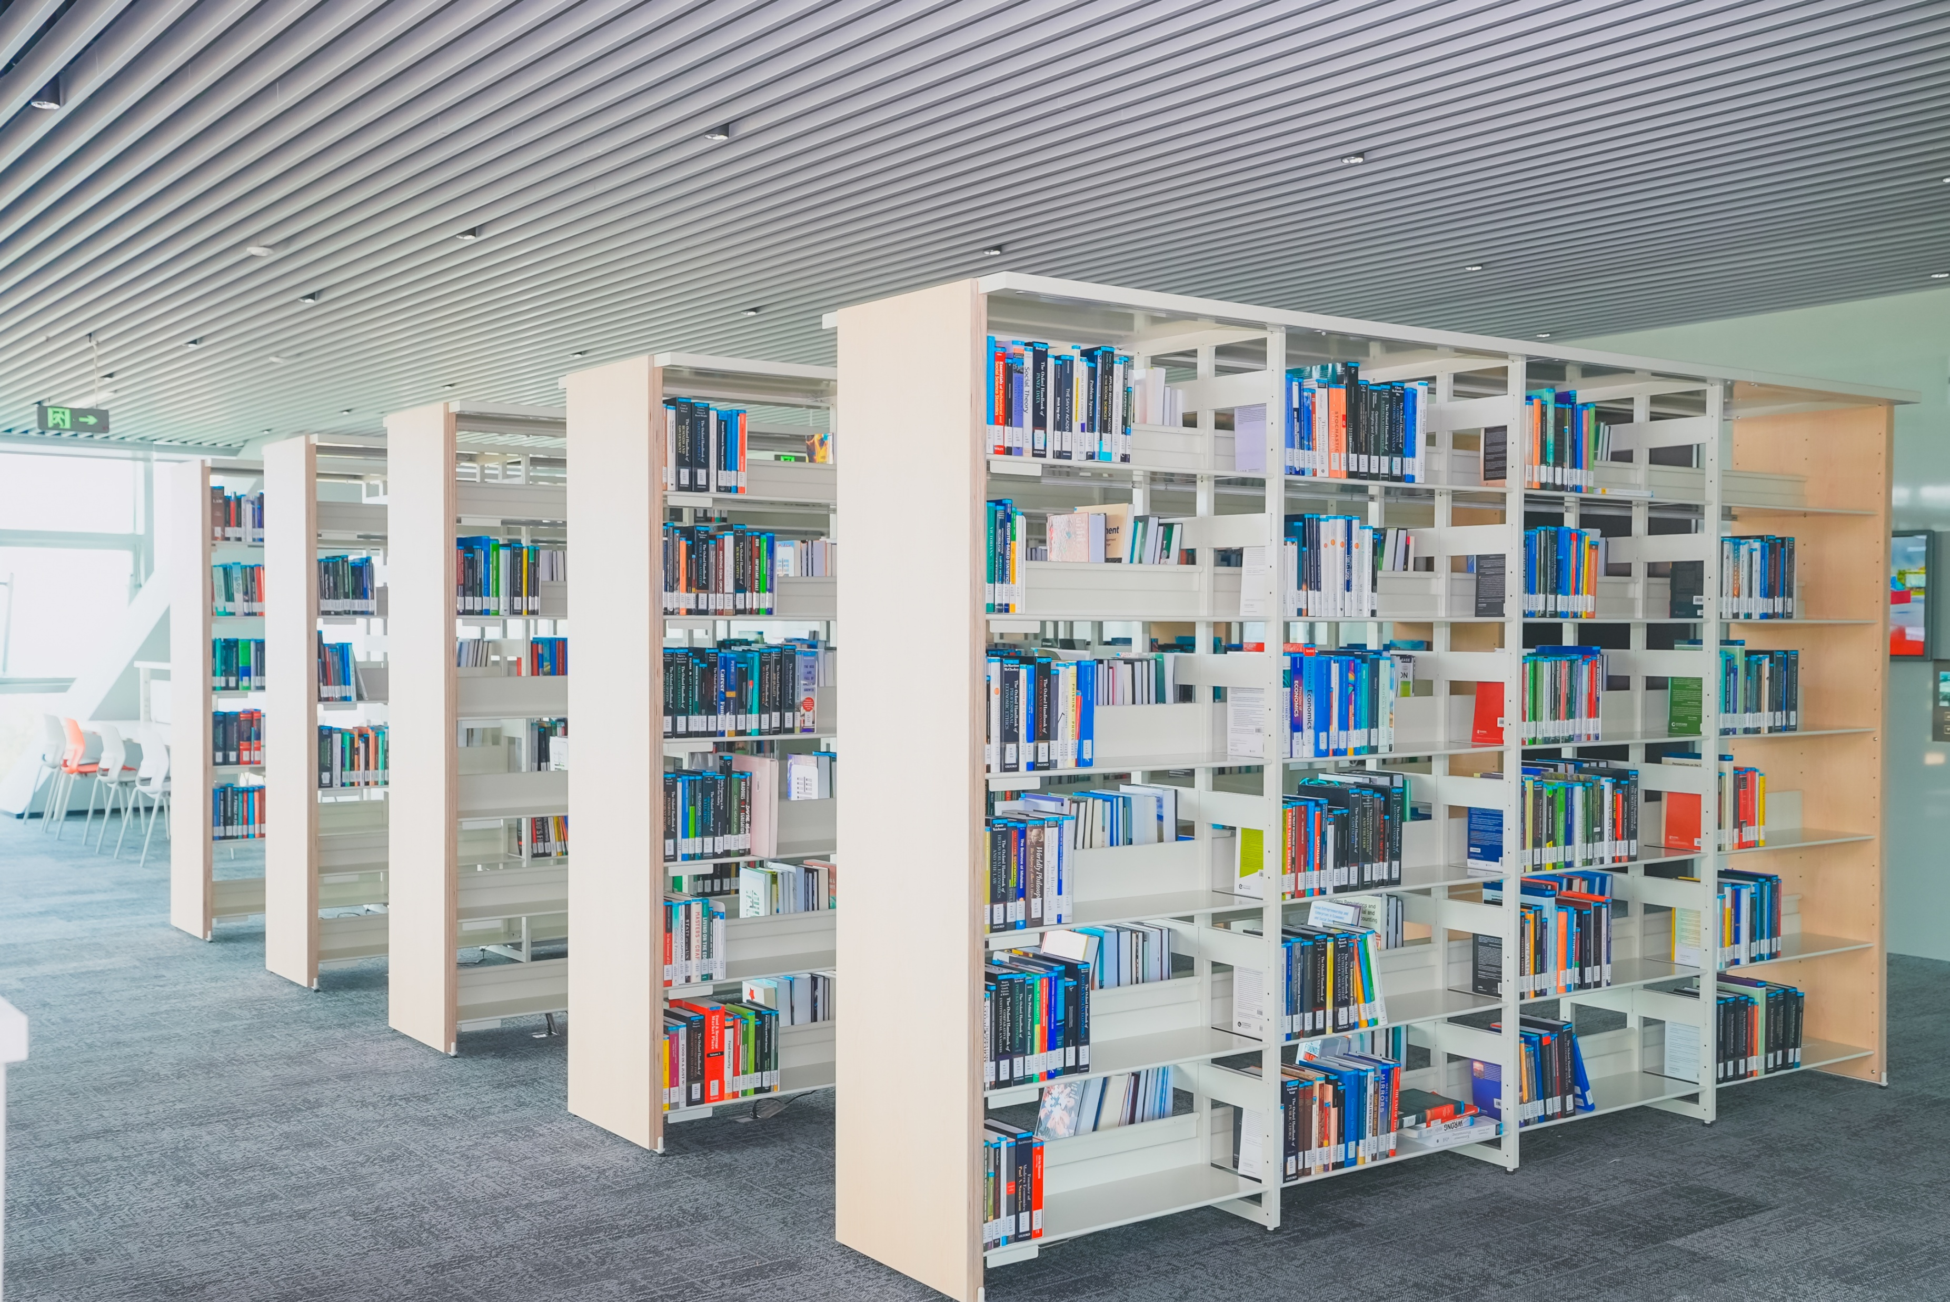

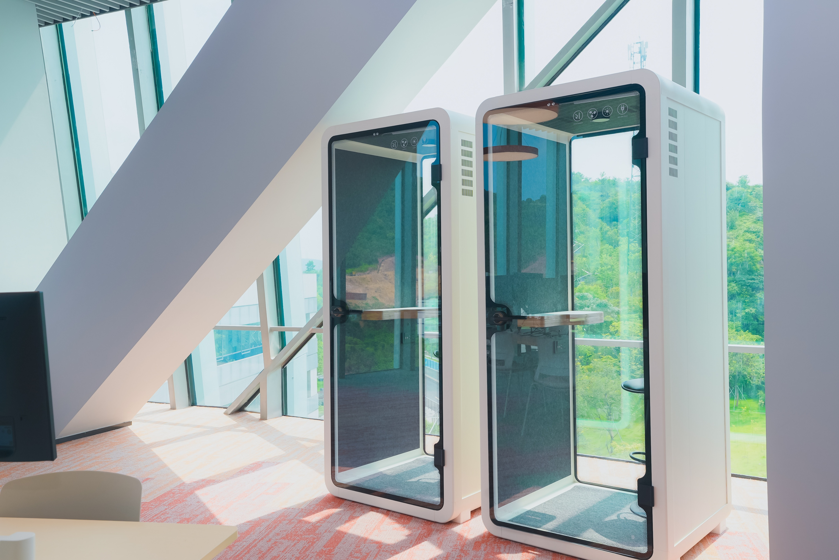
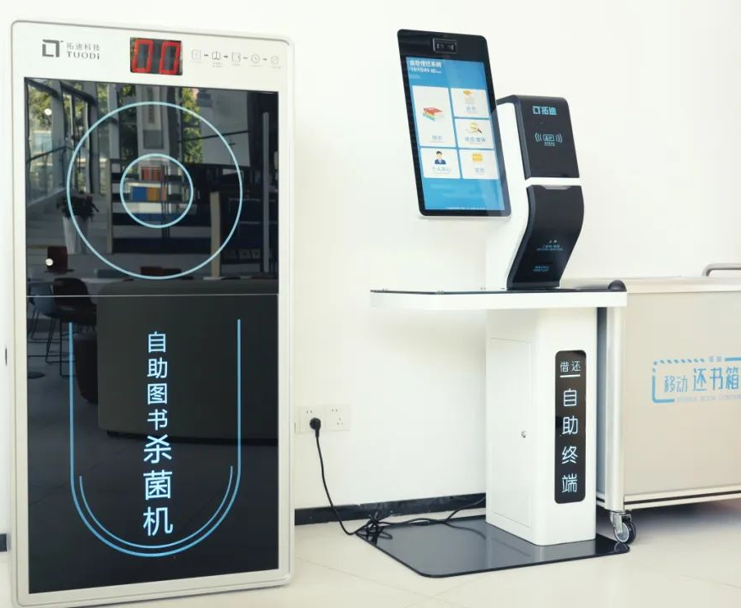
Space – Levels 5 to 7
01-1
Quiet Study
Collaborative Study
Open-shelve Books
Immersive Study
Phone Booth
Leisure Reading
Computer Hub
Self-Check
Notes:
There are open-bookshelves on each floor. Books on different flows are different categories, for example textbooks and reference books on level 6. Other facilities include computer screens, phone booth and self-check machines.

Slide 4
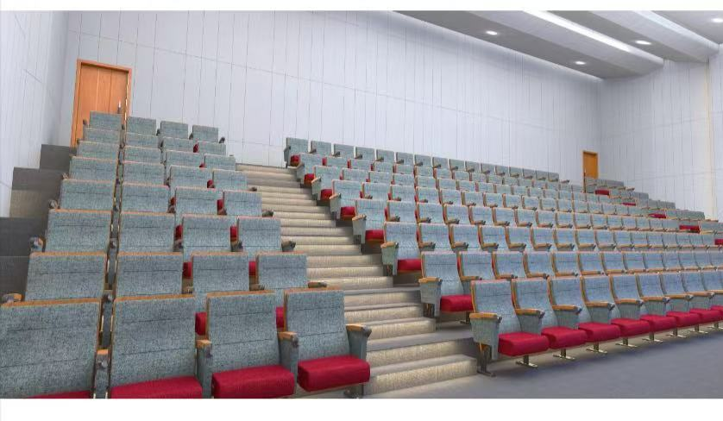
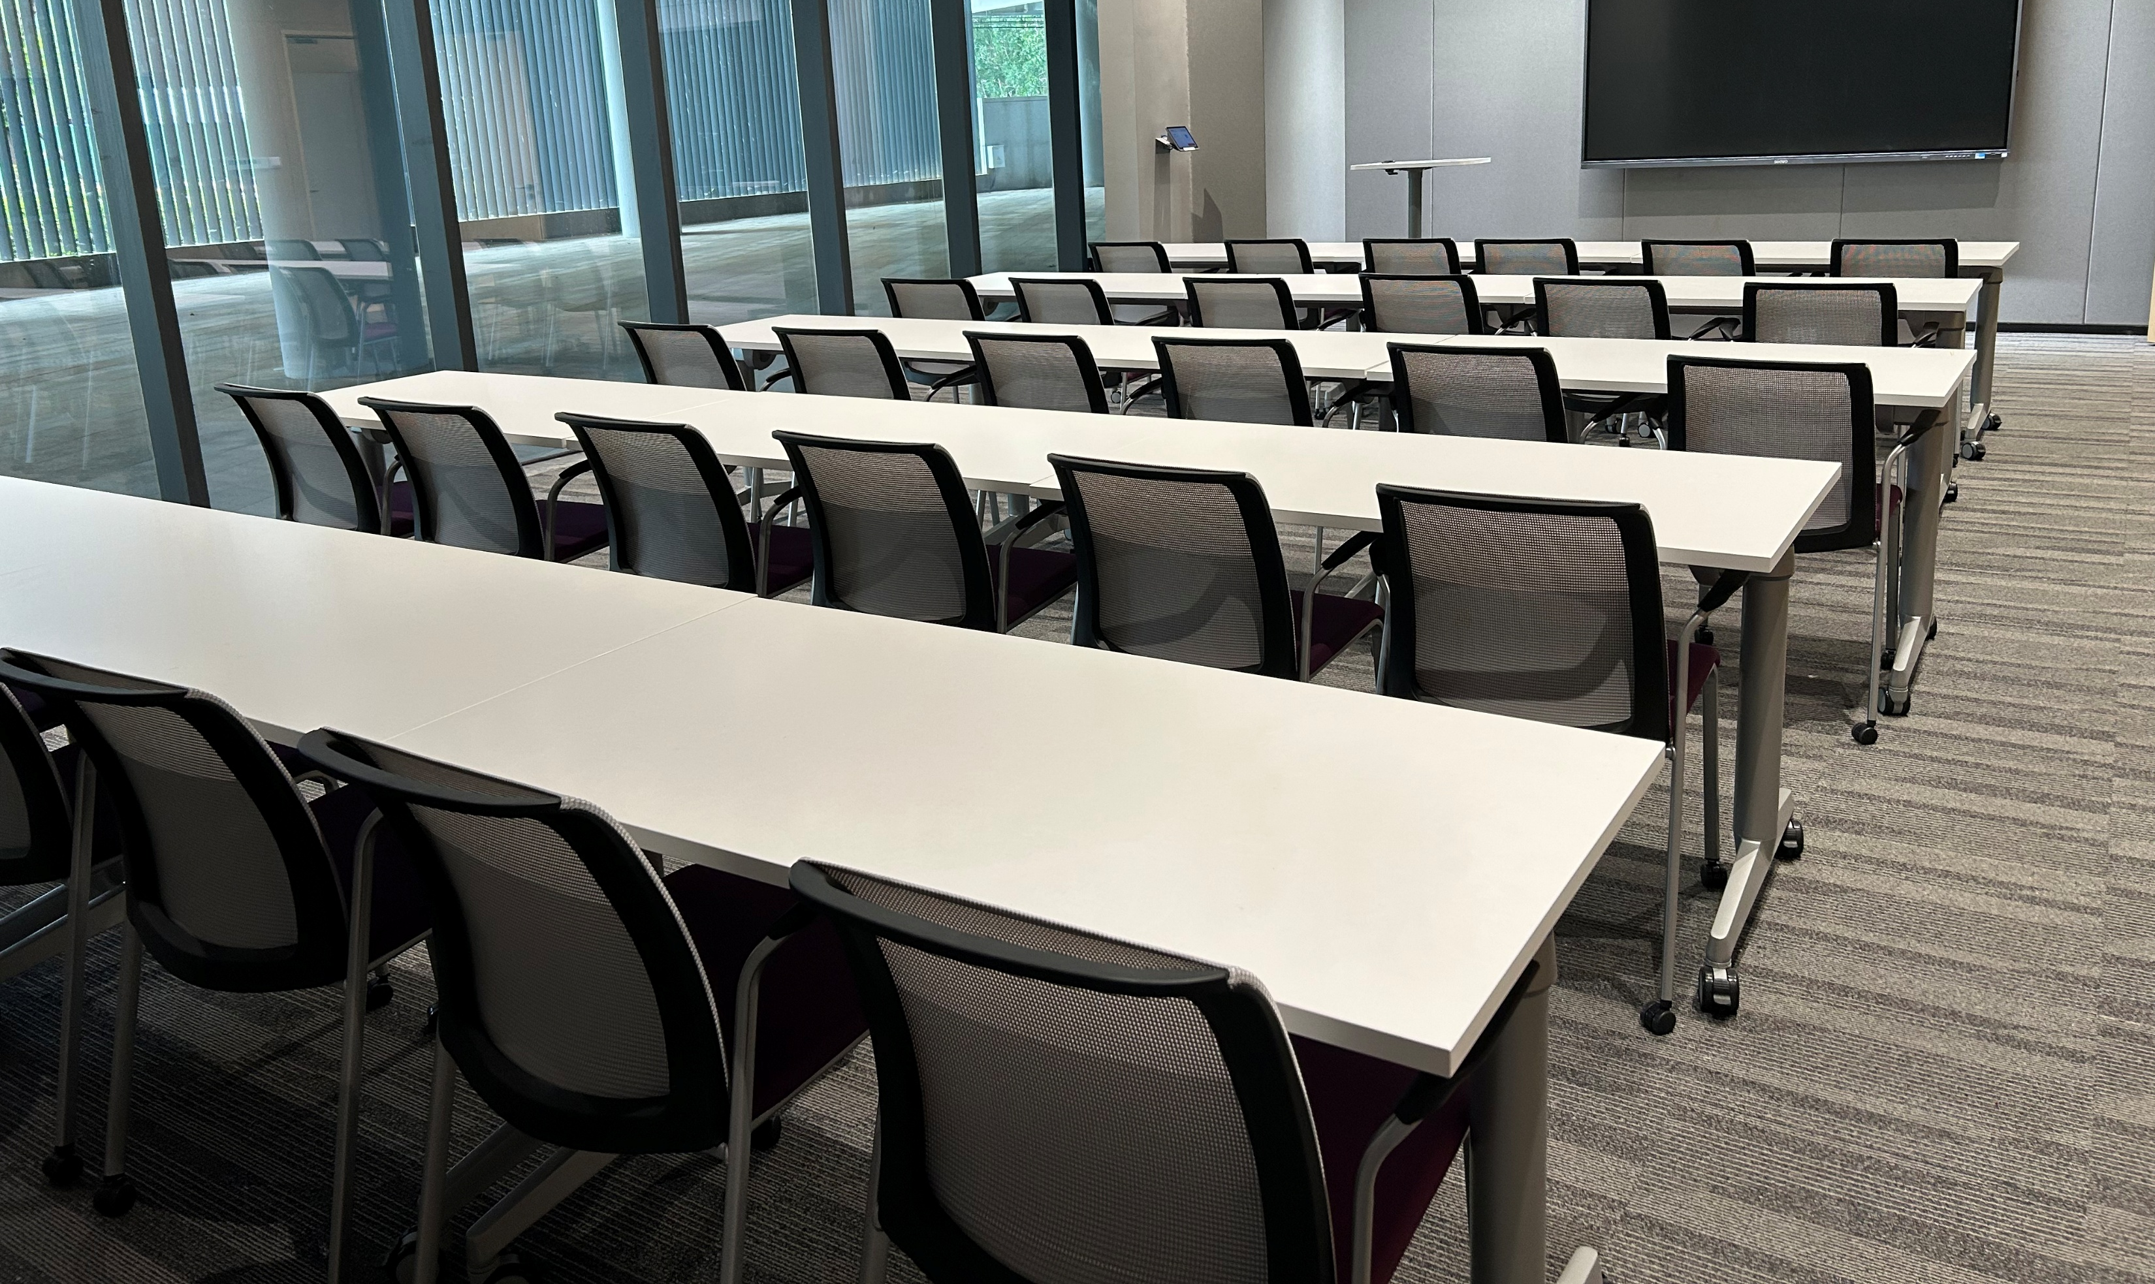
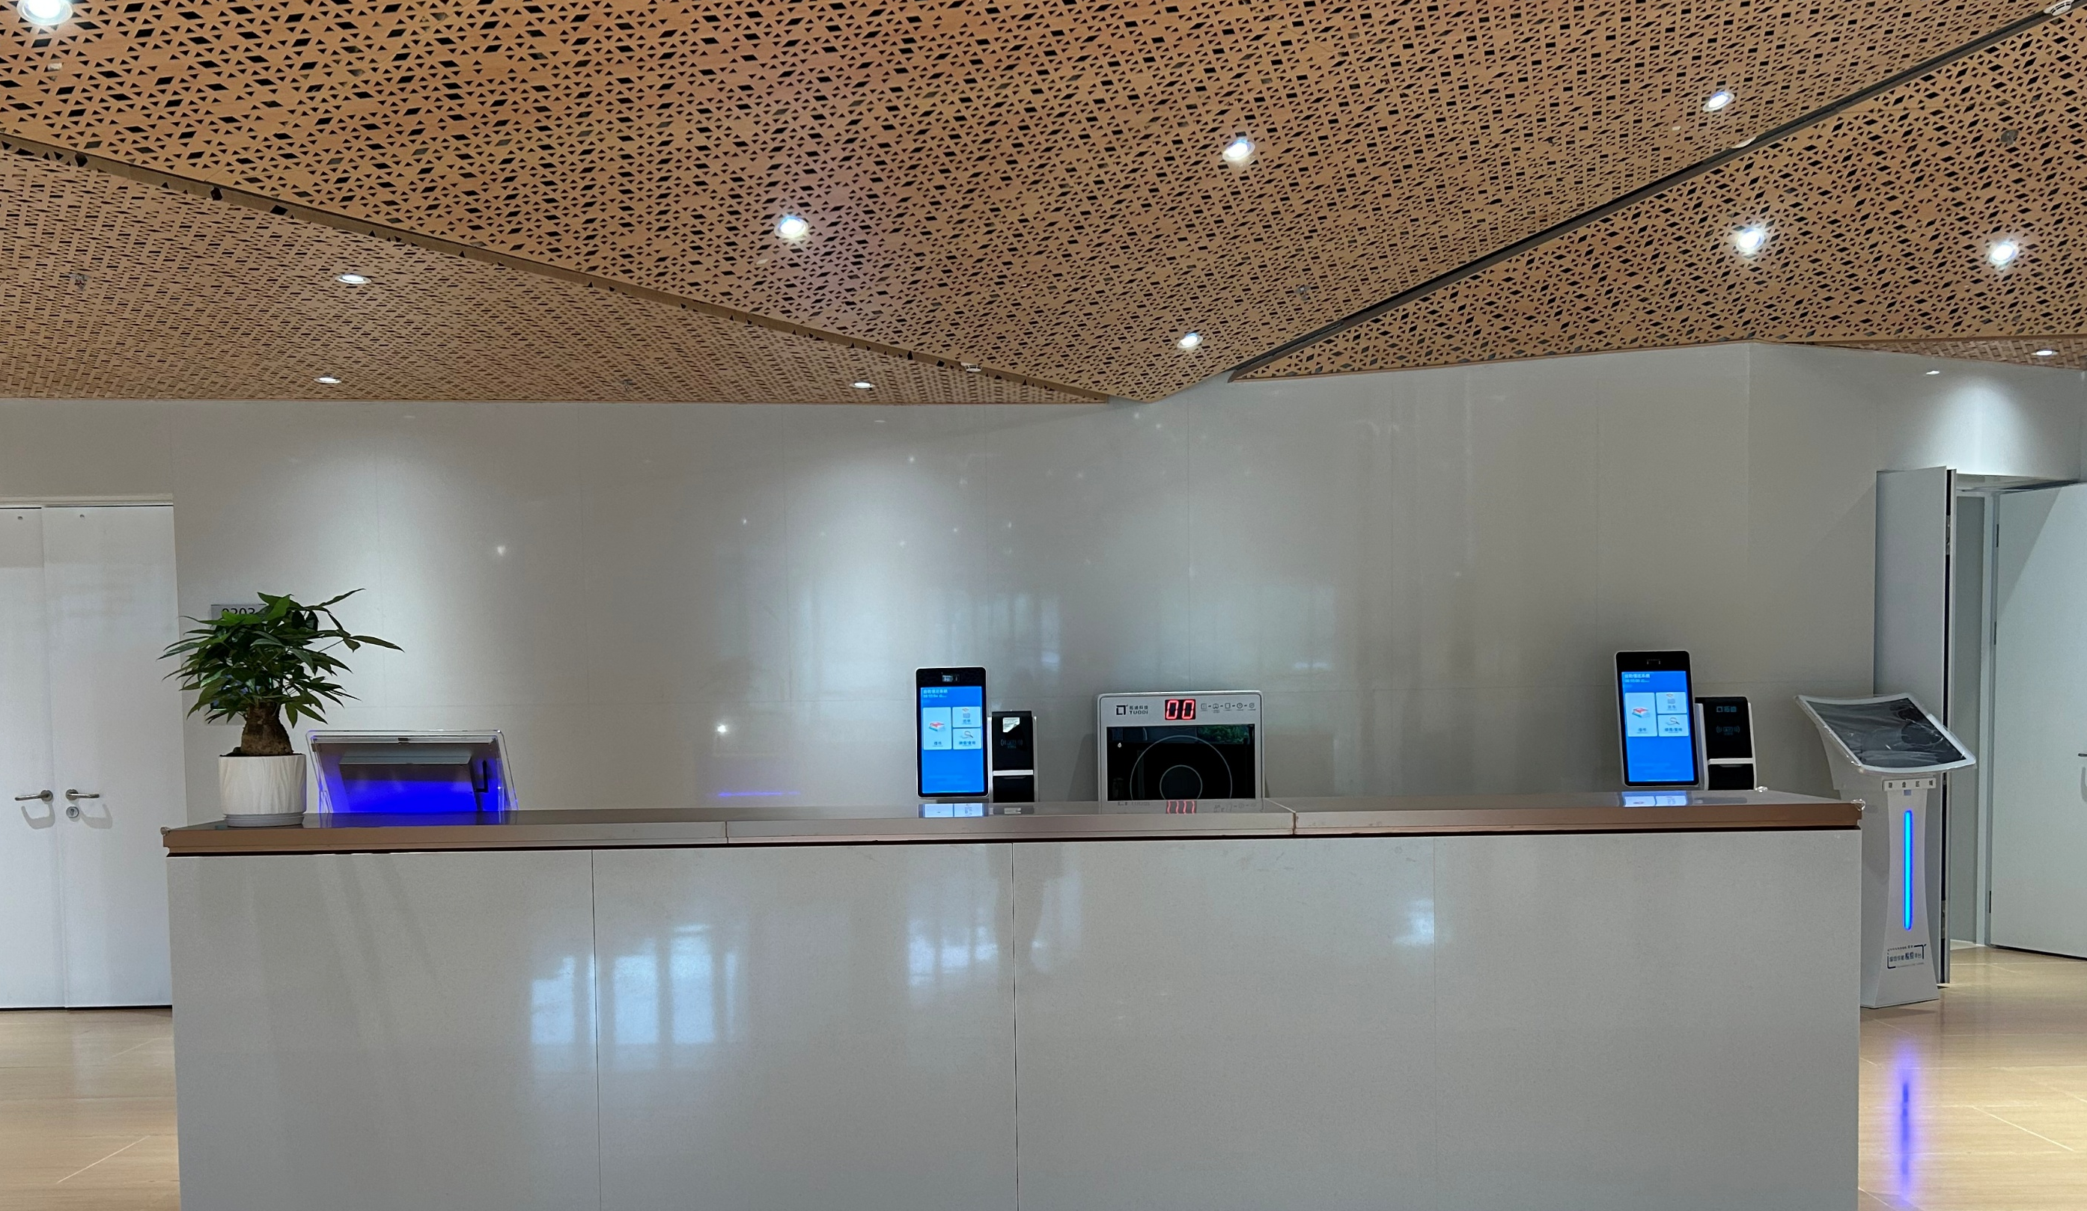
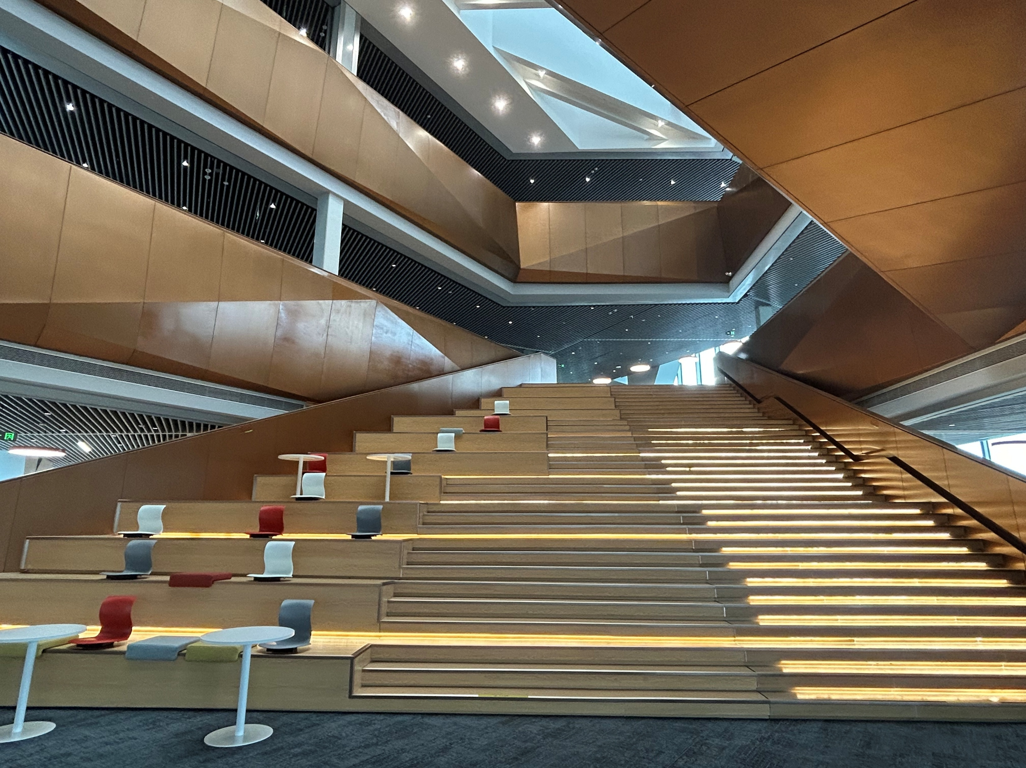
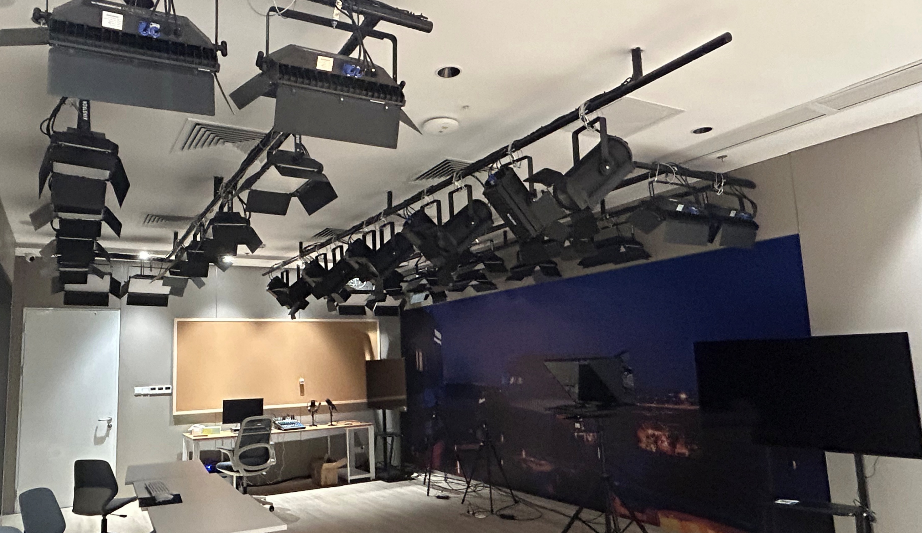
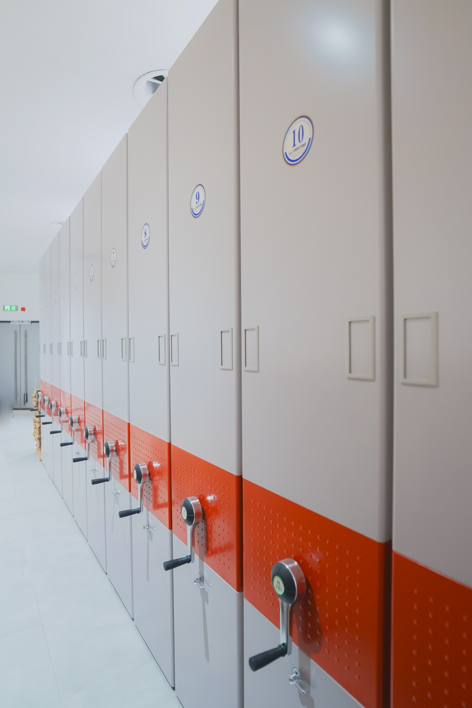
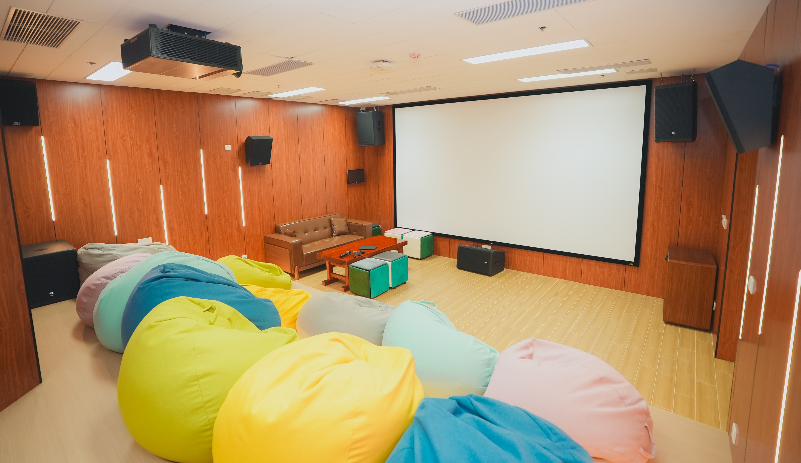
Space – Levels 1 to 4
01-2
Lecture Hall, Training Rooms, Compact Bookshelves
Service Desk, Media Centre,
Coffee Bar
Media Theatres, Music Room
Compact Bookshelves
L1
L2
L3
L4

Slide 5
01
Introduction
Agenda
02
Resources
03
Services

Slide 6
Resources
02
Databases
Books & E-Books
Theses & Dissertations
Academic
Journals
Course Reserves
Magazines

Slide 7
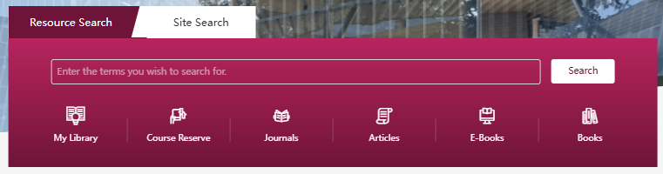
02-1
Books & E-Books
Type | Number
Books | 70,000+
E-Books | 360,000+
Obtain print books from the library
Access e-books online

Slide 8
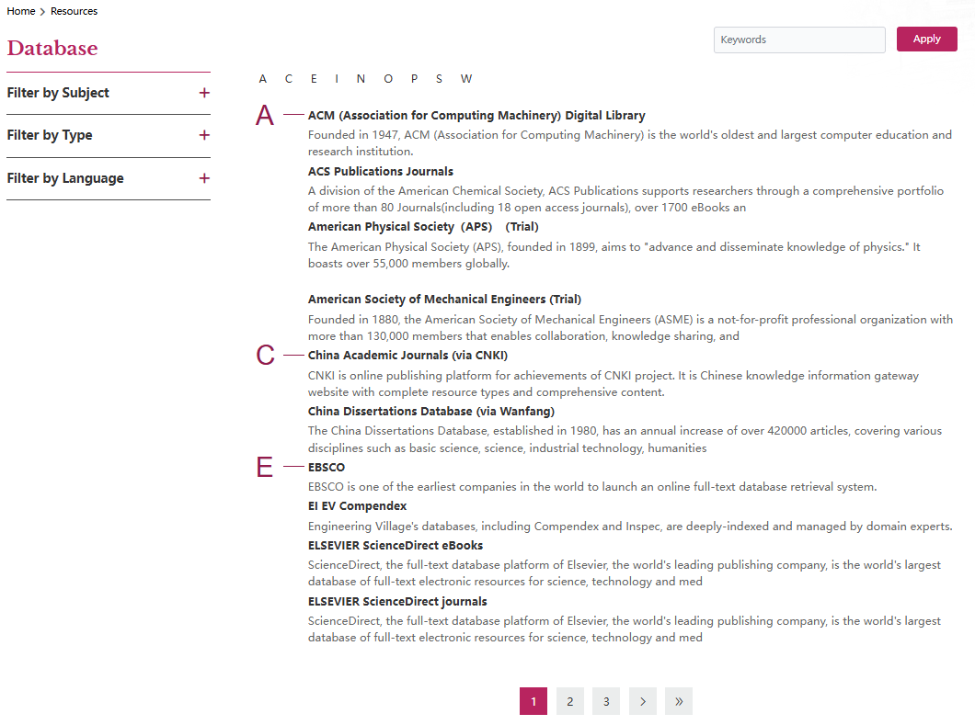
02-2
Databases Subscribed by Library
Home > Resources > Databases

Slide 9
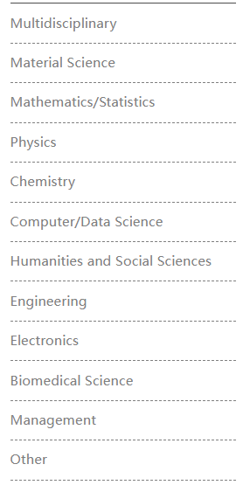
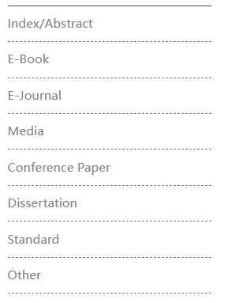
Databases
02-2
Classified by Content Types
Classified by Subjects

Slide 10
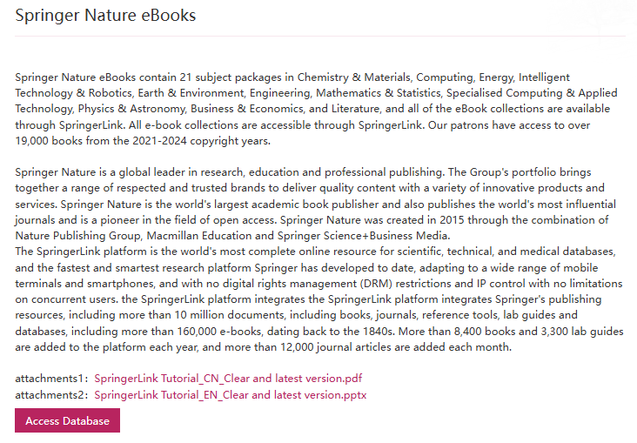
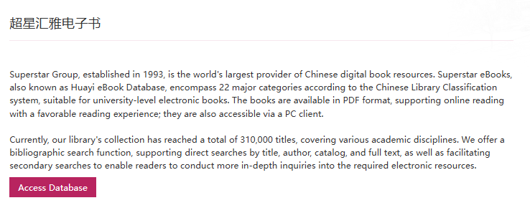
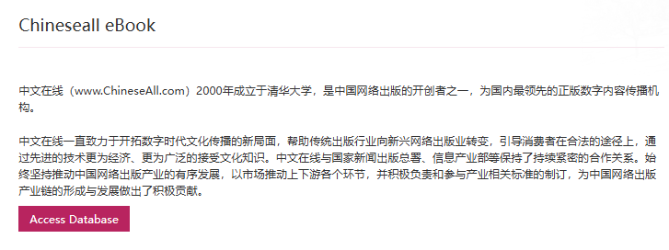
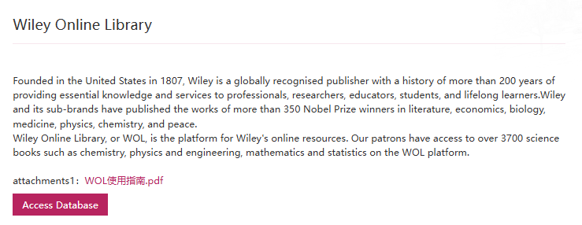
Databases – E-Books
02-2

Slide 11
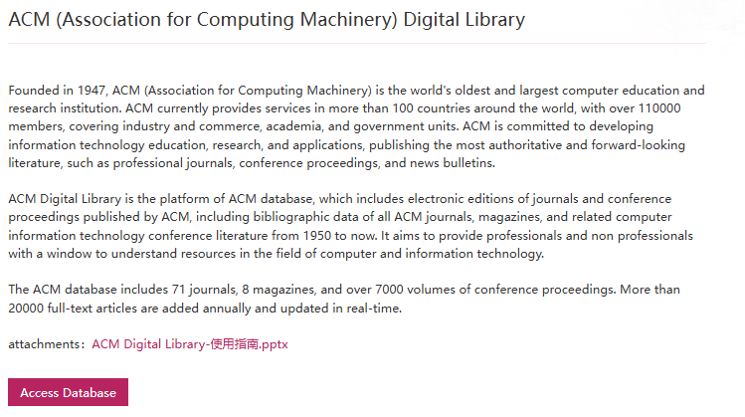
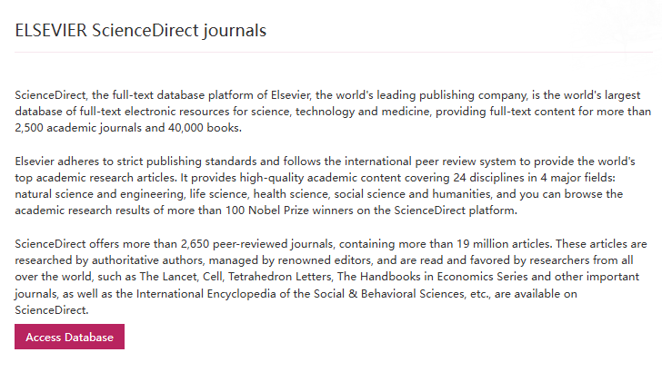
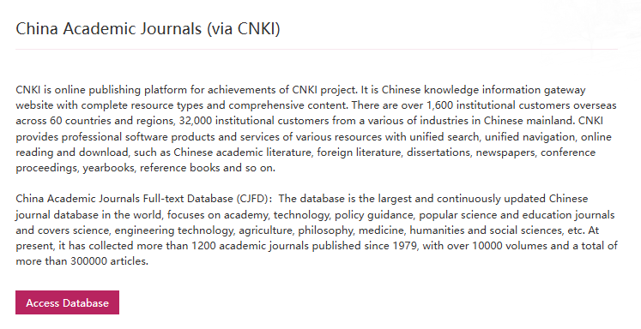
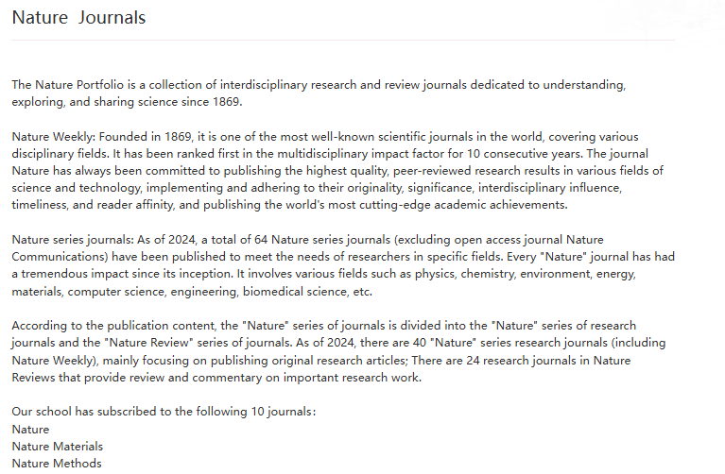
Databases – E-Journals
02-2

Slide 12
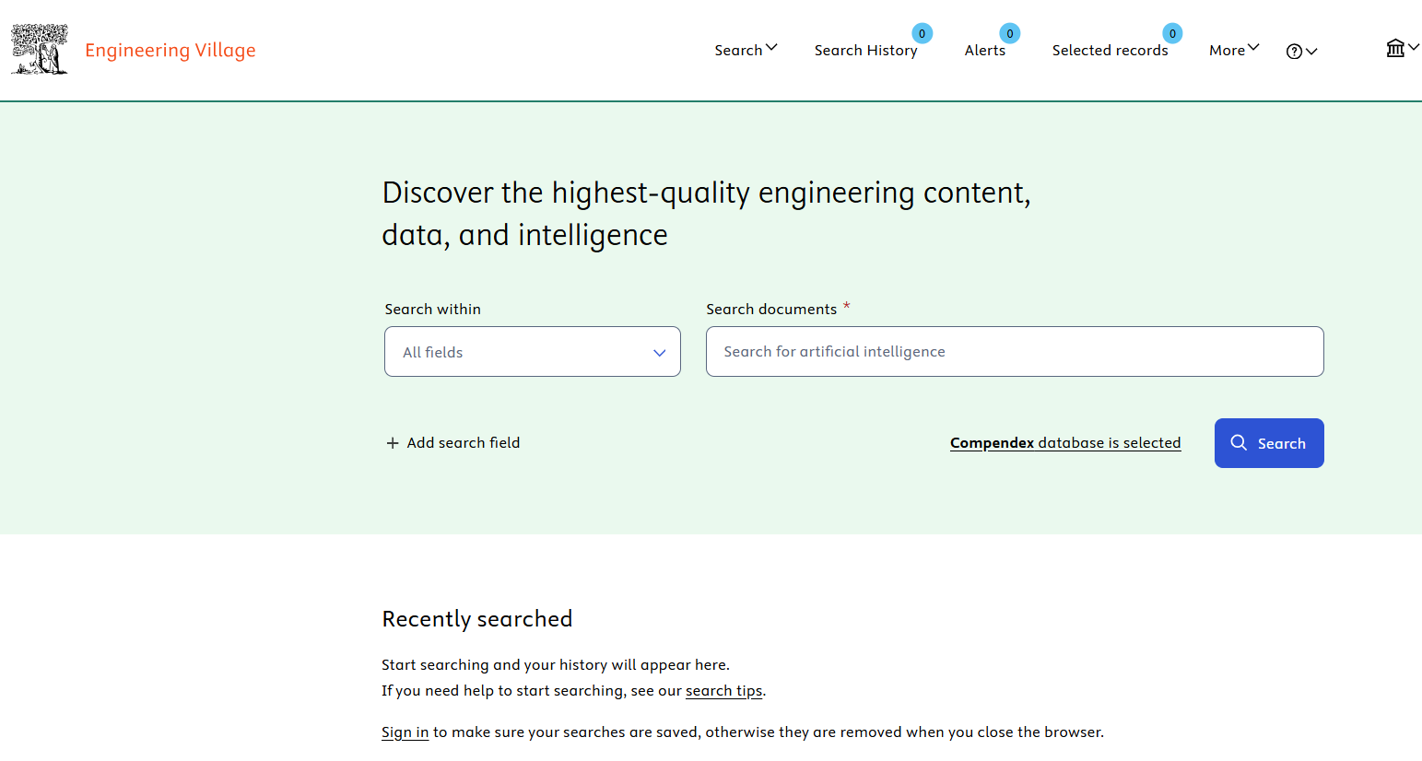
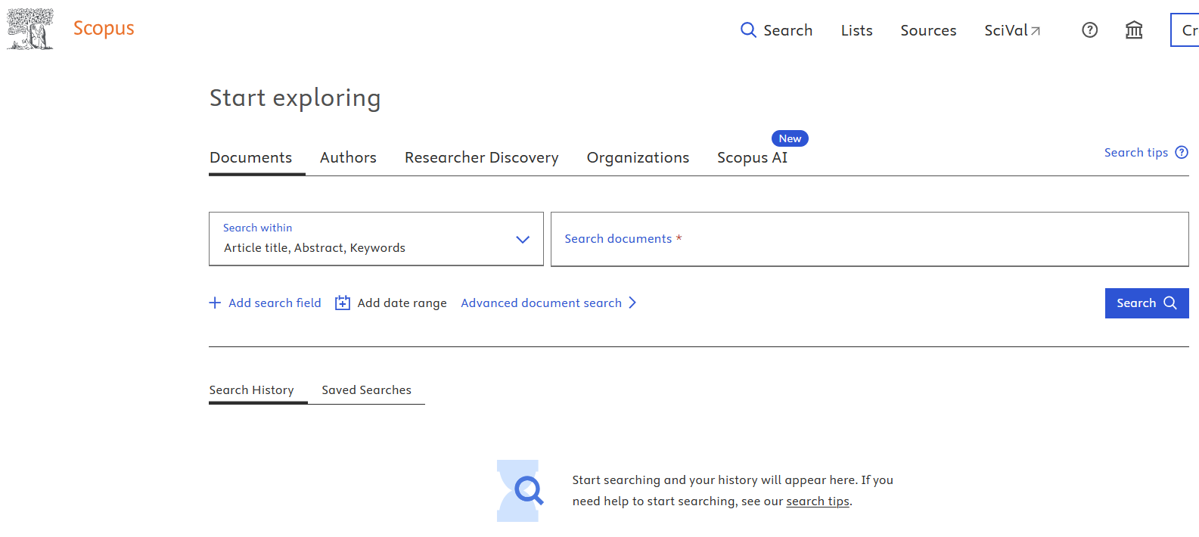
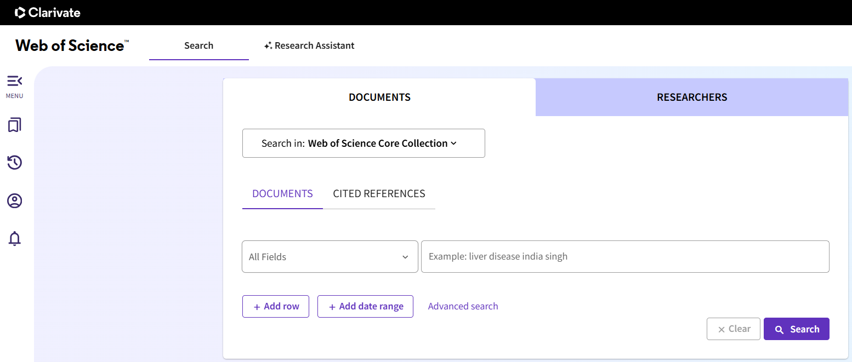
Databases – Abstract / Index
02-2

Slide 13
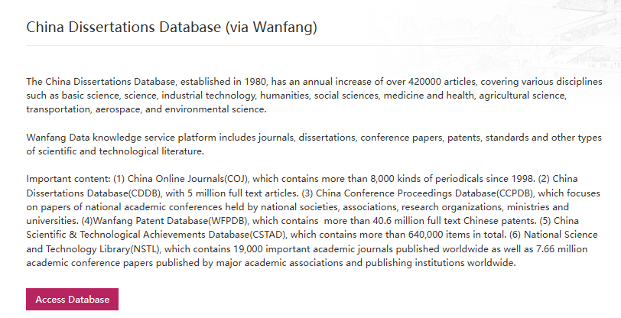
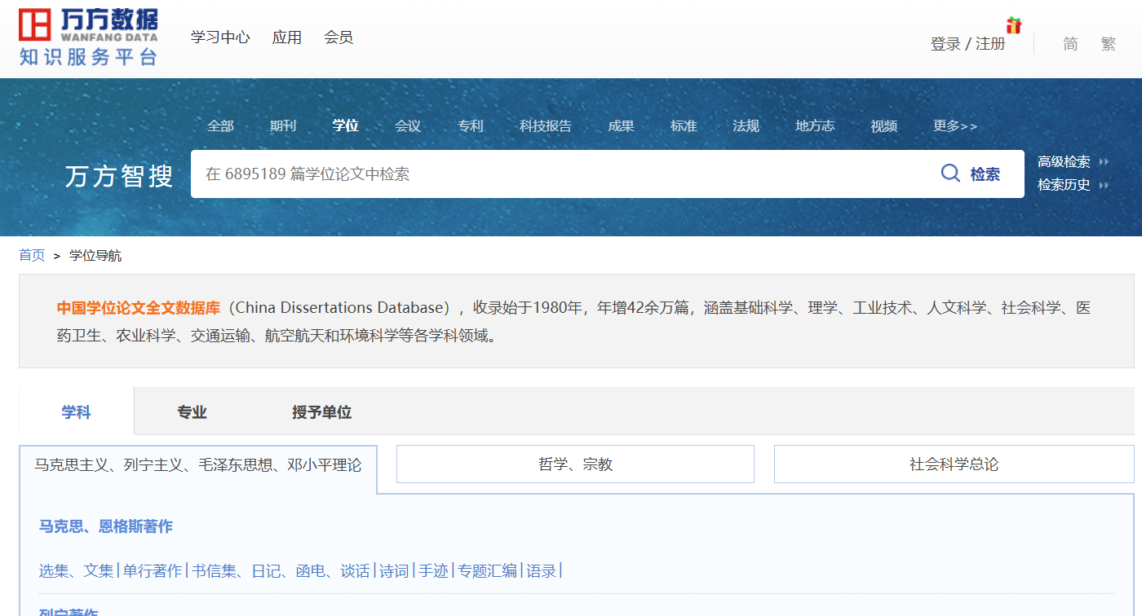
Databases – Theses & Dissertations
02-2

Slide 14

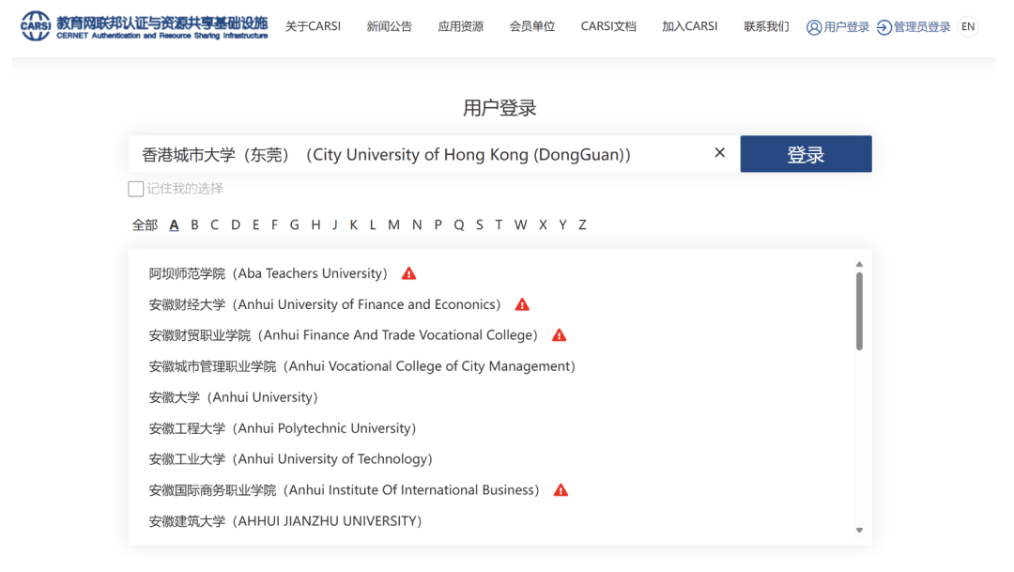
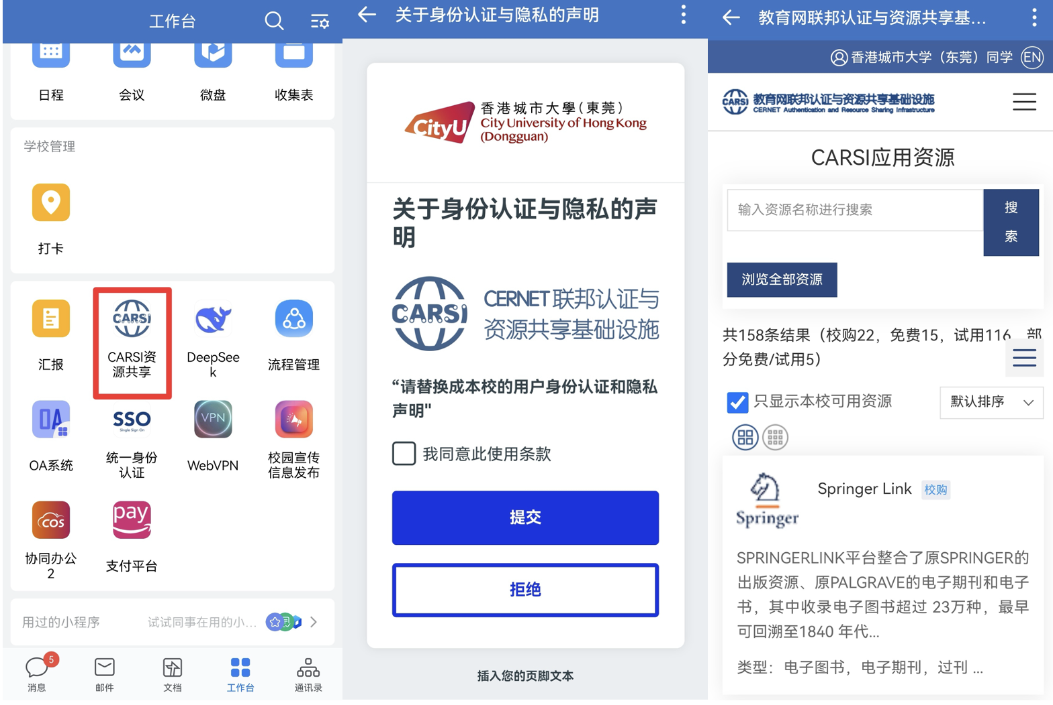
Databases – Remote Access
02-2
CERNET Authentication and Resource Sharing Infrastructure
（CERNET：China Education and Research Network)
Method 1
Method 2
https://ds.carsi.edu.cn/login/index.html
CityU-DG WeCom

Slide 15
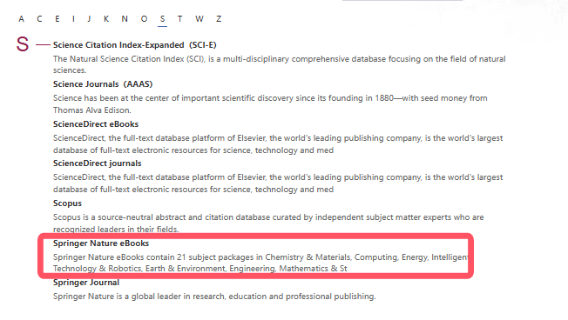
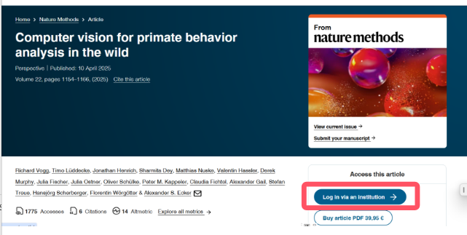
Databases – Remote Access
02-2
Method 3
Login CARSI when access the database
Step 1
Access the database from library website
Step 2
Find Institution Login
Step 1

Slide 16
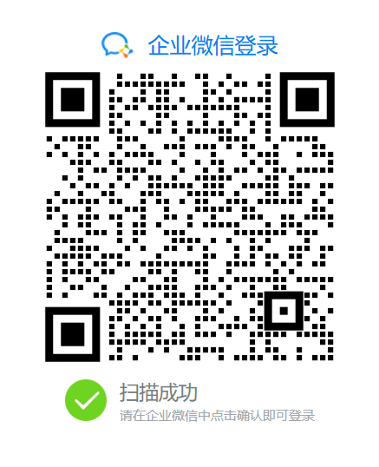
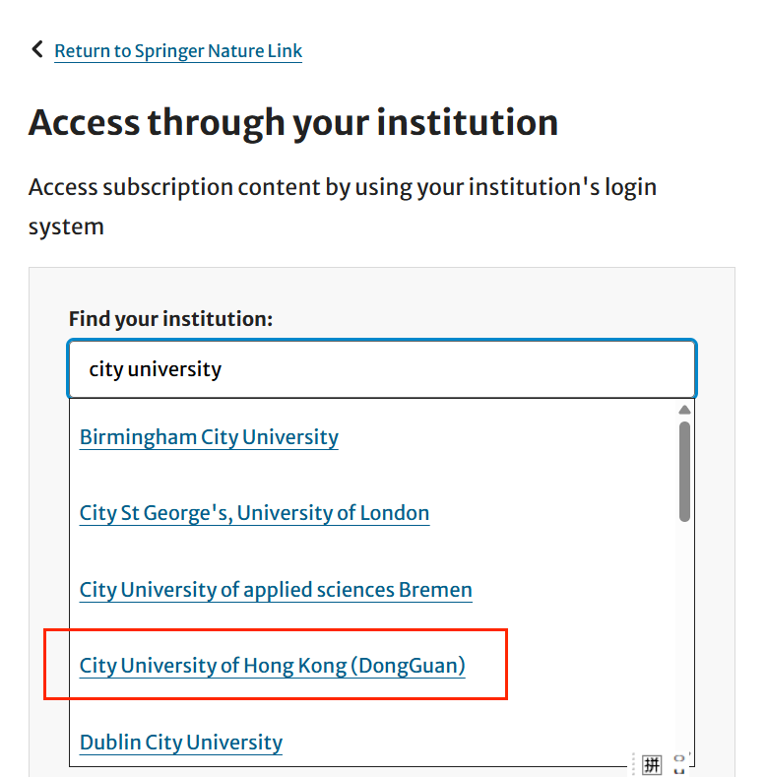
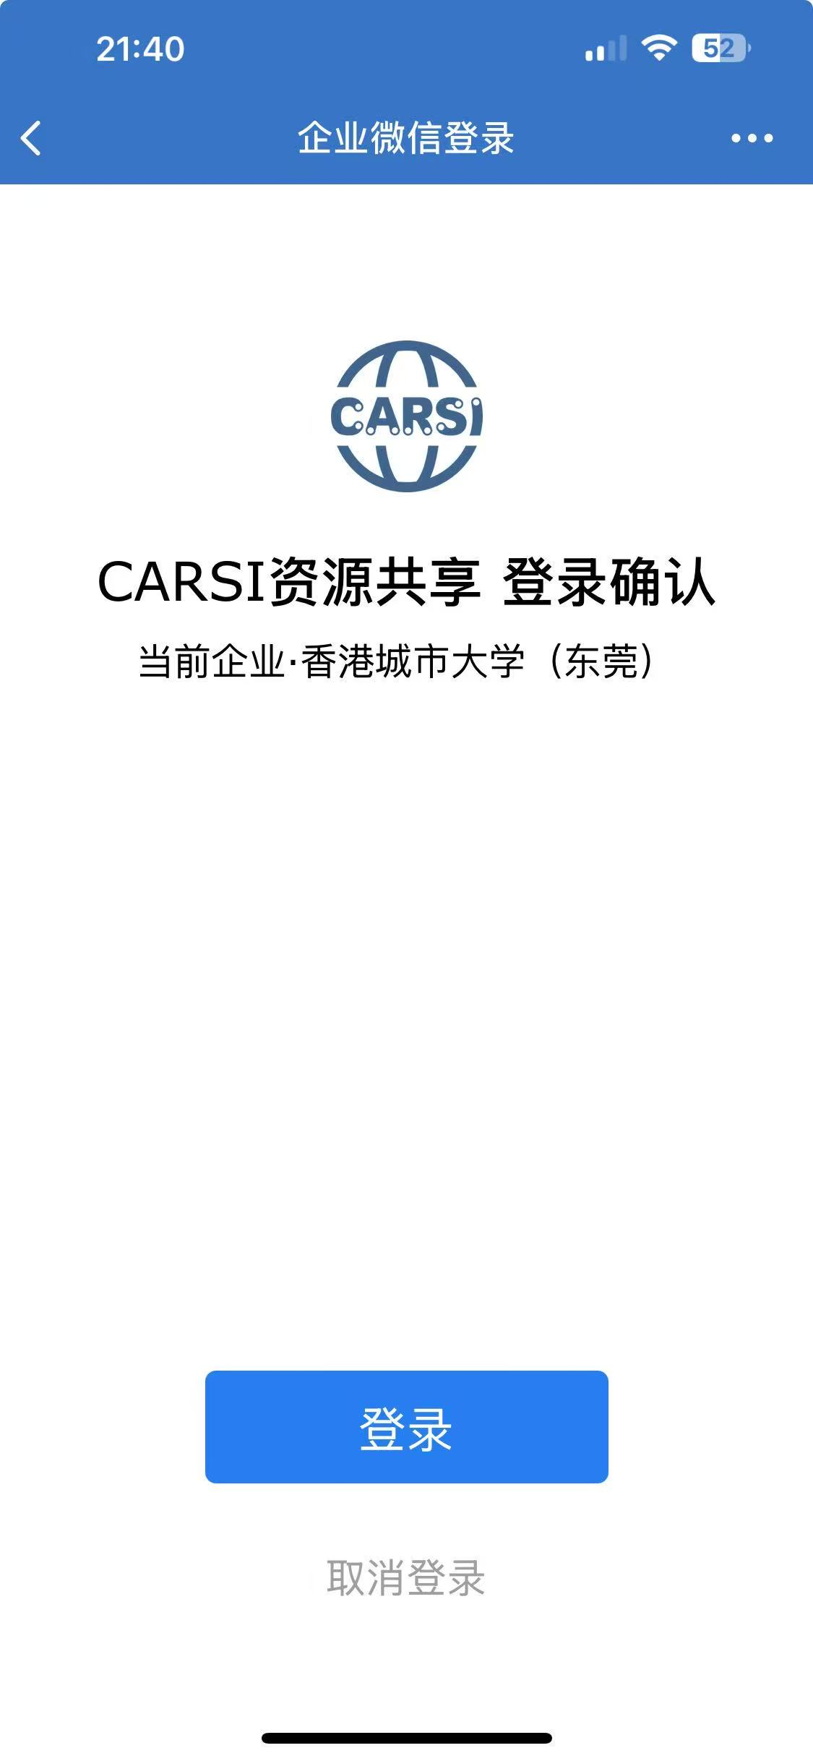
Databases – Remote Access
02-2
Method 3
Login CARSI when access the database
Step 3
Search for CityUHK(DG)
Step 4
Scan QR Code
Step 5
CRASI Login
Step 1

Slide 17
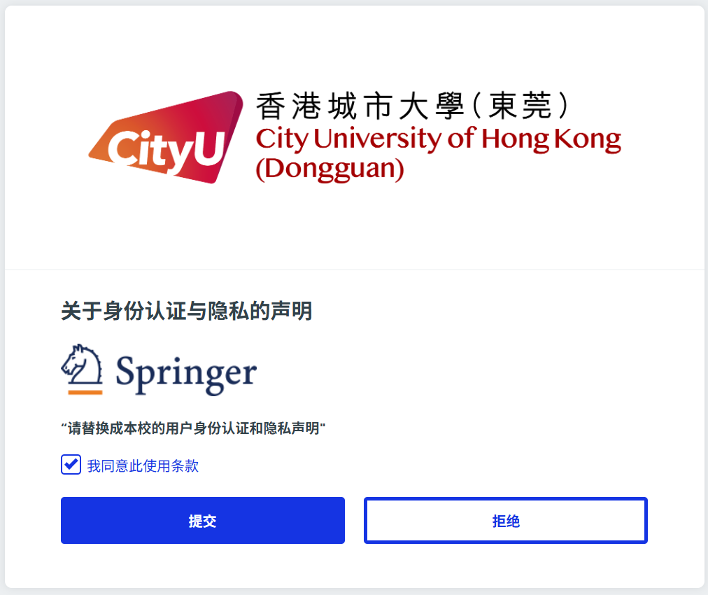
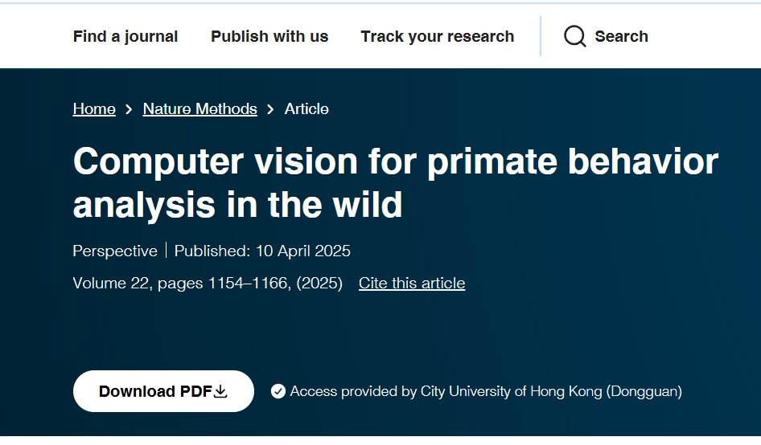
Databases – Remote Access
02-2
Method 3
Login CARSI when access the database
Step 6
Agree Terms of Use
Step 7
Download Full Text
Step 1

Slide 18
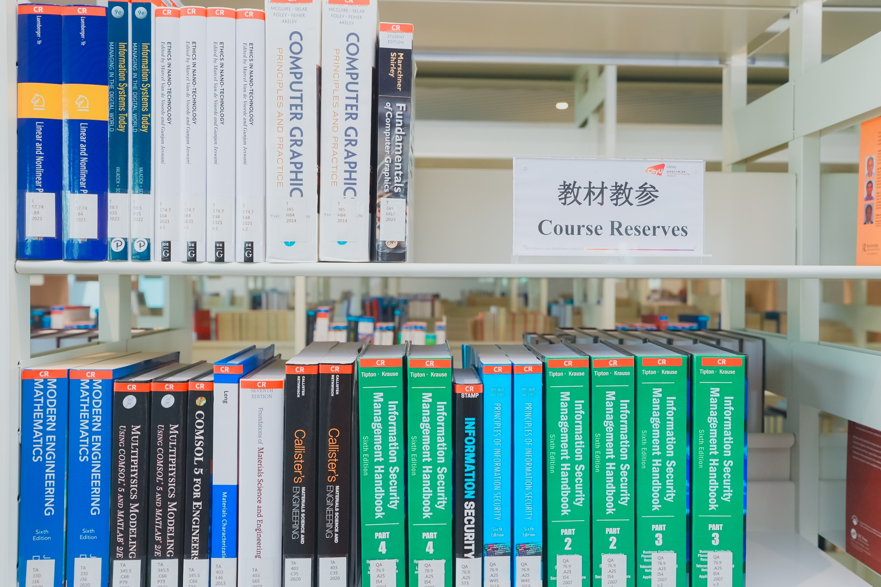
Course Reserves
02-3
Library Collection
Students’
Copy
No. of Students | Print Book | E-Book
< 25 students/class | 1 | Purchase only when the institutional copy is available
>=25 students/class | 2
Library provides a supplier whom students can buy textbooks and reference books from. The supplier is awarded through a proper procurement process.
Level 6

Slide 19
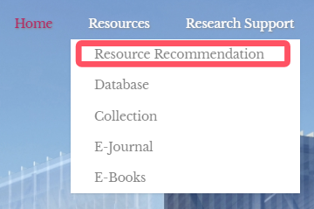
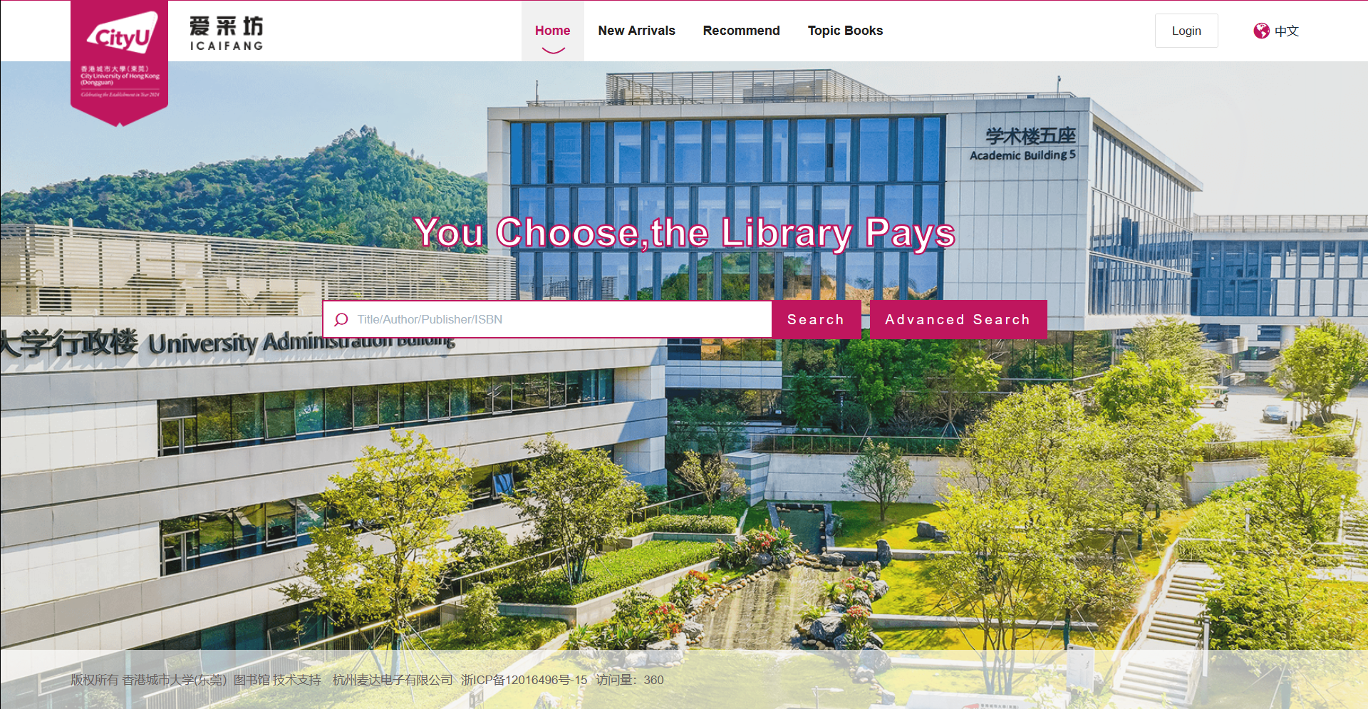
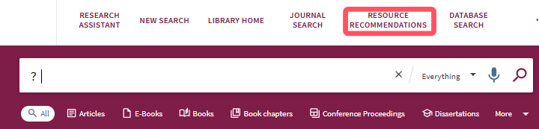
Resource Recommendation
02-4
Notes:
If you cannot find the books or other materials in the library, you can make a recommendation by using Library’s resource recommendation platform. It is mainly for recommending print books. However, if you want the electronic version of the book, you can write your requirement in the note field.

Slide 20
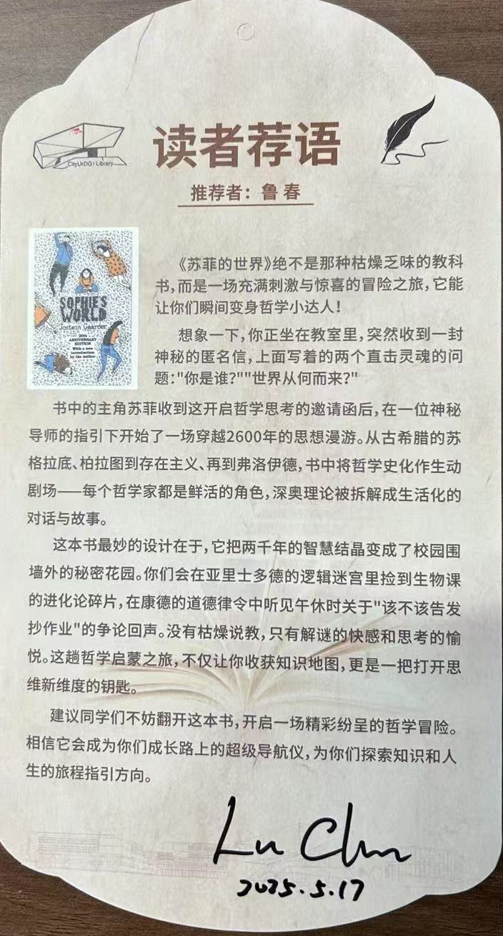
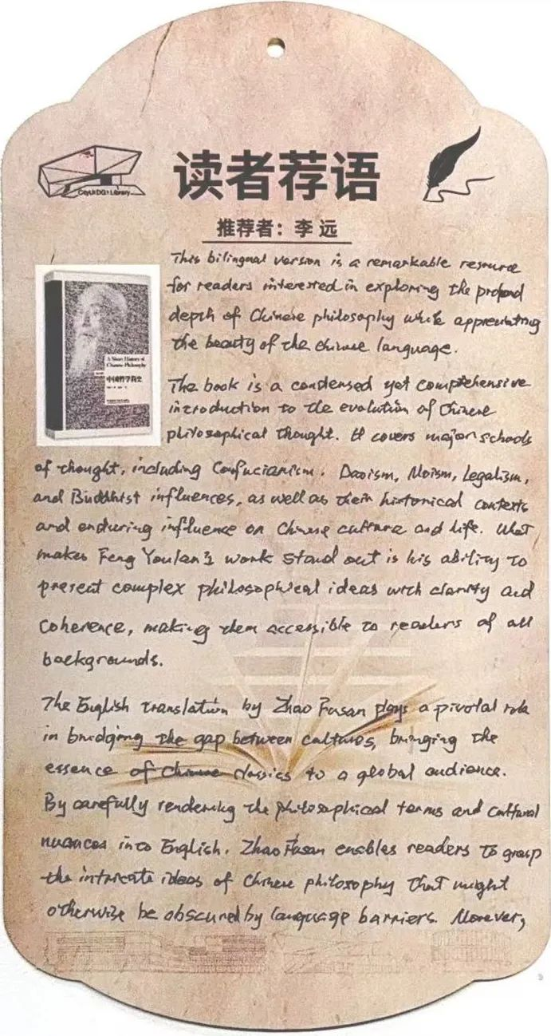
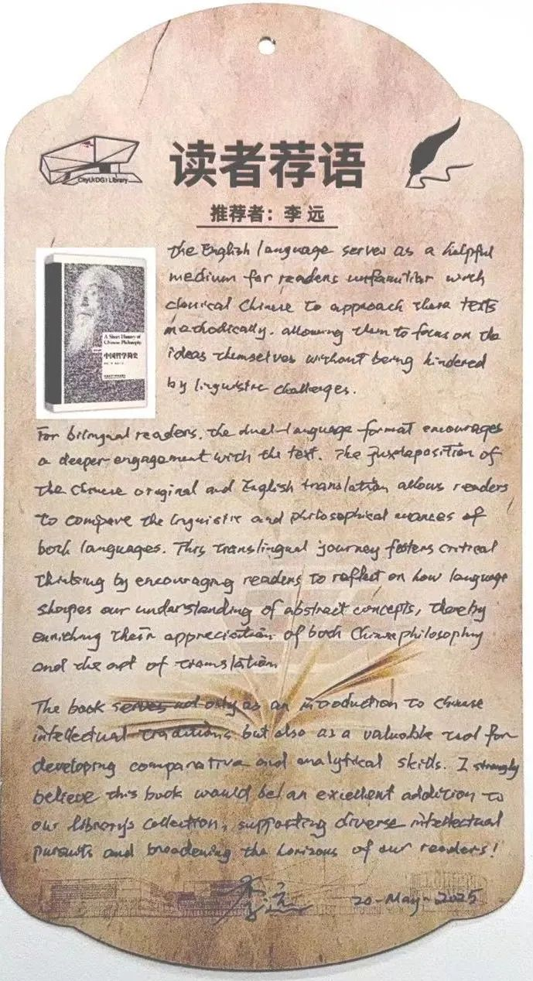
Resource Recommendation
02-4
Amber Collection
Recommend the good books you've read to others so that they can also benefit from them. Write your recommendation by hand.

Slide 21
01
Introduction
Agenda
02
Resources
03
Services

Slide 22
Loan Service
03-1
User Types | Open-Shelf Books |  |  | Course Textbook |  | Course Reference
 | Loan Quota | Loan Period | Maximum Loan Days | Loan Quota | Loan Period | Loan Quota | Loan Period
Staff | 50 | 90 days | 360 days | 1 | 1 Day | 1 | 7 Days
Students | 50 | 60 days | 180 days | 1 | 1 Day | 1 | 7 Days
Others | 20 | 60 days | 120 days

Slide 23
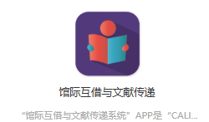
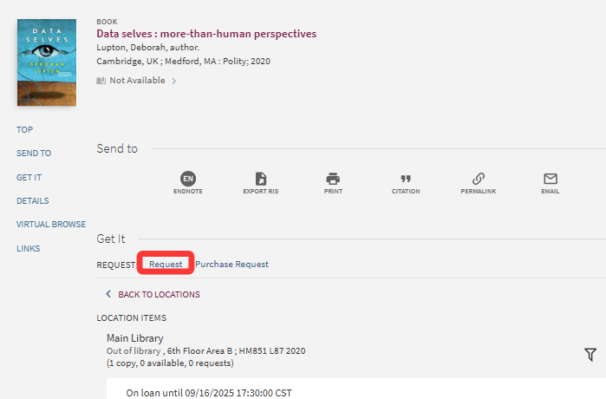


Loan Service
03-1
Renew
Request
ILL & DocDel
Renew before the due date
Renew online using “My Library” account
Request online
Pickup within 3 days

Slide 24
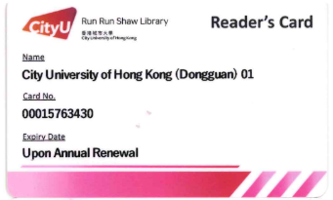
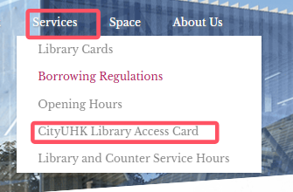
CityUHK Library Access Cards
03-1
10 cards
Access CityUHK library materials and facilities within the library.
Cannot be used during examination period.
Reserve
Return
Lost/Damage
Collect
Library website:
Borrowing privileges will be suspended
With 3 working days
7 days loan period
Return at library service counter
At library service counter
Auto cancellation if not collected on time
Pay 100HKD at City UHK Library service counter

Slide 25


Subject Librarians
03-2
Your point of contact point at the library
Program | Librarian
Materials Science and Engineering Materials Engineering and Nanotechnology Intelligent Manufacturing Engineering | Ms Liao Hairu
Computer Science | Mr He Jiawei
Energy Science and Engineering Electronic Information Engineering | Ms Li Ruonan
Engineering Management | Ms Wang Ziru
Biomedical Engineering | Ms Wang Yifan
Data Science | Ms Lu Dongmei
Business Information Systems | Ms Xia Qinxian

Slide 26



Citation Reports
03-3

Slide 27



Citation Reports
03-3

Slide 28


Citation Reports
03-3

Slide 29




Trainings
03-4
Academic Staff
Admin Staff
Post-
Graduate
Under-
Graduate

Slide 30

Trainings
03-4

Slide 31

Contact Us
Website：lib.cityu-dg.edu.cn
Email: library@cityu-dg.edu.cn
Follow us on Webchat
iSlide
2024/9/8

