Slide 1
Library Orientation for MSVC Students
Du Juan, University Librarian
15 January 2026

Slide 2
Collections
01
Spaces
02
Agenda
03
04
Database Remote Access
Borrowing Regulations
Website & WeChat
Essentials for New Researchers
05
06

Slide 3
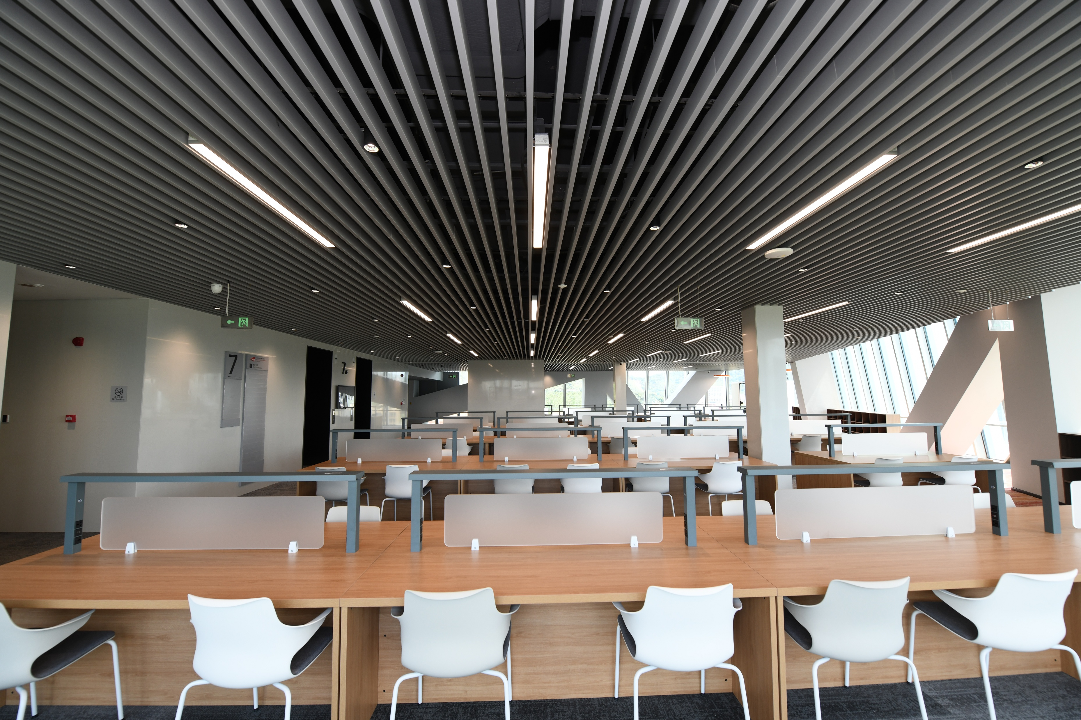
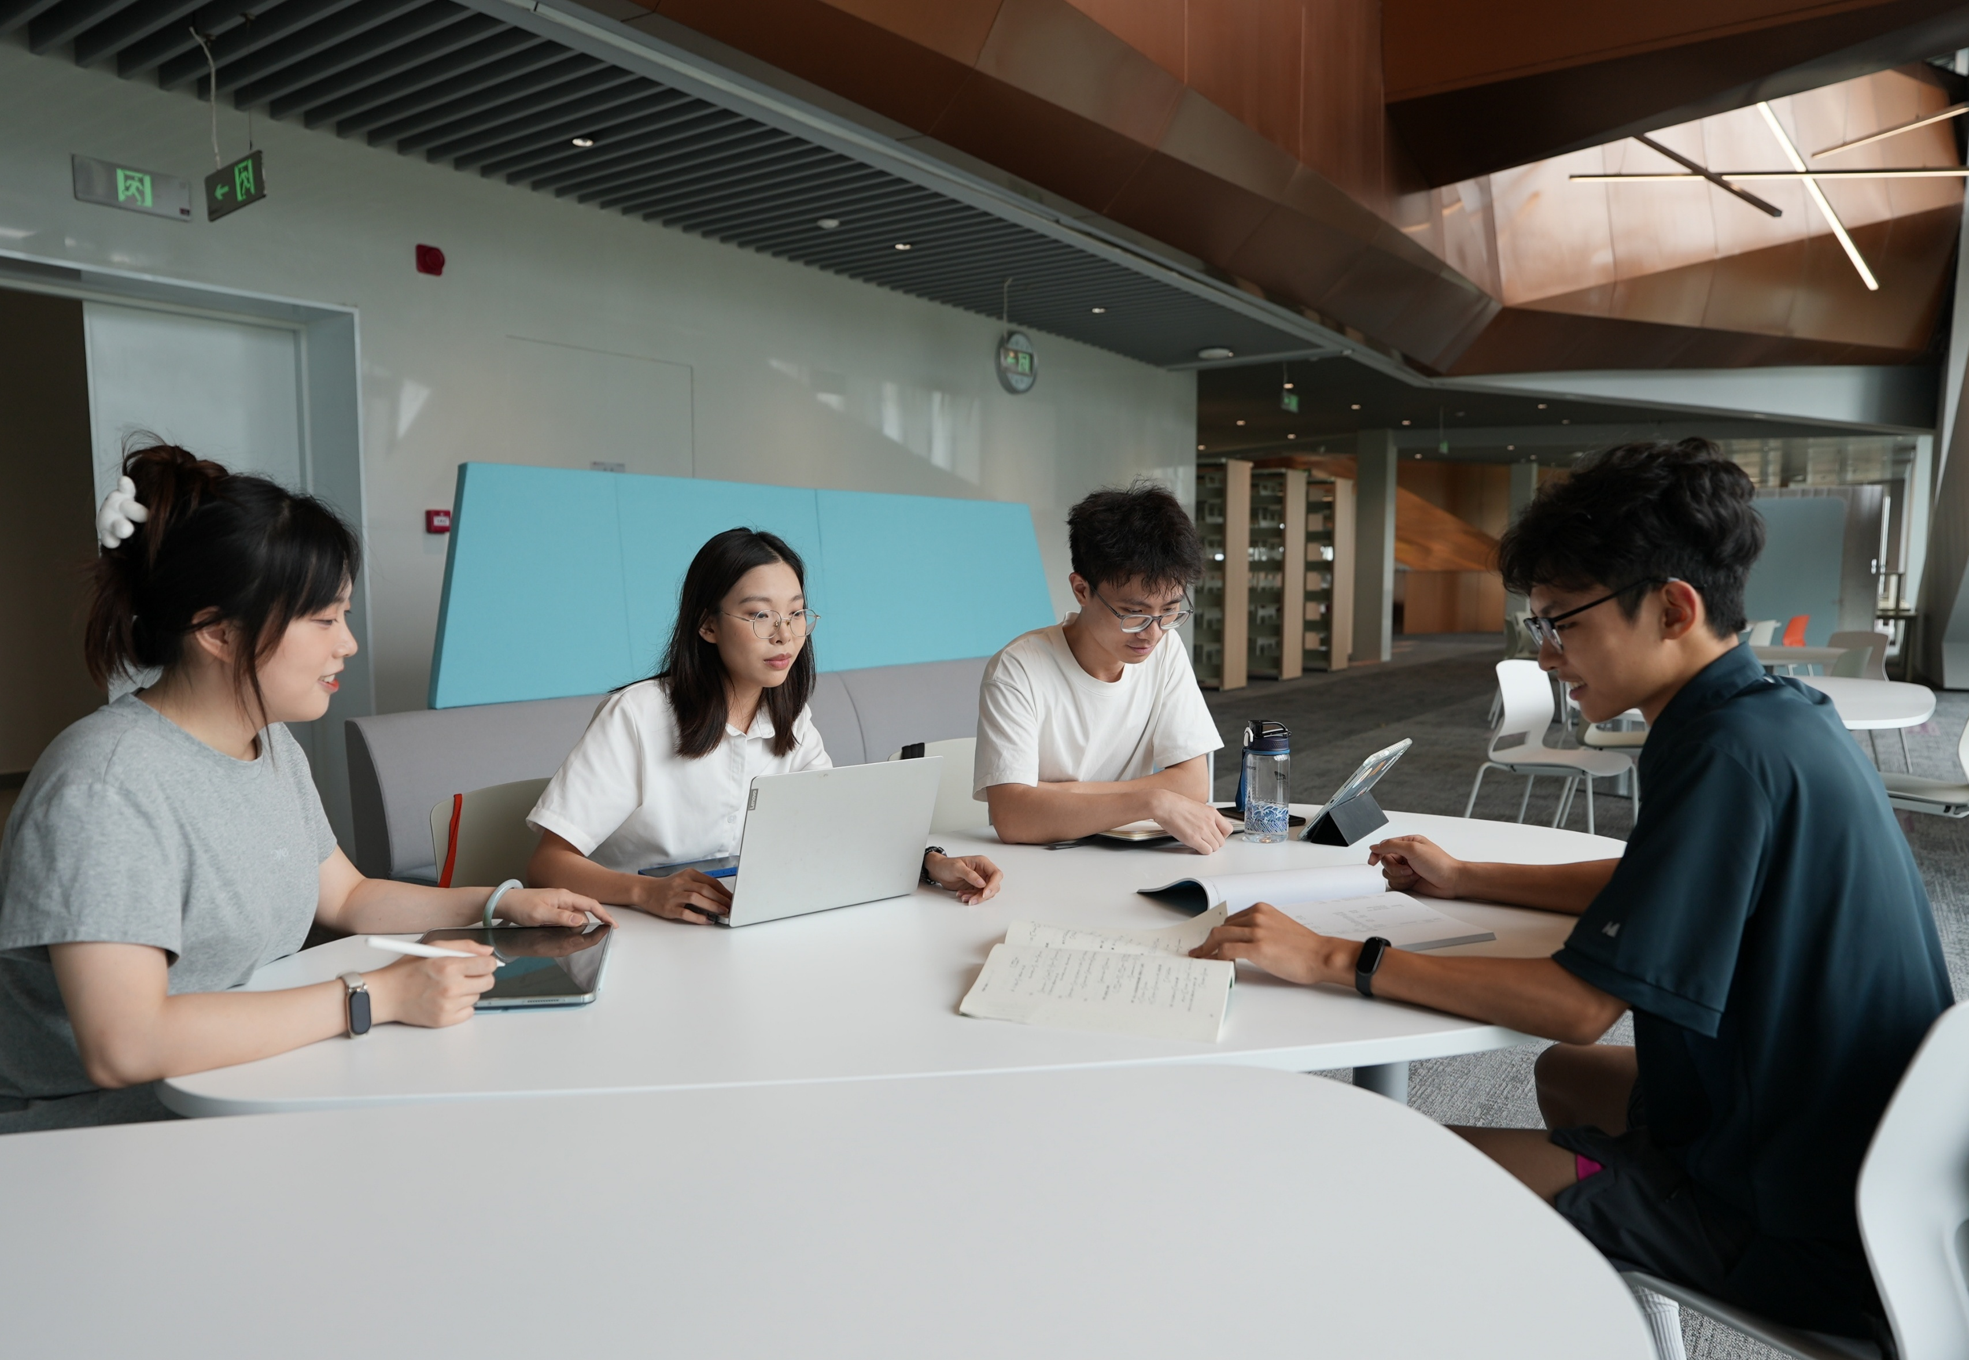
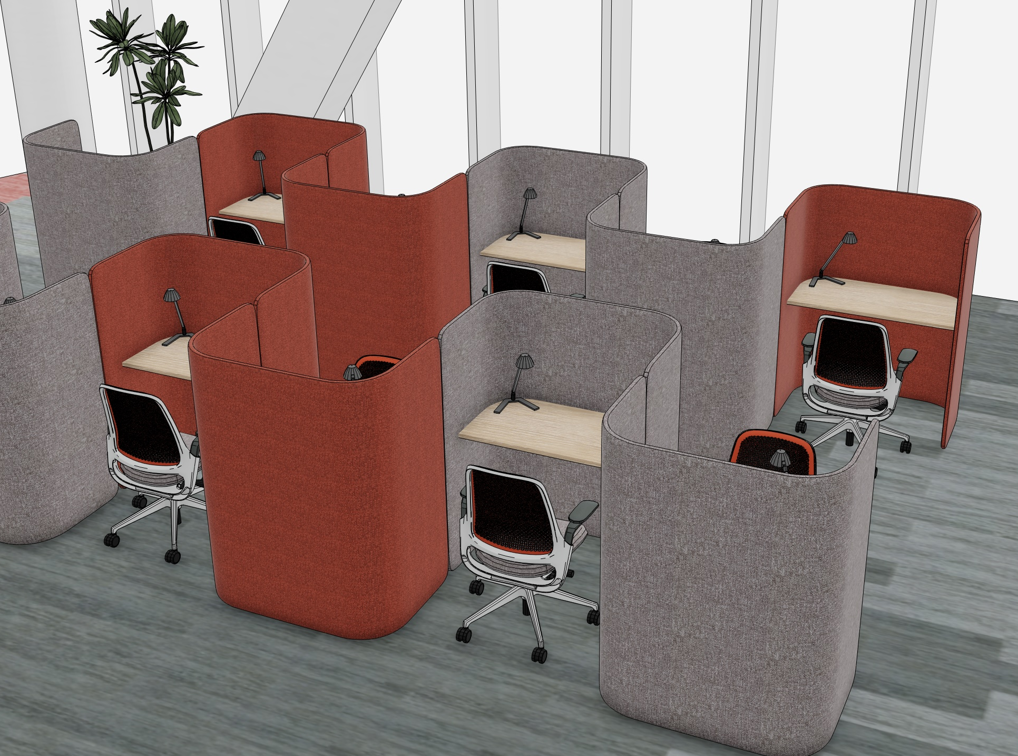

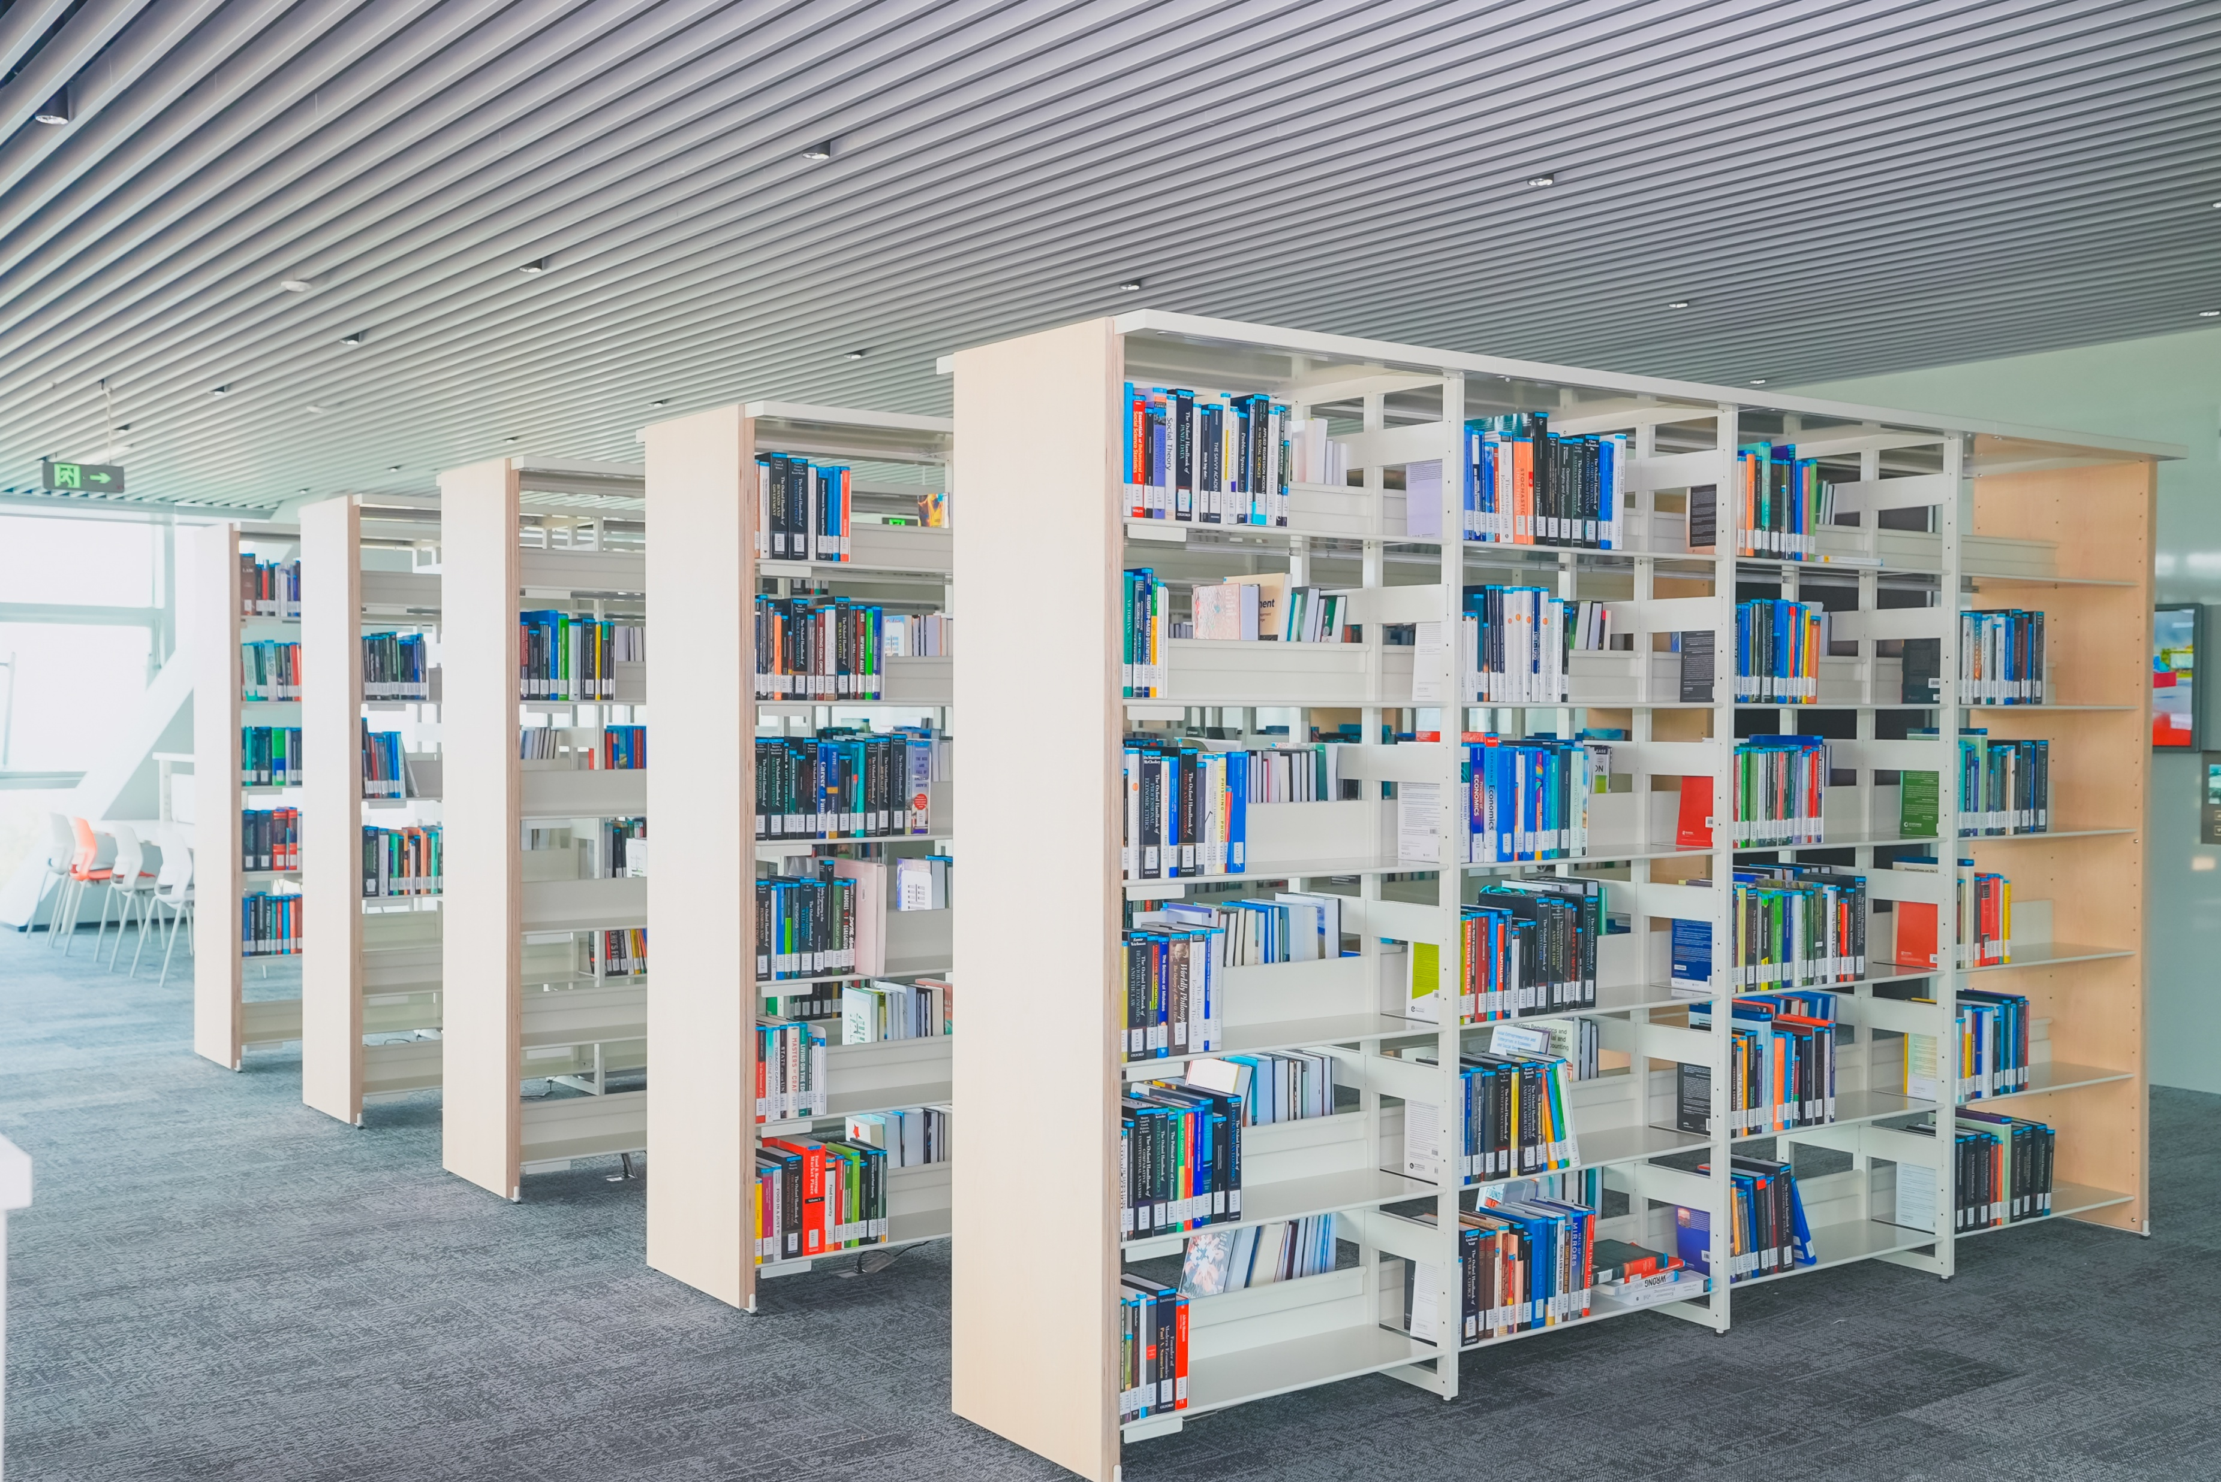

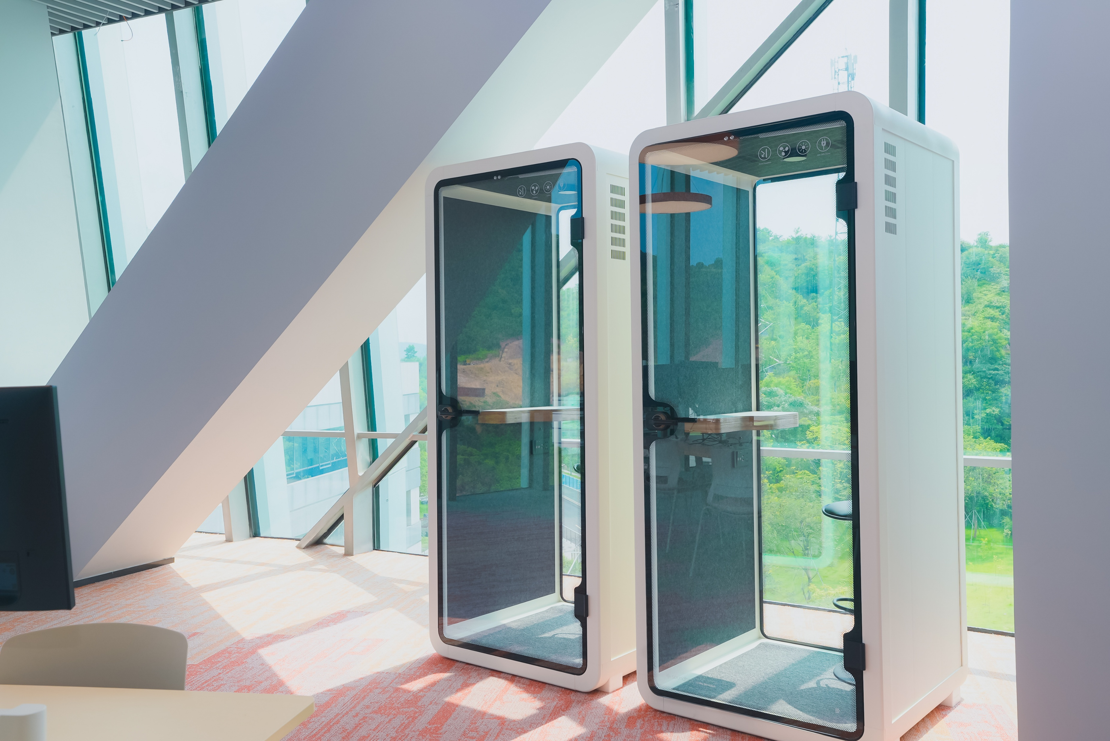
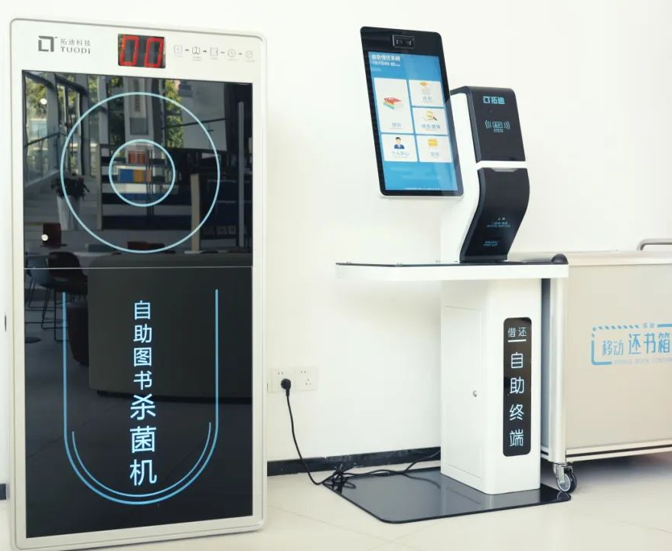
Space – Levels 5 to 7
1-1
Quiet Study
Collaborative Study
Open-shelve Books
Immersive Study
Phone Booth
Leisure Reading
Computer Hub
Self-Check

Slide 4
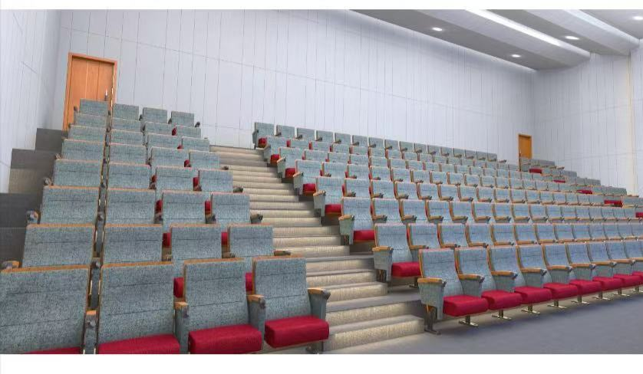

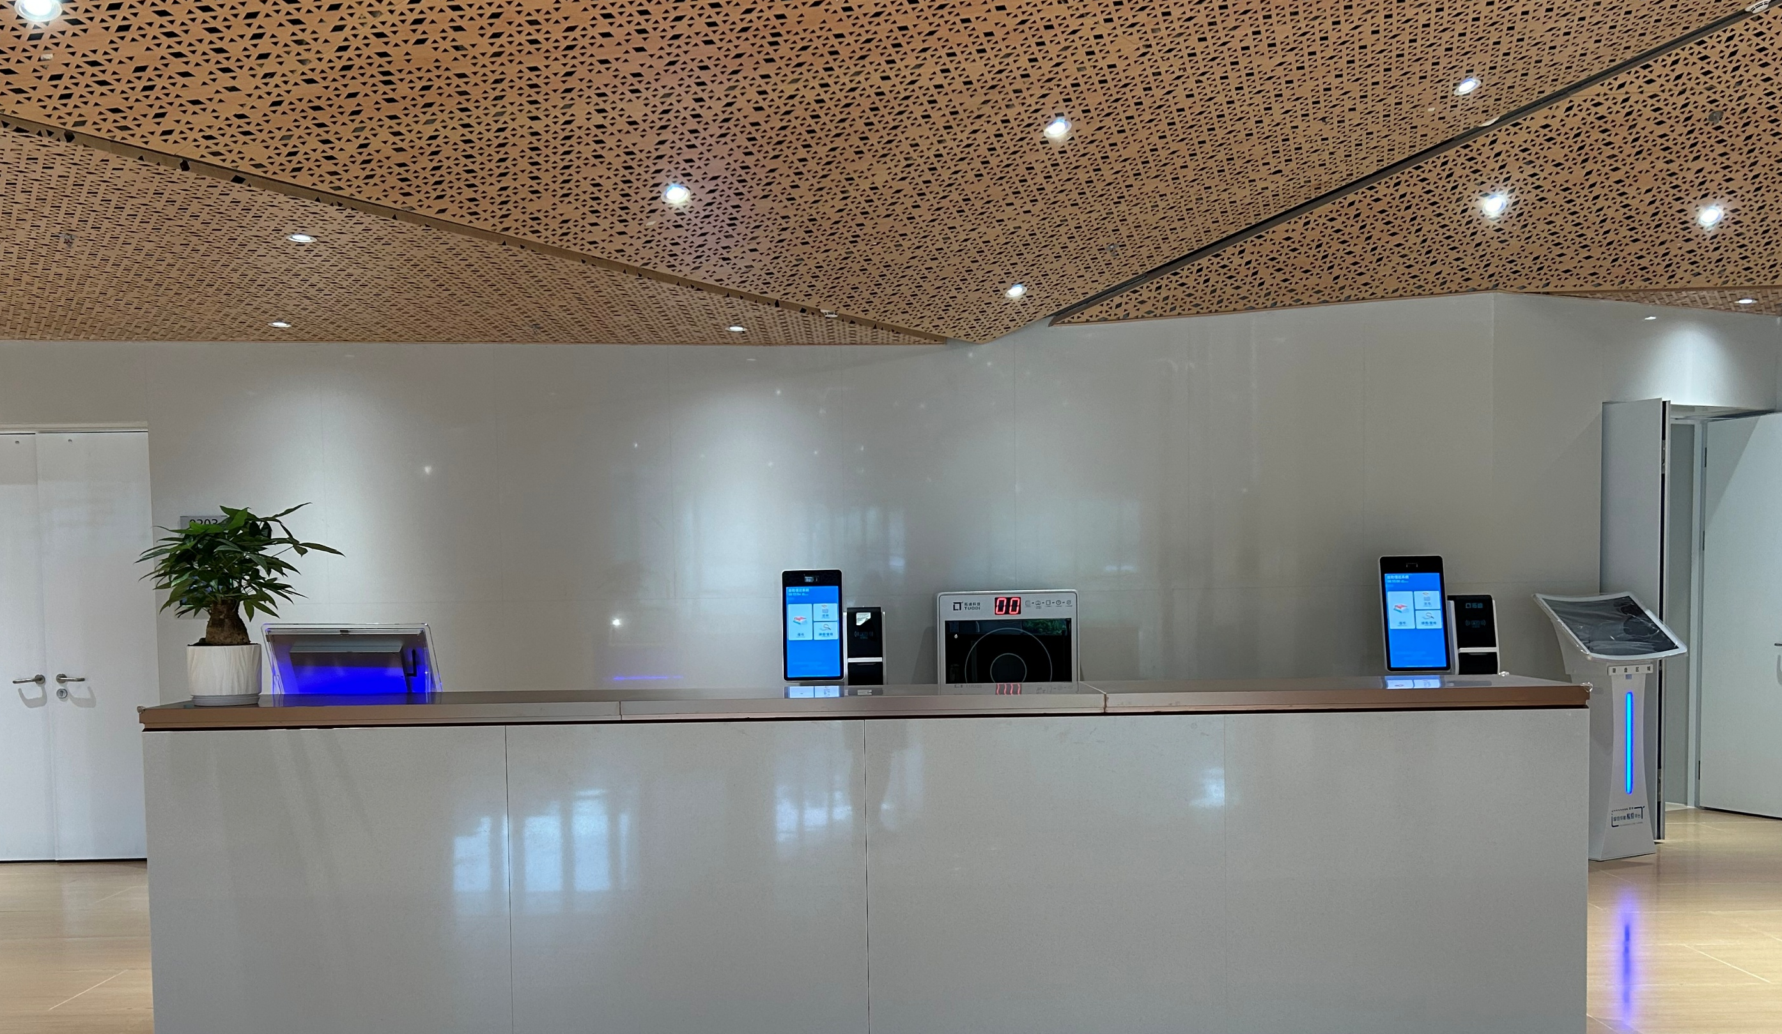
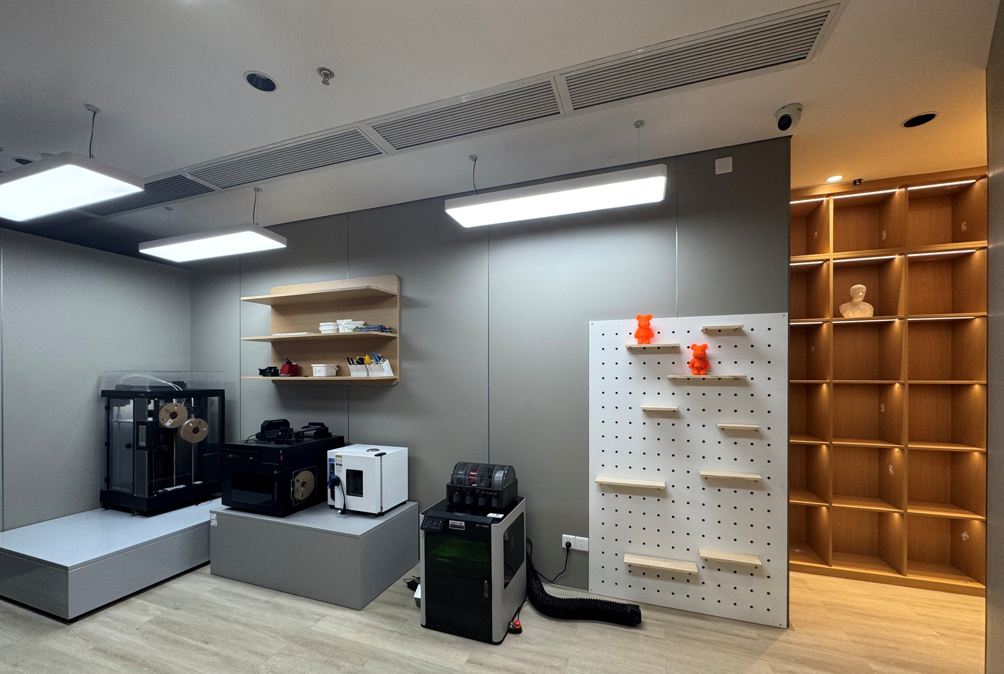
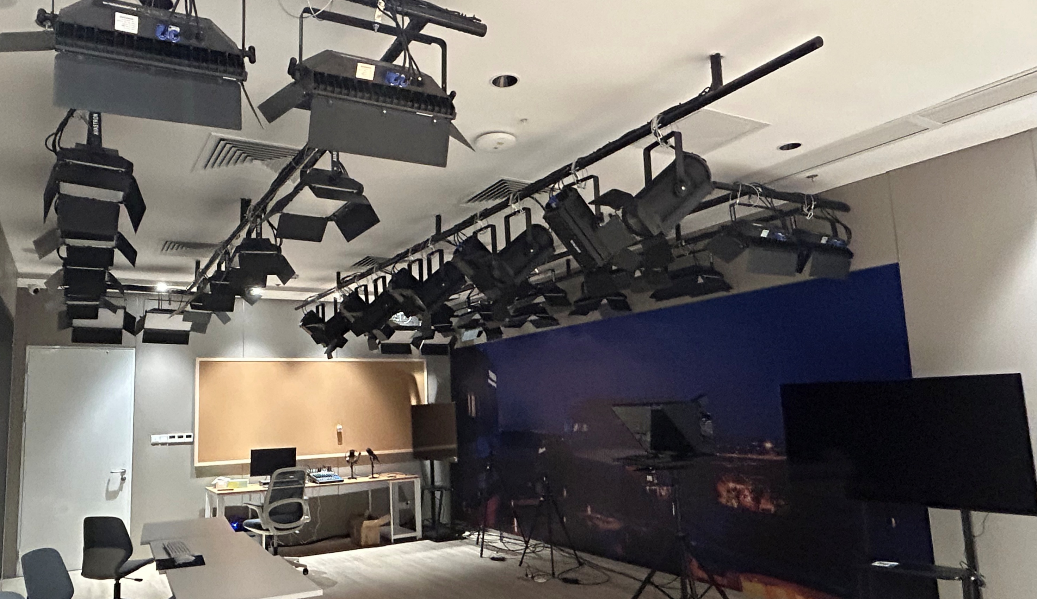
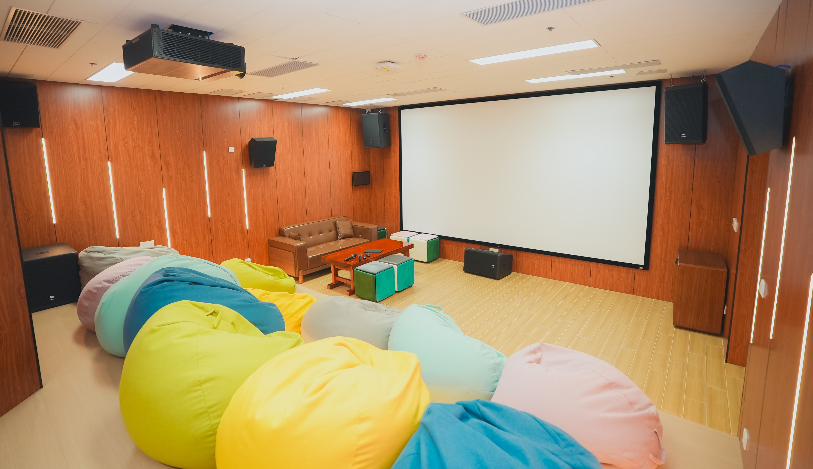
Space – Levels 1 to 4
1-2
Lecture Hall, Training Rooms, Compact Bookshelves
Service Desk, Media Centre, Creative Space
Exhibition Area
Media Theatres, Art and Culture Room
Compact Bookshelves
L1
L2
L3
L4

Slide 5
Collections
01
Spaces
02
Agenda
03
04
Database Remote Access
Borrowing Regulations
Website & WeChat
Essentials for New Researchers
05
06

Slide 6
Collections
2-1
Databases
Books & E-Books
Theses & Dissertations
Academic
Journals
Course Reserves
Newspapers
Magazines

Slide 7
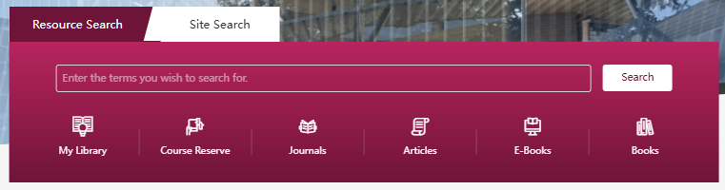




2-2
Books & E-Books
Type | Number
Books | 118,000+
E-Books | 1,530,000+
Obtain print books from the library
Access e-books online
Special Collections：

Slide 8
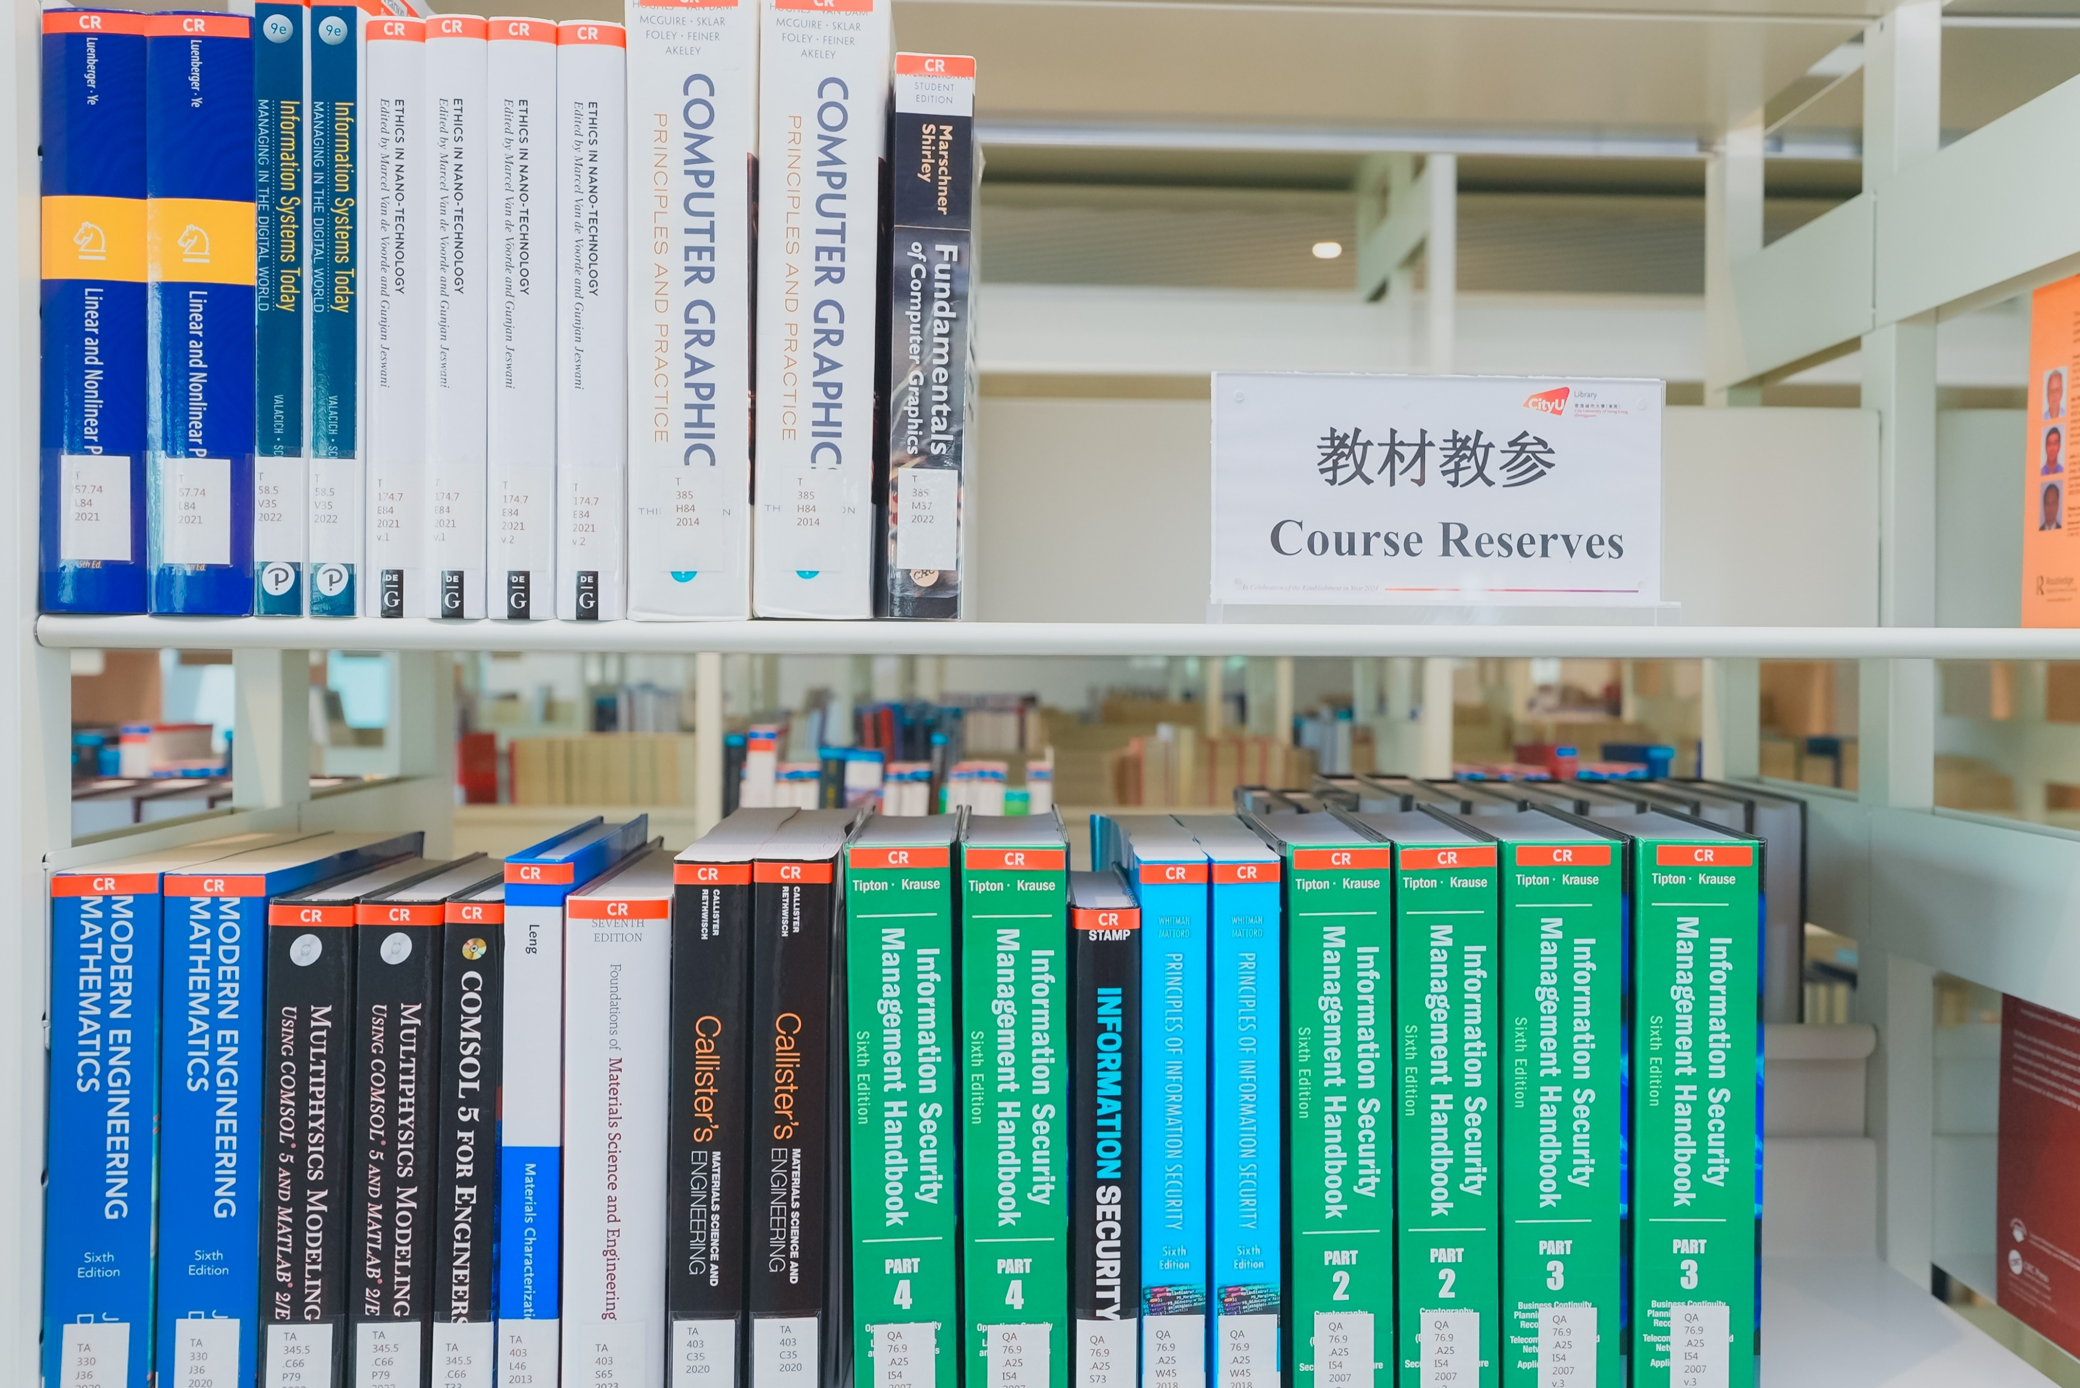
Course Reserves
2-9
Level 6
Library Collection
Student Size | Print Book | E-Book
< 25 | 1 | Purchase only when the institutional copy is available
>=25 | 2
Students’
Copy
Library provides a supplier whom students can buy textbooks and reference books from. The supplier is awarded through a proper procurement process.

Slide 9
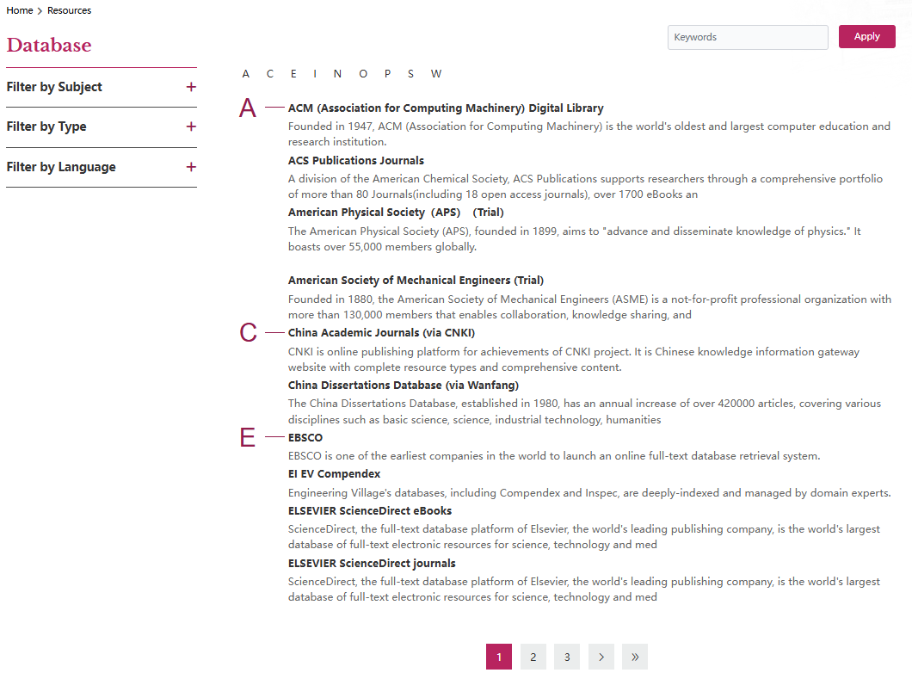
2-3
Databases Subscribed by Library
Home > Resources > Databases

Slide 10
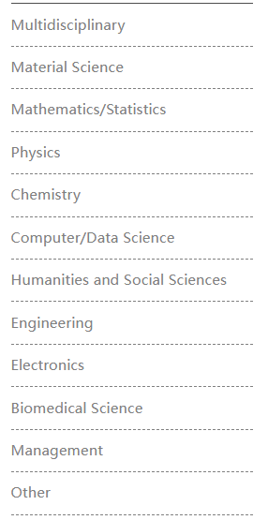
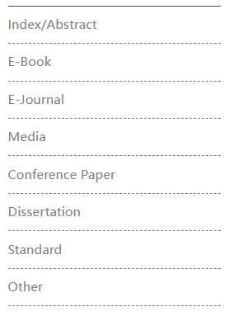
Databases
2-4
Classified by Content Types
Classified by Subjects

Slide 11
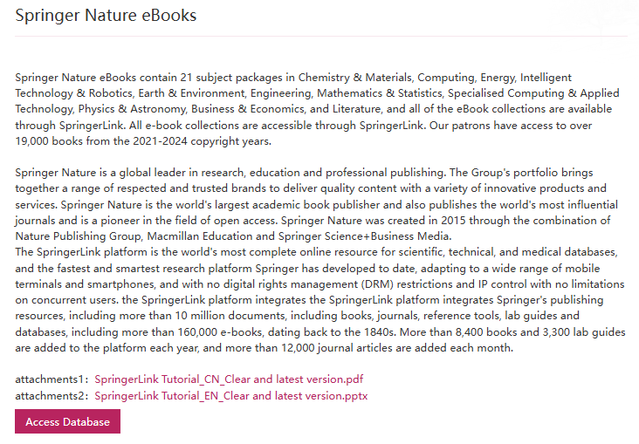
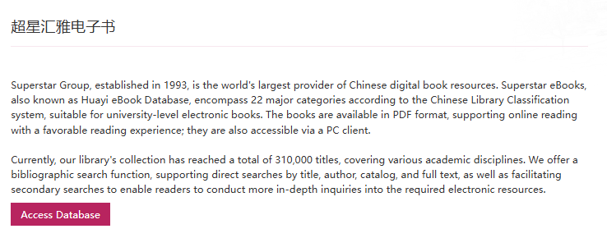
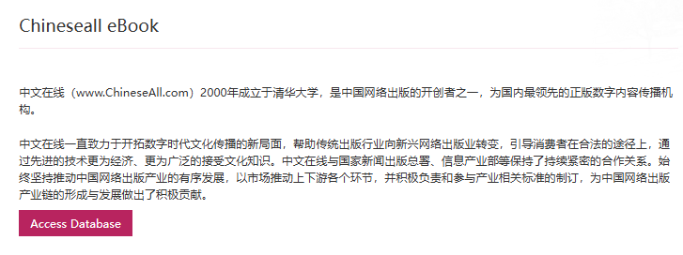
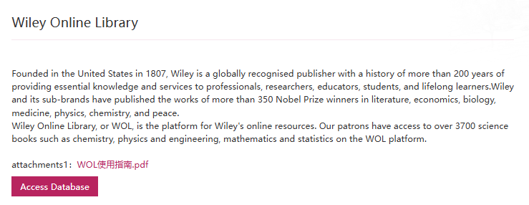
Databases – E-Books
2-5

Slide 12
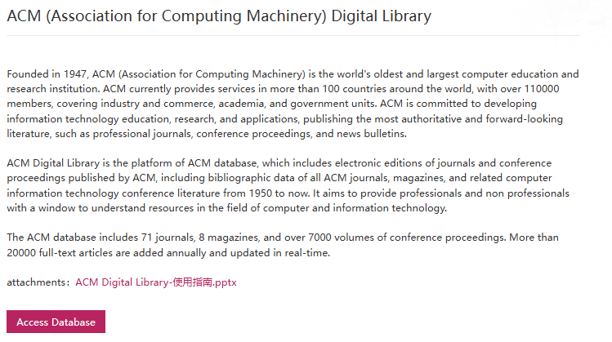
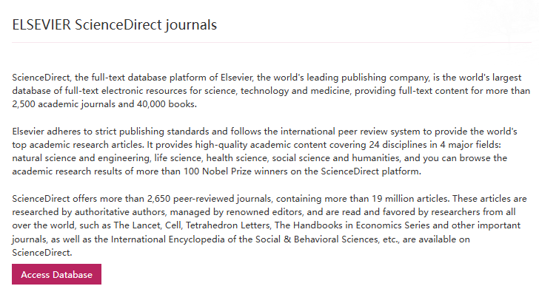
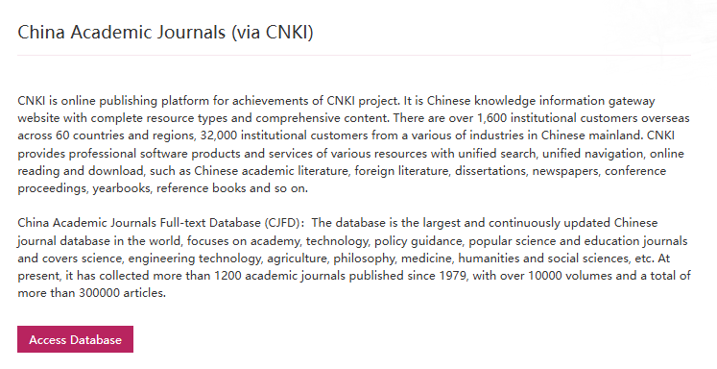
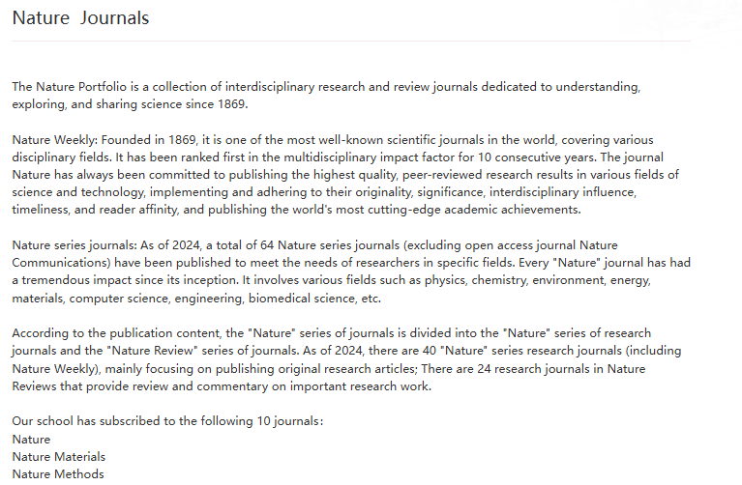
Databases – E-Journals
2-6

Slide 13
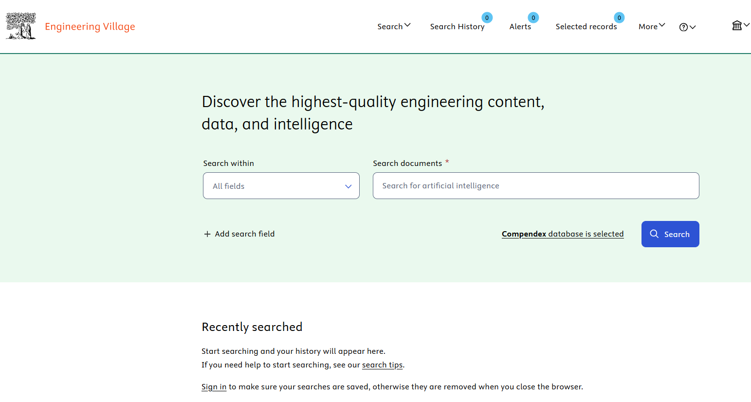
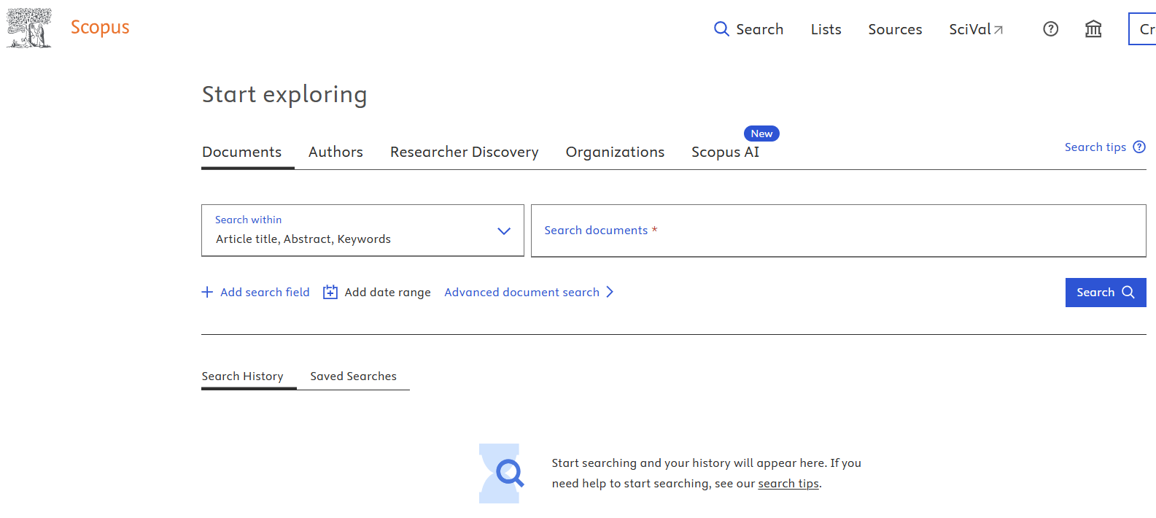
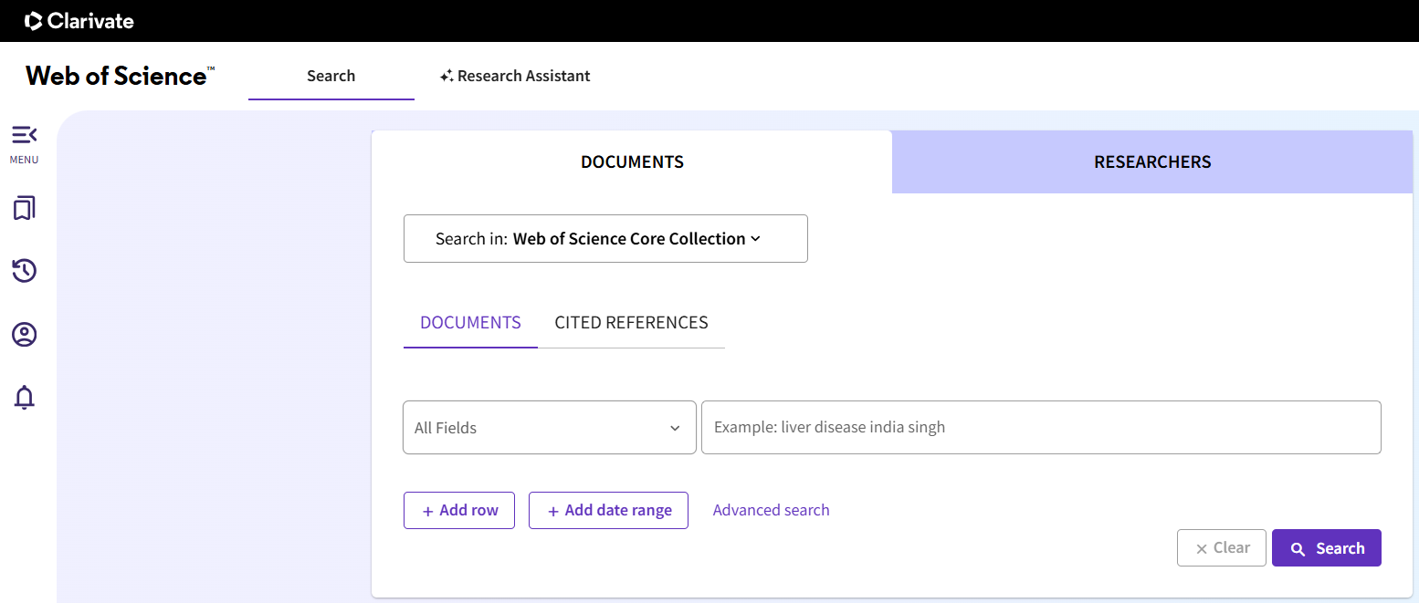
Databases – Abstract / Index
2-7

Slide 14
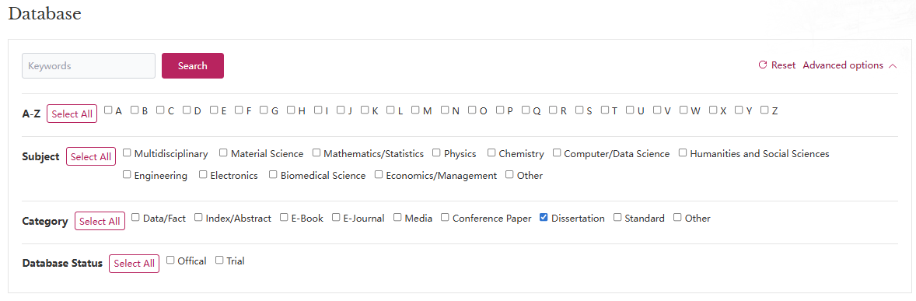
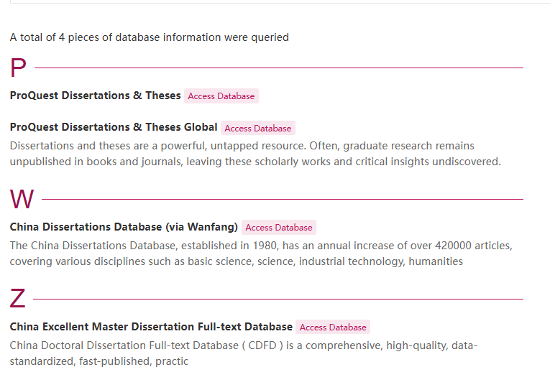
Databases – Theses & Dissertations
2-8

Slide 15
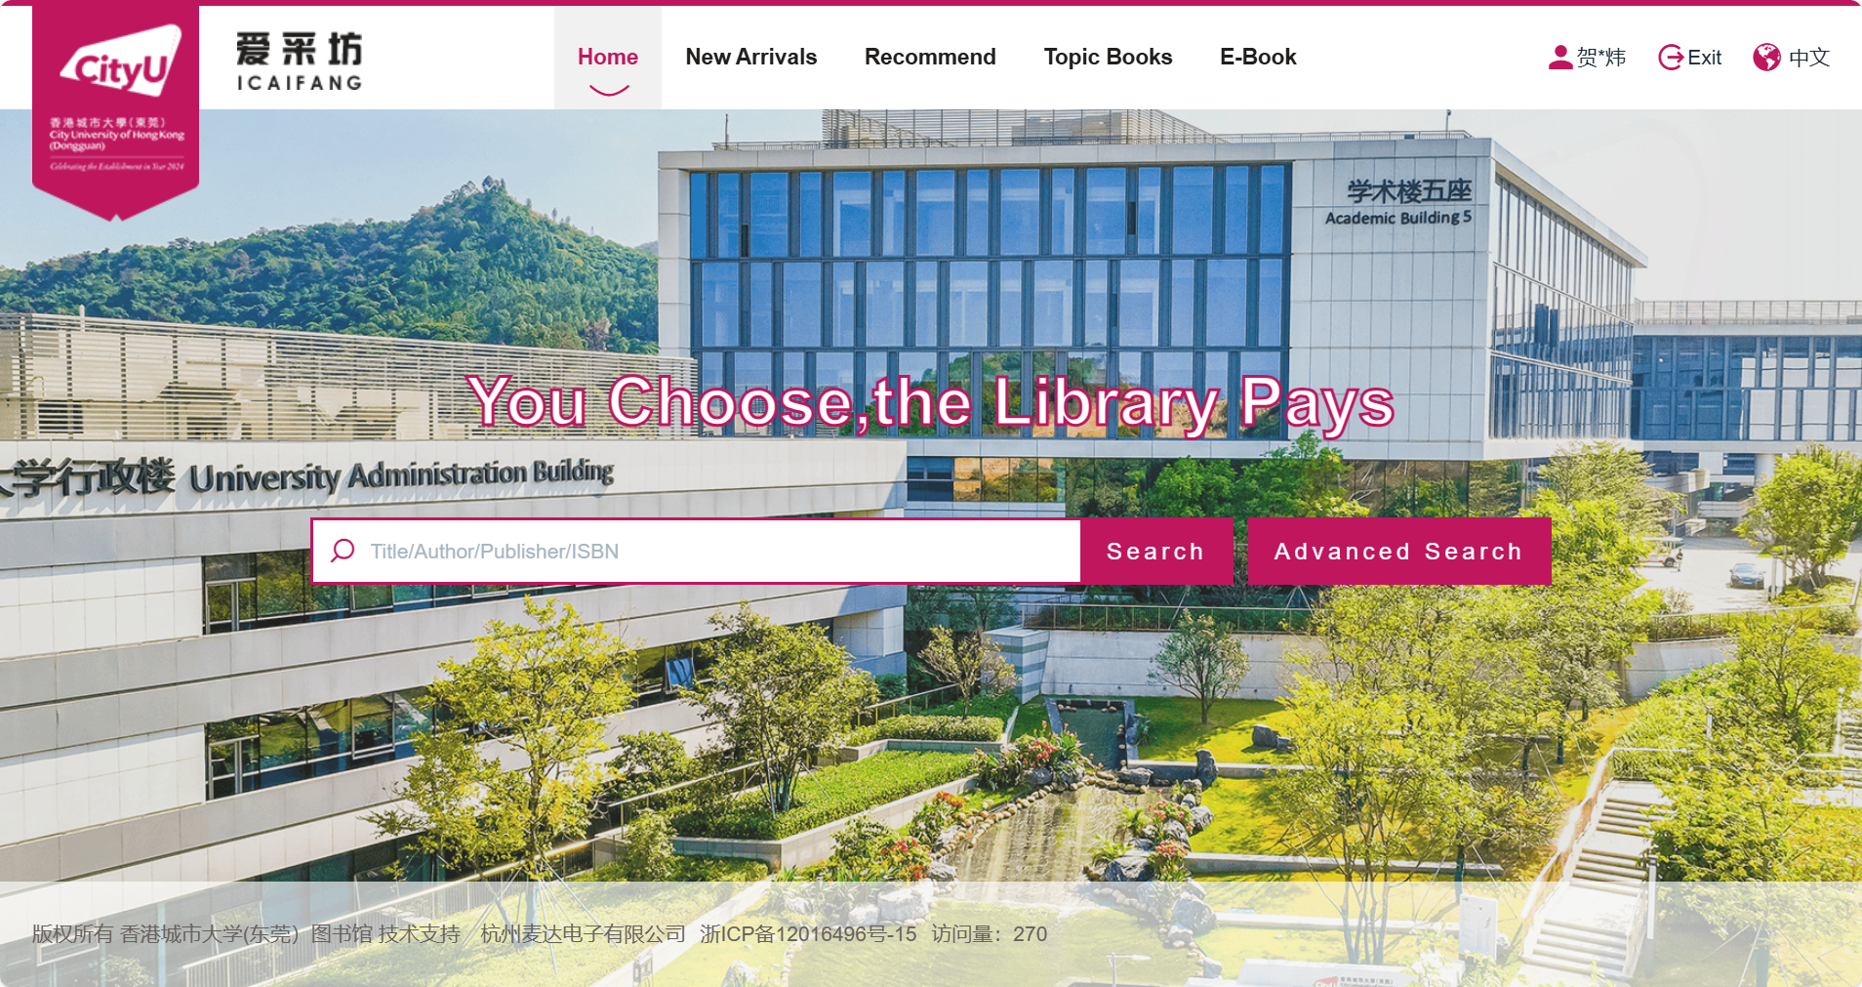
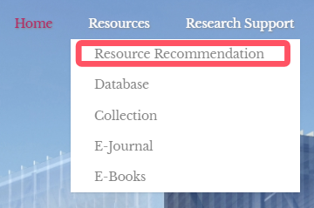
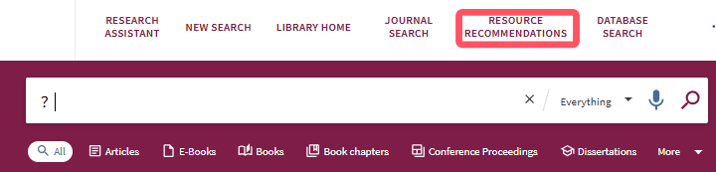
Resource Recommendation
2-9

Slide 16
Collections
01
Spaces
02
Agenda
03
04
Database Remote Access
Borrowing Regulations
Website & WeChat
Essentials for New Researchers
05
06

Slide 17
Borrowing Privileges
3-1
User Types | Open-Shelf Books |  |  | Course Textbook |  | Course Reference
 | Loan Quota | Loan Period | Maximum Loan Days | Loan Quota | Loan Period | Loan Quota | Loan Period
Staff | 50 | 90 days | 360 days | 1 | 7 Day | 1 | 7 Days
Students | 50 | 60 days | 180 days | 1 | 7 Days | 1 | 7 Days
Others | 20 | 60 days | 120 days

Slide 18
Renewals and Requests
3-2
Renewals
Requests
Detailed Guidelines
A user can renew a borrowed item before it is due, and the due date will be extended by one borrowing period from the date of renewal.
However, if the loan period reaches its maximum, or if the borrowed item is on call, you cannot renew the item. Textbooks are not renewable.
A user can request an item if it is out on loan. A message will be sent to you when the item comes back to the library and is ready for you to pick up at the Service Desk by presenting the email.
The library will keep the item at the Service Desk for a maximum of three days. Textbooks cannot be requested.

Slide 19
Recalls
3-3
Recall Process
Consequences of Non-Return
Recall Policy Basics
When a recalled book is not due, the system automatically sends a courtesy recall notice. The user should return the book as soon as possible after use.
If the recalled book is not returned 7 days after the due date, the user’s borrowing privilege will be suspended.
All open-shelf books can be recalled. Books that are recalled cannot be renewed.

Slide 20
Overdue and Fines
3-4
01
02
01
02
Course Text-Books and Course Reference Books
Damaged or Lost Library Materials
Damaged Library Materials
Warning Letters
Suspending borrowing privileges
Purchasing a replacement copy
Lost
Report immediately
Pay for unreplaceable items
 | Loan Period | Overdue Fines
Course Text-books | 1 day | ¥8/ day stop borrowing
Course Reference | 7 days | stop borrowing

Slide 21
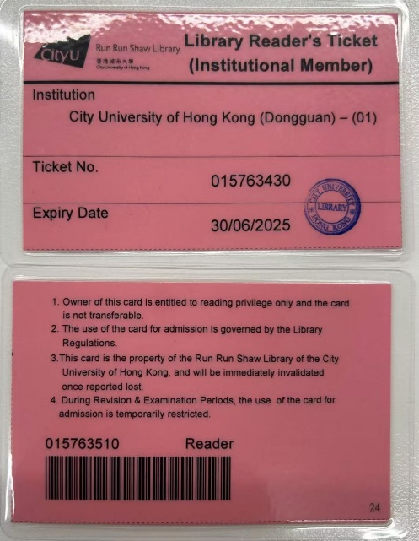
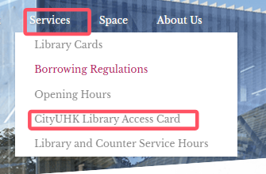
CityUHK Library Access Cards
3-5
10 cards
Access CityUHK library materials and facilities within the library.
Cannot be used during examination period.
Reserve
Return
Lost/Damage
Collect
Library website:
Borrowing privileges will be suspended
With 3 working days
7 days loan period
Return at library service counter
At library service counter
Auto cancellation if not collected on time
Pay 100HKD at City UHK Library service counter

Slide 22
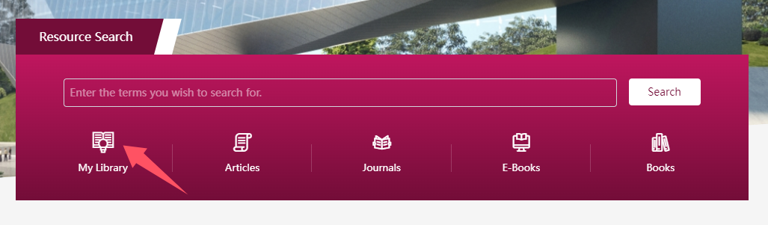
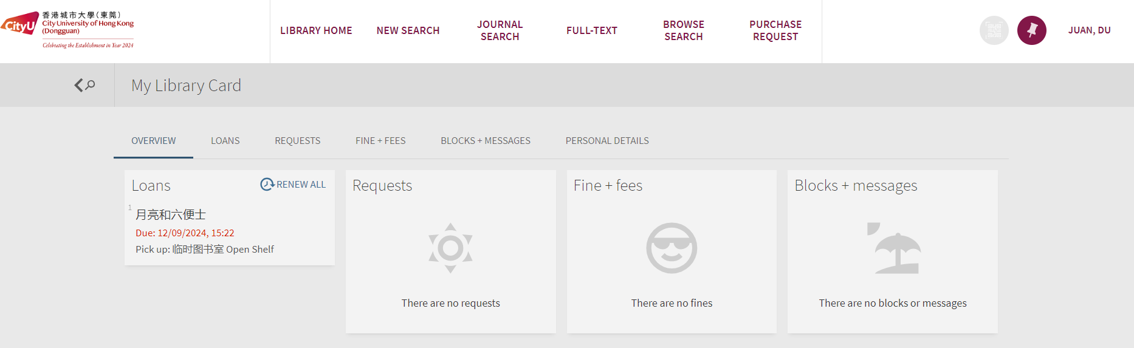
My Library Account
3-6

Slide 23
Collections
01
Spaces
02
Agenda
03
04
Database Remote Access
Borrowing Regulations
Website & WeChat
Essentials for New Researchers
05
06

Slide 24

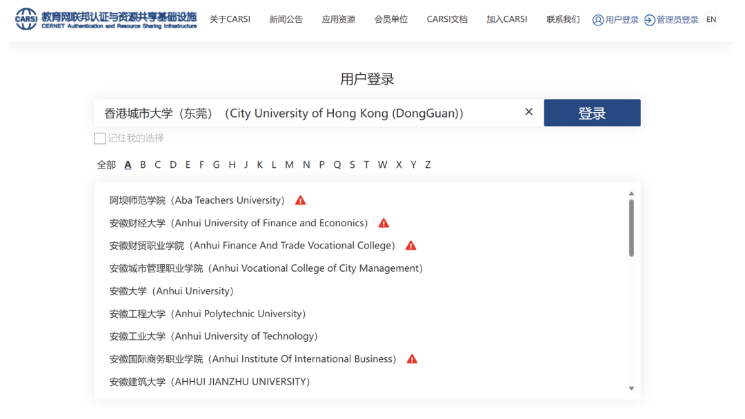
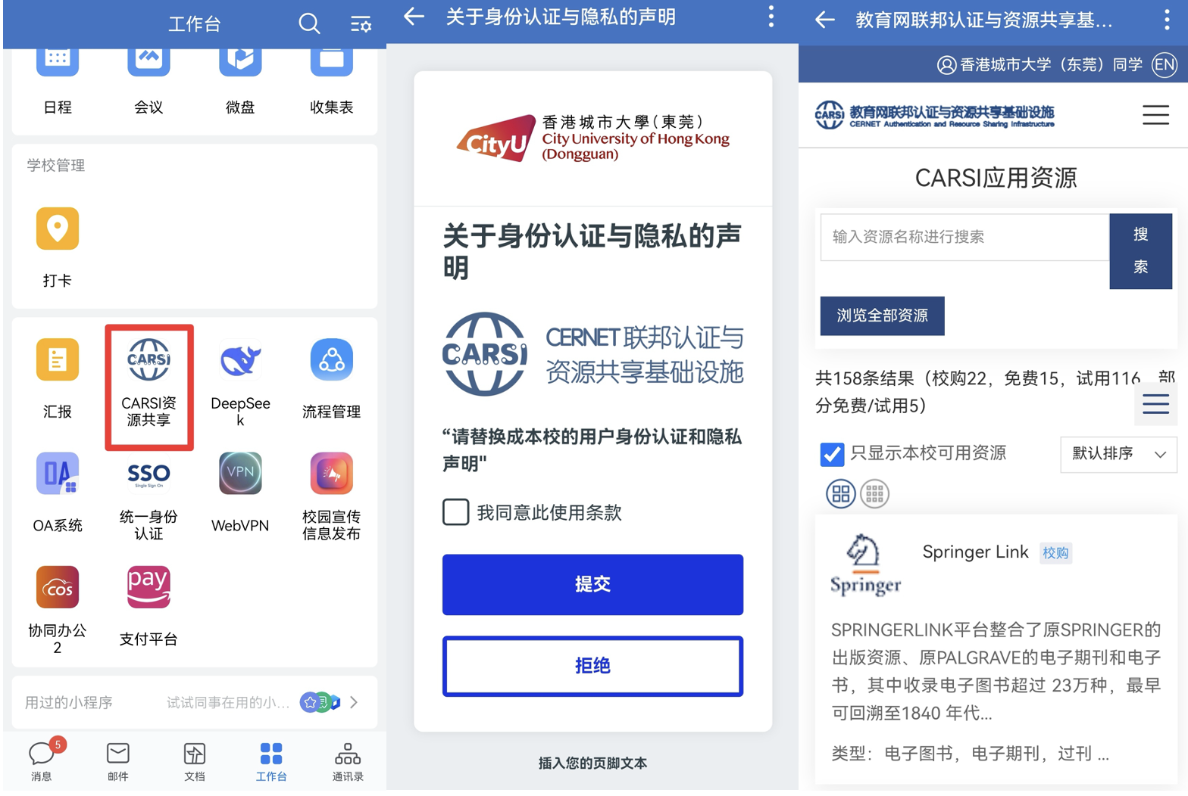
Databases – Remote Access
4-1
CERNET Authentication and Resource Sharing Infrastructure
（CERNET：China Education and Research Network)
Method 1
Method 2
https://ds.carsi.edu.cn/login/index.html
CityU-DG WeCom

Slide 25
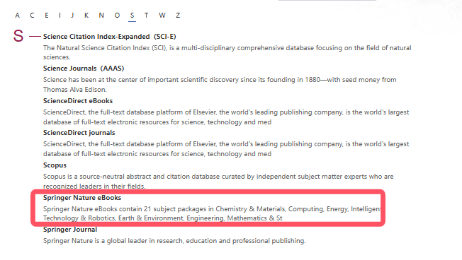
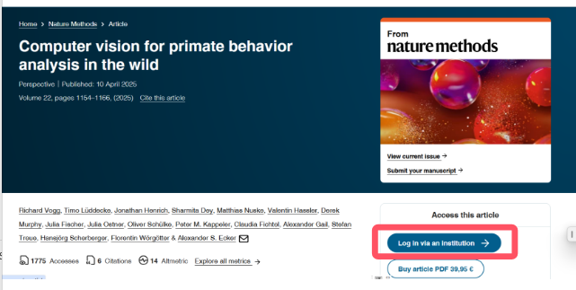
Databases – Remote Access
4-2
Method 3
Login CARSI when access the database
Step 1
Access the database from library website
Step 2
Find Institution Login
Step 1

Slide 26
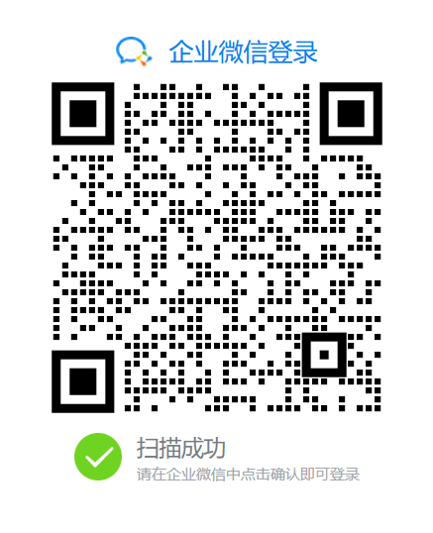
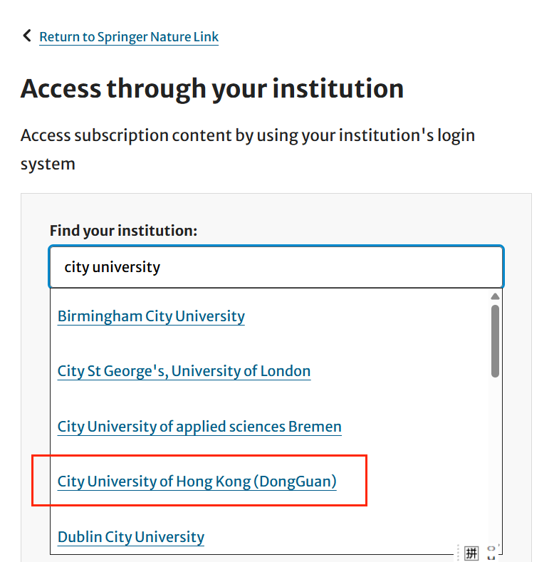
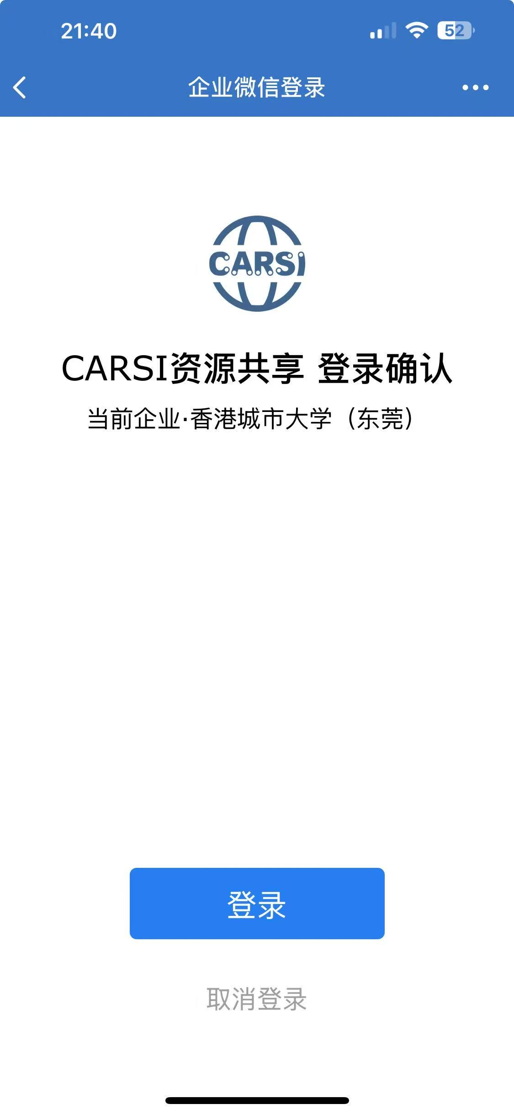
Databases – Remote Access
4-3
Method 3
Login CARSI when access the database
Step 3
Search for CityUHK(DG)
Step 4
Scan QR Code
Step 5
CRASI Login
Step 1

Slide 27
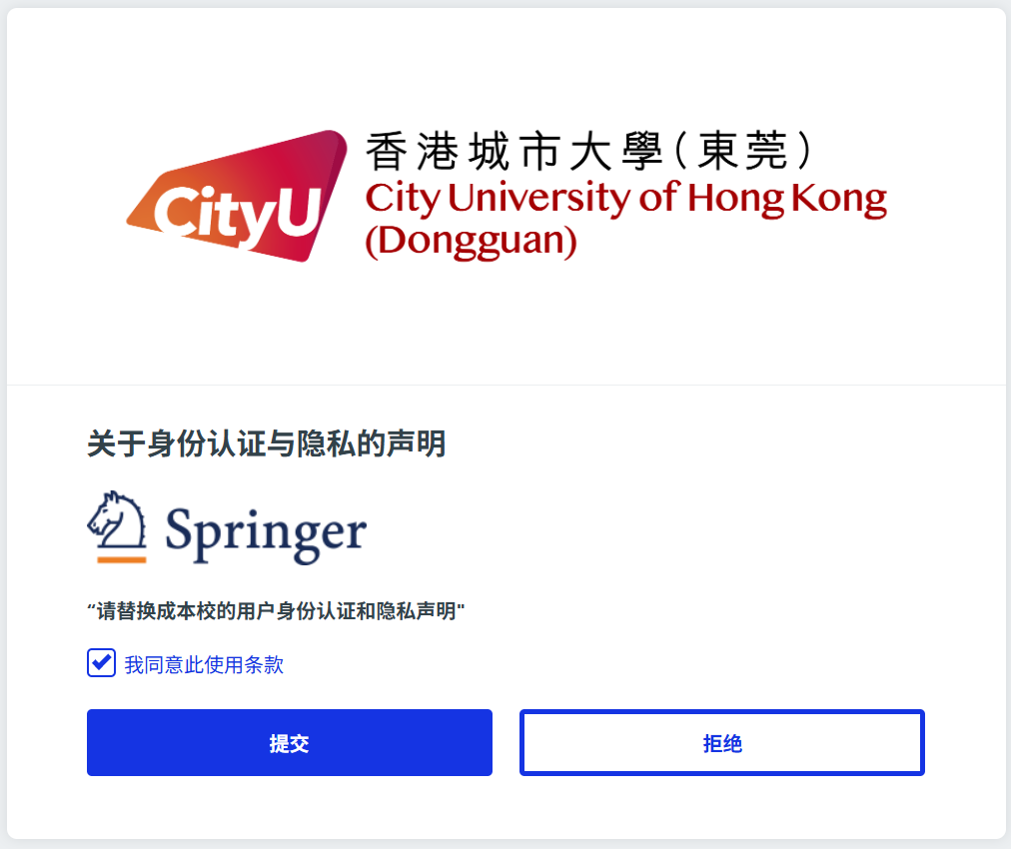
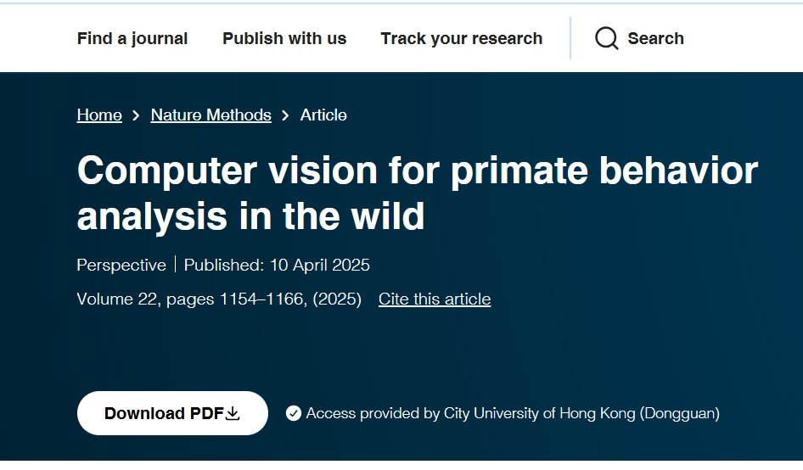
Databases – Remote Access
4-4
Method 3
Login CARSI when access the database
Step 6
Agree Terms of Use
Step 7
Download Full Text
Step 1
Notes:
You have to agree with the terms of us. After you have logged in successfully, you see the download PDF button for your download the ebooks.

Slide 28
Collections
01
Spaces
02
Agenda
03
04
Database Remote Access
Borrowing Regulations
Website & WeChat
Essentials for New Researchers
05
06

Slide 29
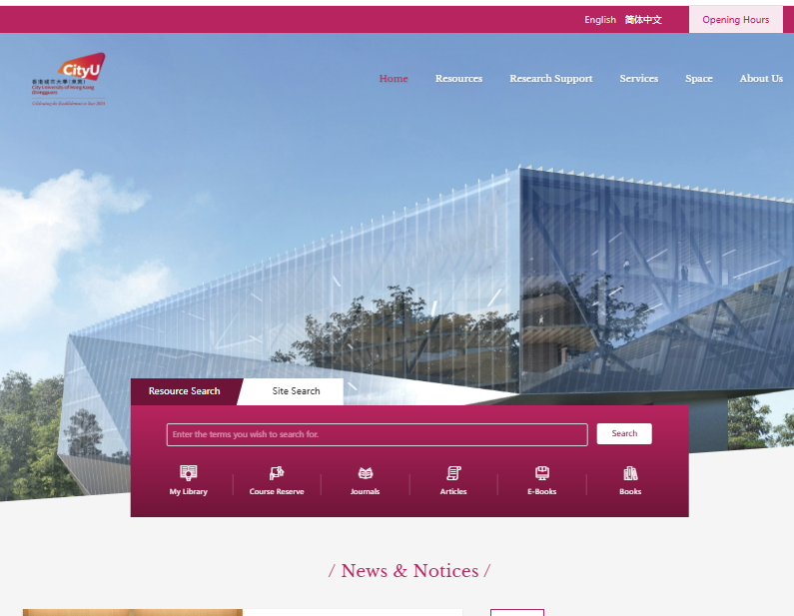
5-1
Library Website
lib.cityu-dg.edu.cn

Slide 30
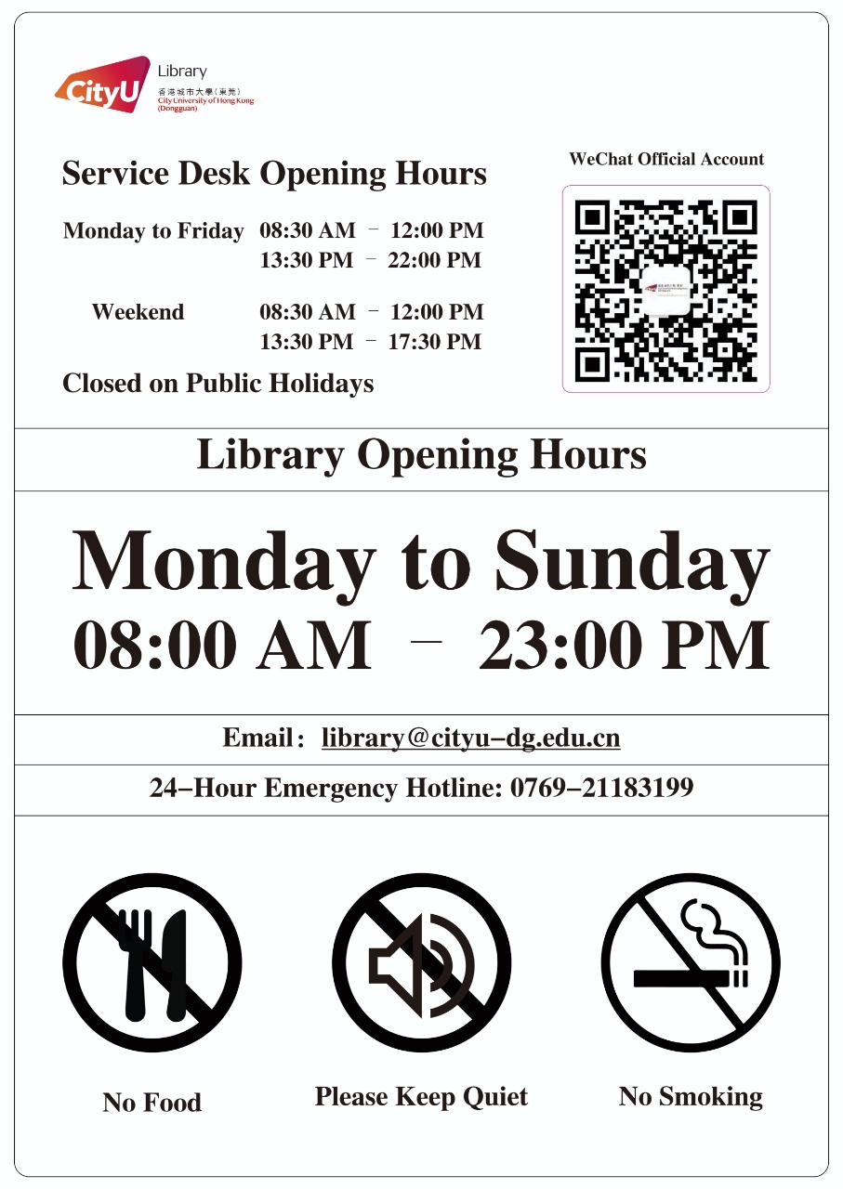
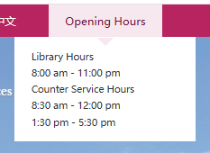
Library Opening Hours
5-2
Top right corner of Library Website:
Notes:
Library is open from 8am to 11pm everyday. During the revision and examination period, we will extend the closing time to 1am. You can find our opening
Hours on the top right corner of the library website.

Slide 31
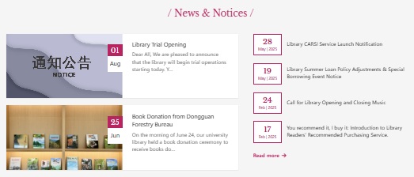
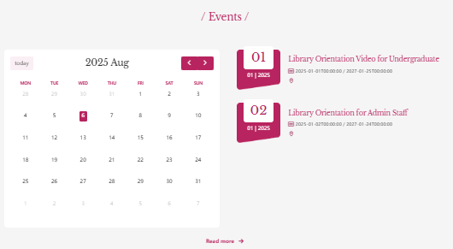
News, Notices, Workshops
5-3

Slide 32



Library WeChat
5-4

Slide 33
Collections
01
Spaces
02
Agenda
03
04
Database Remote Access
Borrowing Regulations
Website & WeChat
Essentials for New Researchers
05
06

Slide 34

Why Information Literacy Matters
6-1
Now information is abundant. We are flooded with information. And much of it is junk information which is artificially full of greed and anger and fear because of this battle for attention. We basically need to go on information diet. We have to be careful about the quality of what we take in……
Yuval Noah Harari, the author of “Sapiens: A Brief History of Humankind”
Notes:
人类简史 https://www2.lawrence.edu/fast/revieg/acminfolit/acrl.html
He takes the example of food to explain why it is not true that more information is good for us. So the question is how to get the qualitative information that we need
This is the reason why we have to be information literate

Slide 35
Information Evaluation Criteria
6-2
C
Currency
R
Relevancy
Does the information meet the requirements? Who is the intended audience?
A
Accuracy
Is the information supported by evidence? Has the author claimed something that is incorrect or cannot be verified? Has the information been reviewed or refereed?
A
Authority
Who is the author? What is the author’s institutional affiliation? What background does the author have to make him/her an expert?
P
Purpose
Are there biases? Does the author have a hidden agenda? Are alternative points of view presented?
Is the information up-to-date? Have there been recent developments not mentioned?
Notes:
The 3rd component of the information literacy is information evaluation. How we should evaluate the information
This is a very important step we know that we need to go on information diet and not all information

Slide 36

Bibliographic Management Tools
6-3
A software that helps you organize, store, and format your citations and references for academic writing.
Endnote
commercial product on subscription basis
Mandeley
free tool available in both desktop and web versions.
Zotero
BibTeX
free open source software, available for download on your computer or used online via the web.
organize citations in a .bib text file
available on our library website
can be used in LaTeX
free
Also known as:
Reference Management Software
Citation Management Software

Slide 37

Researcher Identifier
6-4
ORCID
Open Researcher and Contributor ID
Can be used across different platforms
Research-er ID
To be used in Elsevier’s Scopus databases
Google Scholar Profile ID
Scopus Author ID
0000-0002-4469-2147
To be used in Web of Science (Clarivate Analytics)
Integrated with Publons and Clarivate
A-1234-2024
12345678900
Associated with a researcher’s Google Scholar profile
VjXk_5EAAAAJ
A unique identifier assigned to researchers to distinguish them from others with similar names and to track their publications, citations, and academic contributions.
Notes:
A Researcher ID is a unique identifier assigned to researchers to distinguish them from others with similar names and to track their publications, citations, and academic contributions. It helps in disambiguating authors and ensures proper attribution of research work.
Some common researcher identifiers include:

Slide 38



Journal Impact Factor
6-5
It is used to assess the influence or importance of a journal within its field.
It is provided by Clarivate Analytics (Web of Science) in its Journal Citation Report (JCR) databases.
Citations in Year X to articles published in Years (X-1) and (X-2)
JIF =
Total number of citable articles published in (X-1) and (X-2)
Notes:
A Researcher ID is a unique identifier assigned to researchers to distinguish them from others with similar names and to track their publications, citations, and academic contributions. It helps in disambiguating authors and ensures proper attribution of research work.
Some common researcher identifiers include:

Slide 39

Journal Impact Factor
6-6

Slide 40



Citation & H-Index
6-7
Web of Science
Citation of an article
Citation report of an author
H-Indec
The H-index is a metric used to measure the productivity and citation impact of the publications of a scientist or scholar.
h-index = the number of publications with a citation number greater than or equal to h

Slide 41


Academic Honesty
6-8
No Plagiarism
Don't copy someone else's work or ideas without giving them credit.
No Cheating:
Don't use unauthorized materials or help during exams or assignments.
No Fabrication
Don't make up data, research results, or sources.
No Facilitation
Don't help others cheat or plagiarize.
Proper Attribution
Always cite your sources correctly.
Independent Work
Unless told otherwise, your work should be your own.
Notes:
Core Principles of Academic Honesty

Slide 42
Thank You
Follow us on Webchat
Tel: 0769-21183021
Email: library@cityu-dg.edu.cn
iSlide
2024/9/8

